Slide 1
RV Solar Panel Installation
1. Install solar panel with mounts
2. Connect cable and ground wire to solar panel
3. Run cable and ground wire down refrigerator vent and under RV
4. Install controller and display
5. Connect cable to controller and ground wire to chassis
6. Connect battery to controller

Slide 2
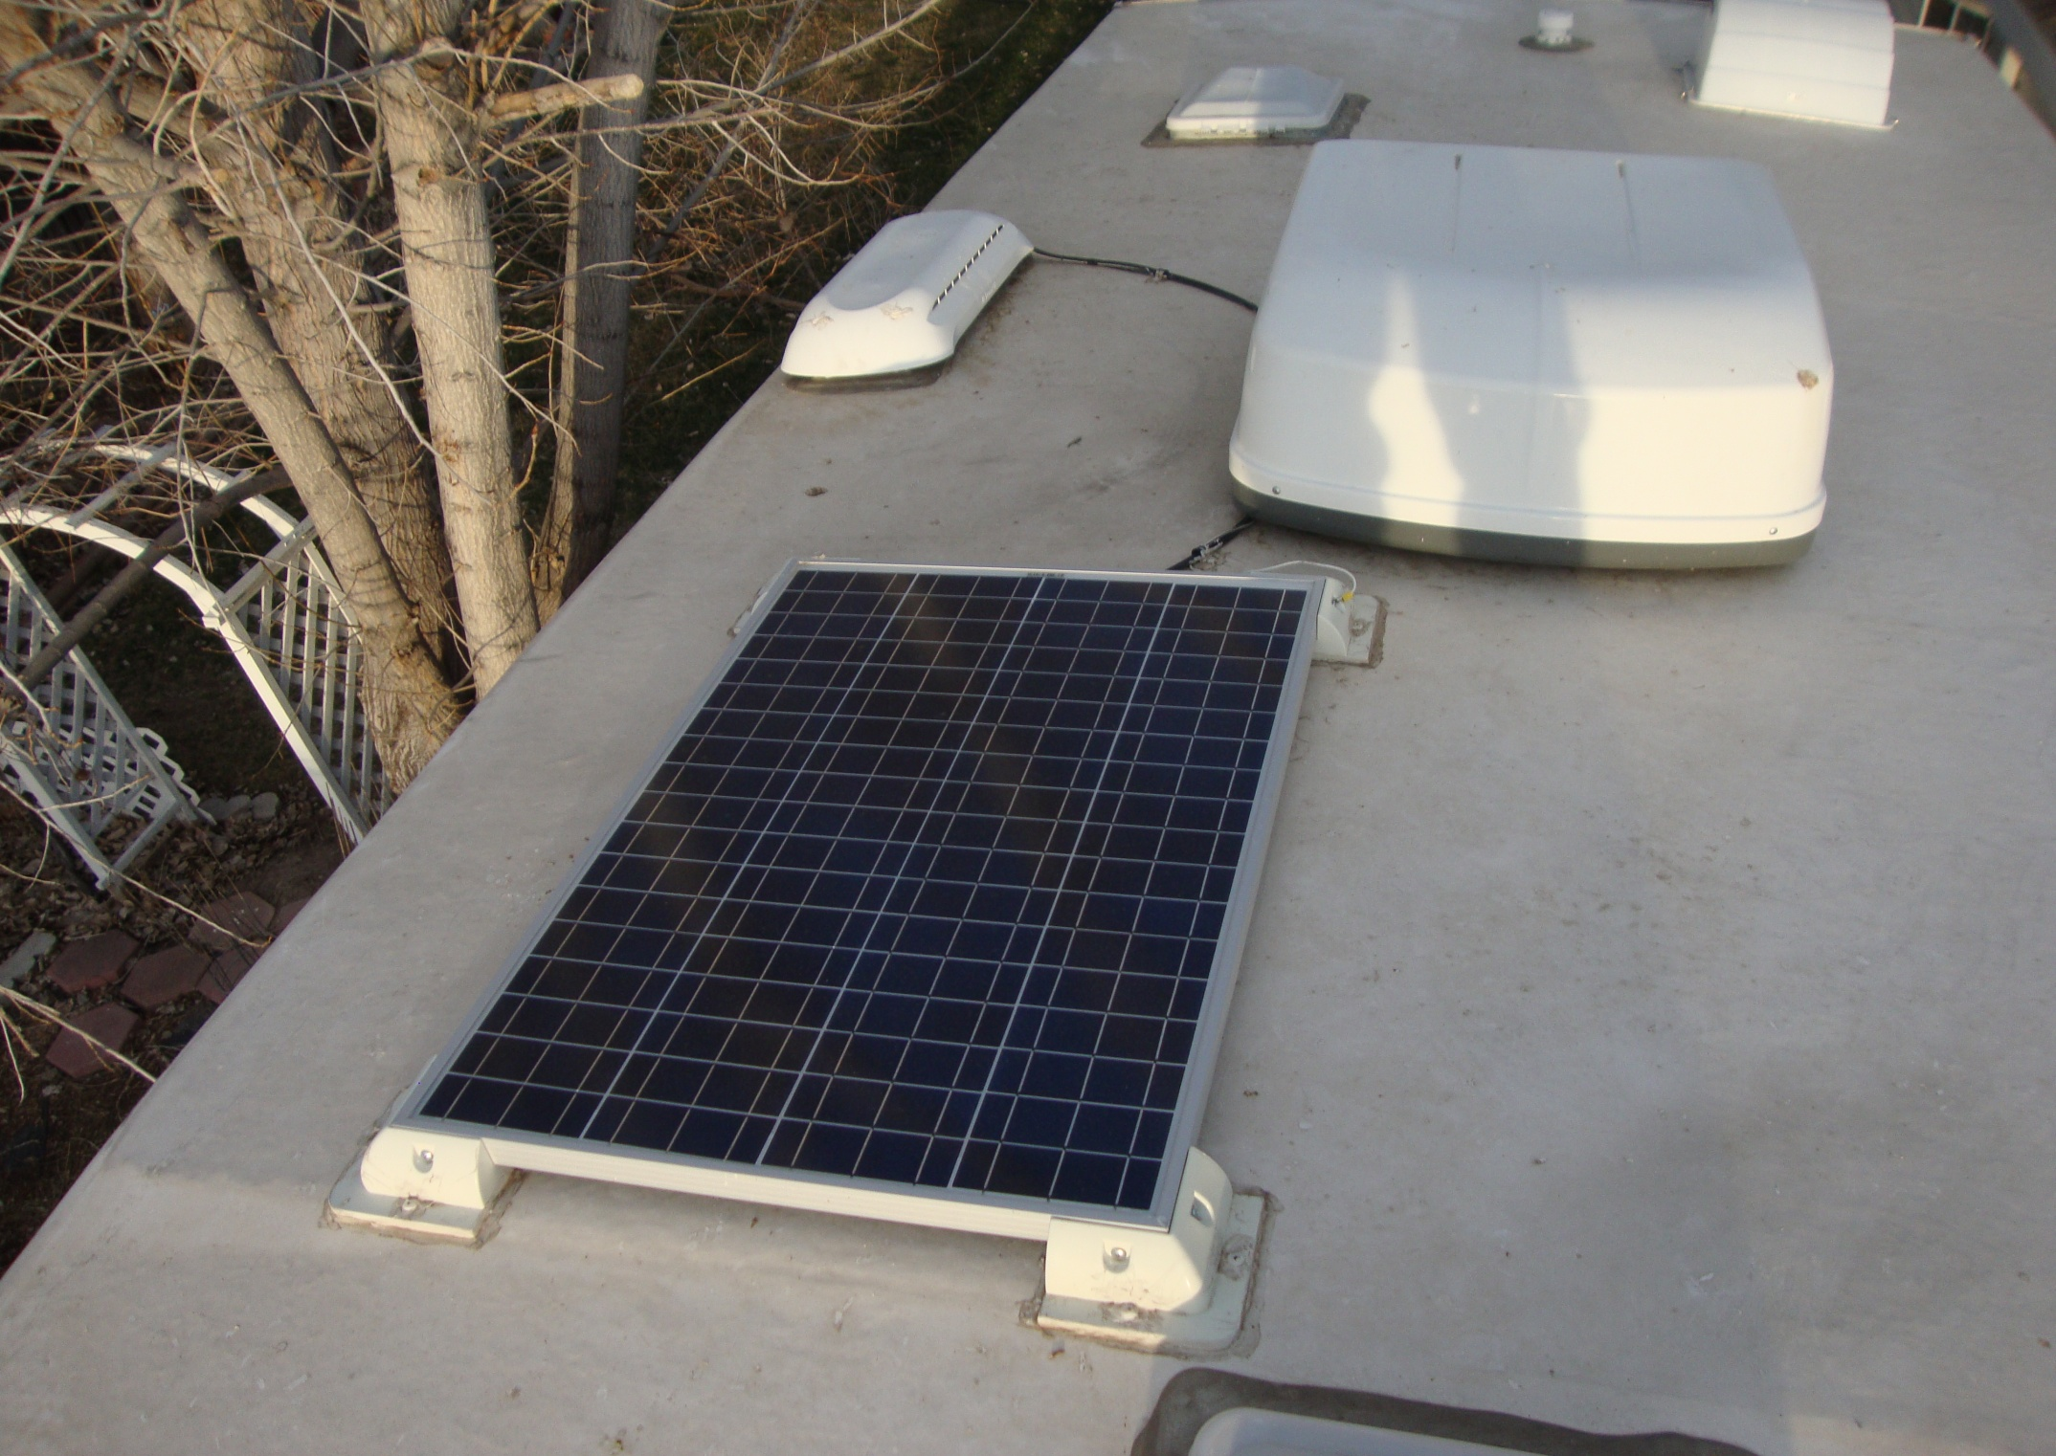

Slide 3
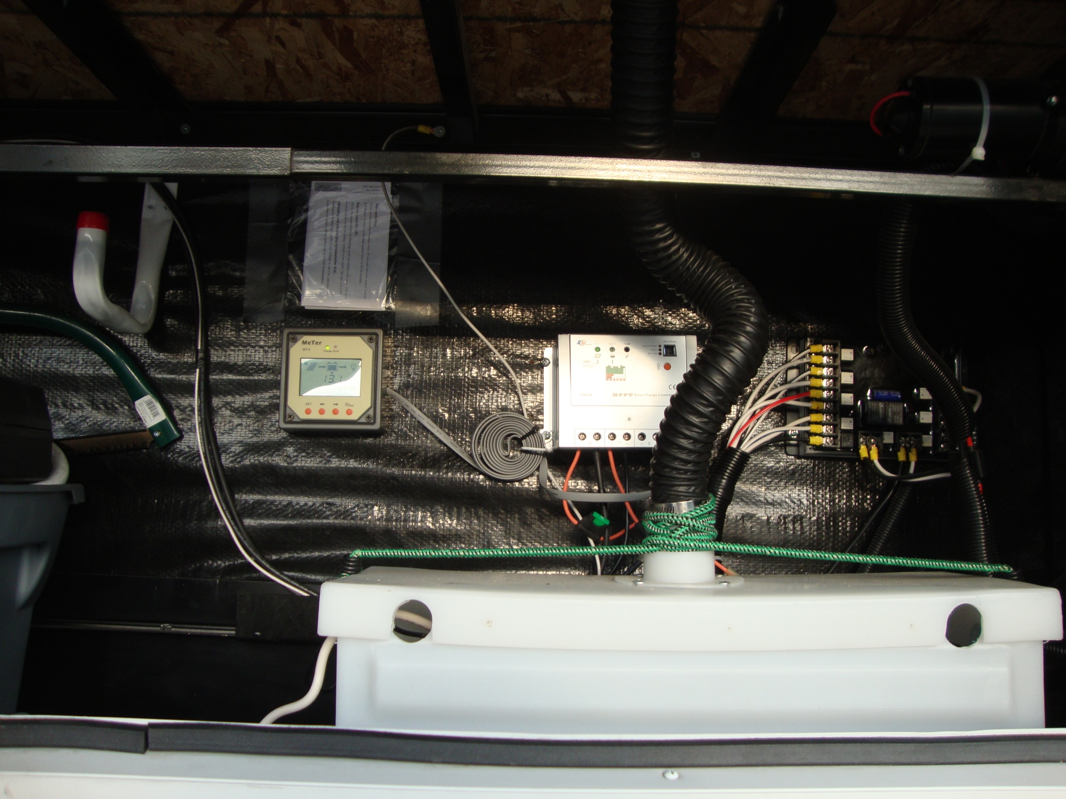

Slide 4
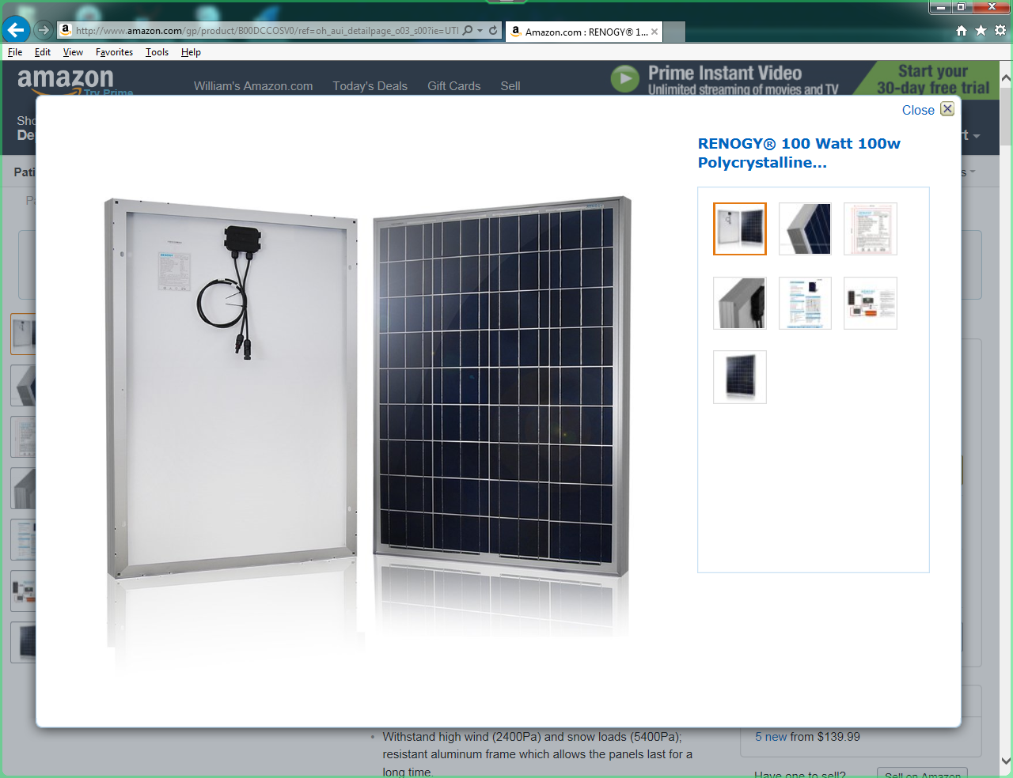

Slide 5
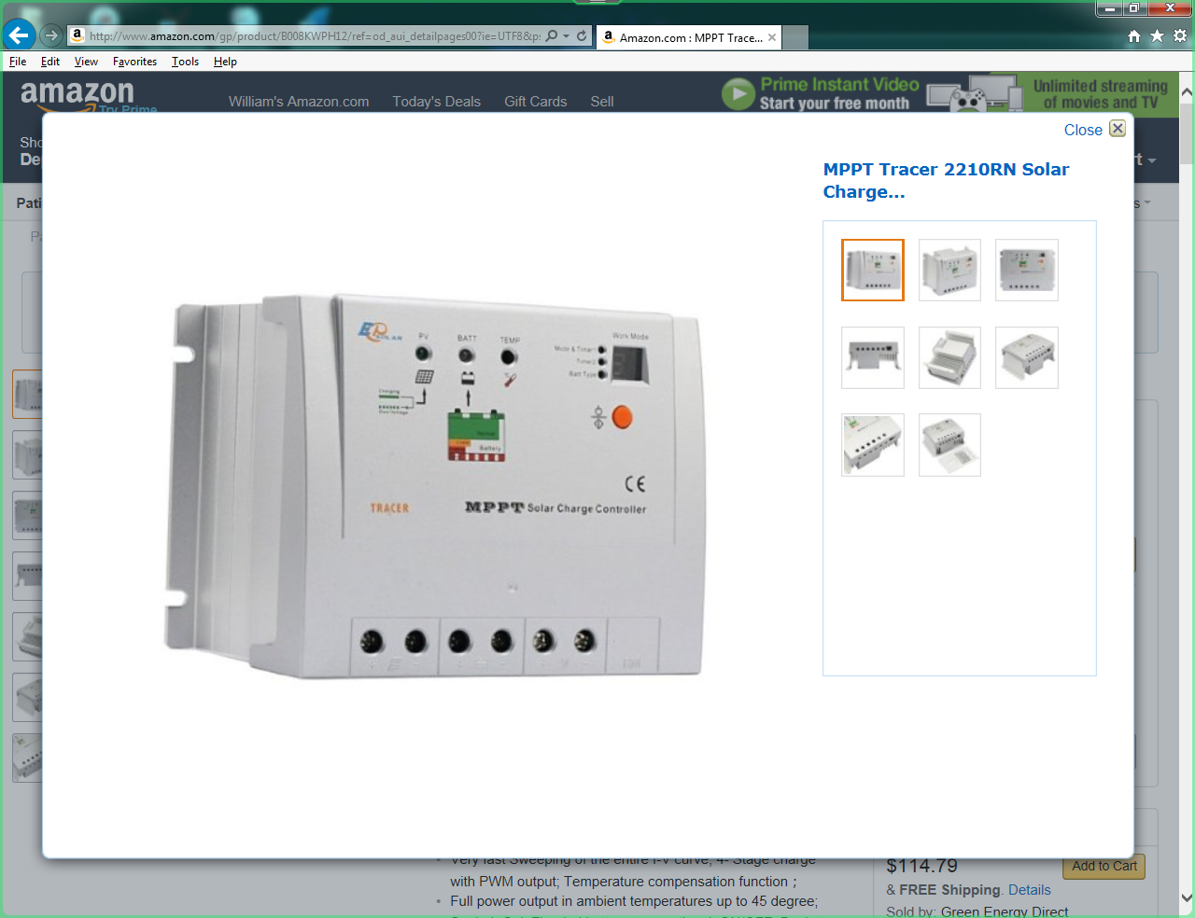

Slide 6
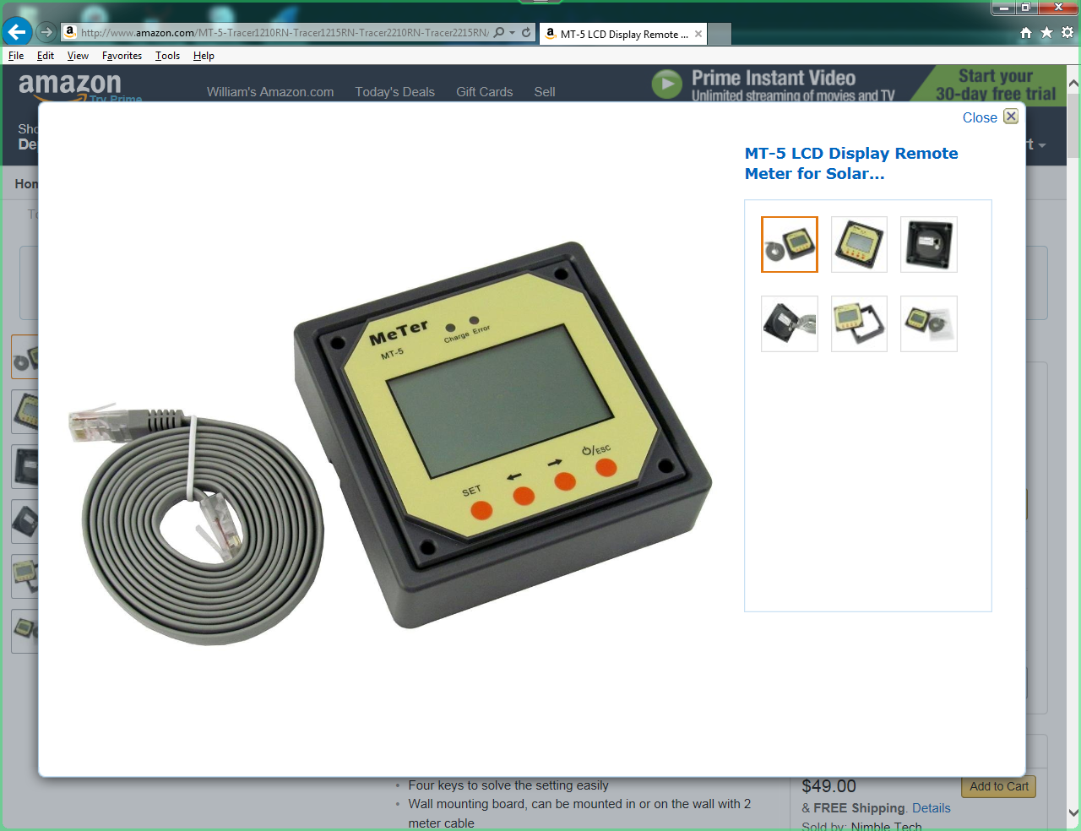

Slide 7
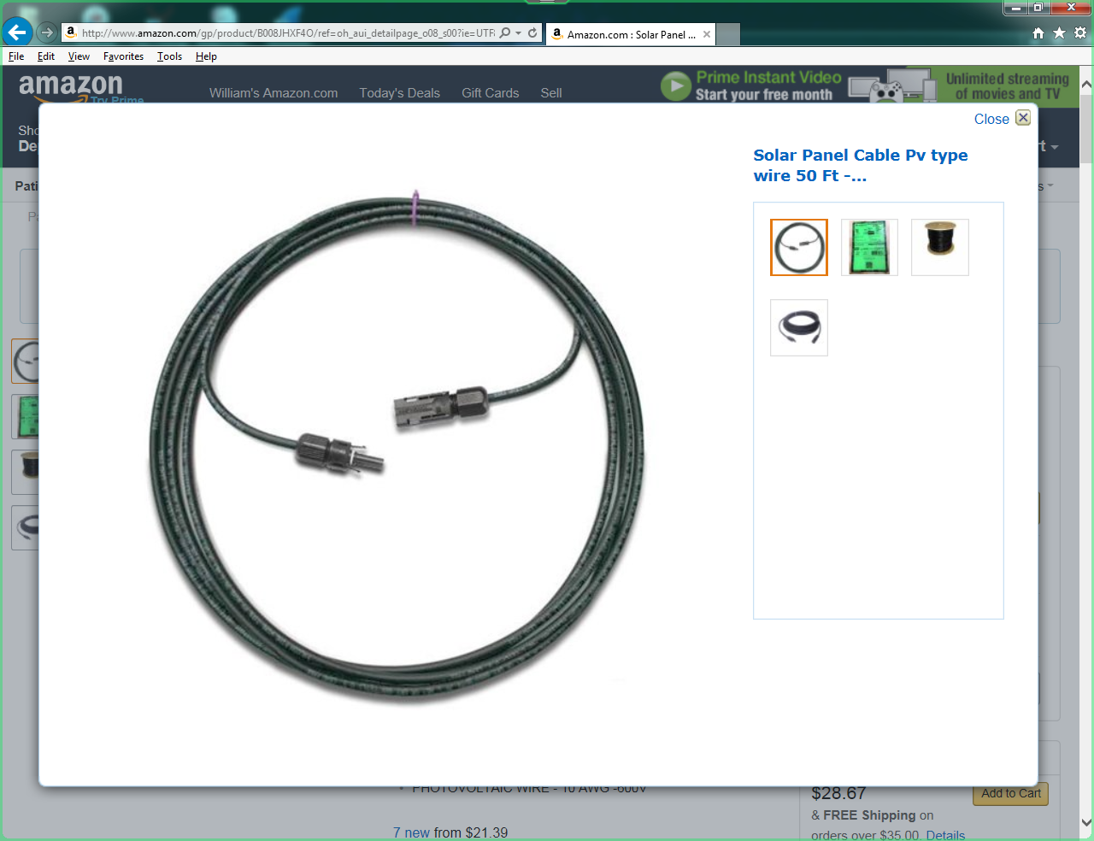

Slide 8
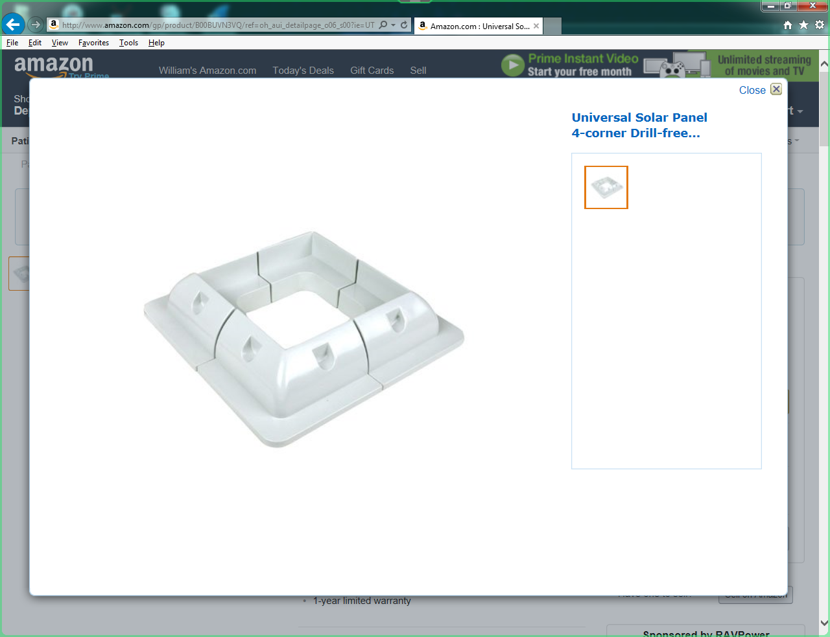

Slide 9
RV Solar Panel Costs
1. RENOGY 100W Solar Panel $133.99
2. Solar Panel Cable x 2 $45.86
3. 50 ft 12G Stranded Ground Wire $5.50
4. Solar Panel Mounts $36.99
5. MPPT (Maximum Power Point Tracking)
Solar Charge Controller $114.79
6. Display Remote Meter $35.00
Total $372.13

