Slide 1


Meshtastic
Brad Rupp, AC7BR

Slide 2
Introduction

Slide 3
What is Meshtastic
An open source, off-grid, decentralized mesh network built to run on affordable, low-power devices. No cell towers. No internet. Just pure peer-to-peer connectivity.

Slide 4
What is Meshtastic
Uses LoRa which stands for Long Range
  Not really long range, when compared to Amateur Radio devices
Encrypted using AES 256-bit encryption (non-amateur radio mode)
Does not rely on the Internet
Native iPhone and Android devices, pair with a small Mestastic radio
  Includes a web interface so that it will run on any device with a USB connection and a web browser
Can track location via GPS (native on the device or from your connected device)

Slide 5
What is the Intermountain Mesh
The Freq51 community is building an open community mesh that anyone local can join. This network is intended as a Radio Frequency tool for emergency/disaster response and off-grid (non-internet) coordination and hobbyist projects.
Uses Meshtastic devices but does not use the default configuration
  Doesn’t use the default LONG_FAST encoding
Actively building and deploying infrastructure nodes
  IMHO, this is what will make Meshtastic work and be useable
  I was very underwhelmed with Meshtastic before I found out about the Intermountain Mesh. Now I am excited about it and see value.

Slide 6
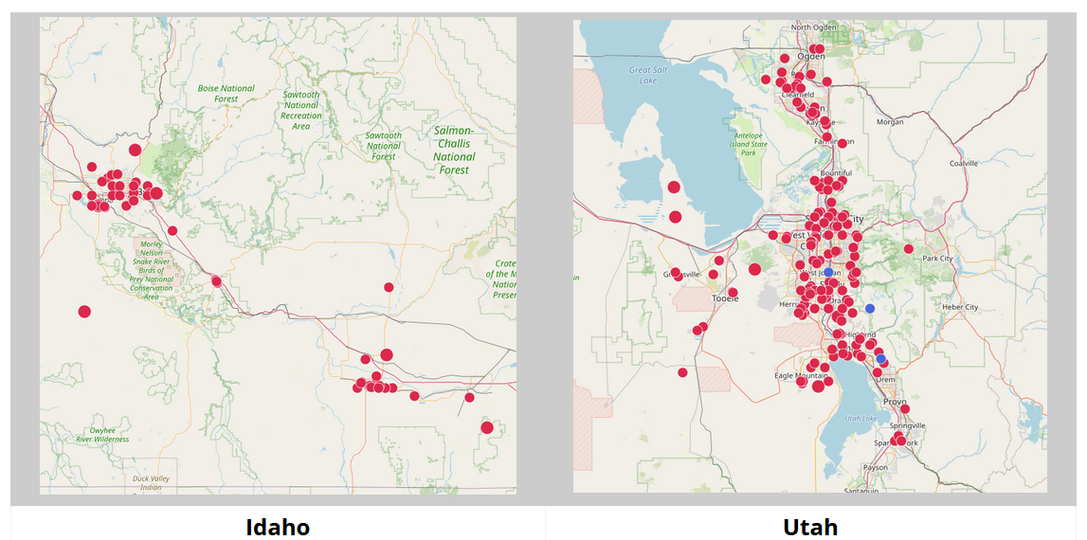
Intermountain Mesh Node Map

Slide 7
Channels
Meshtastic supports 8 channels
  The first (index 0) is used for position updates
  Private, encrypted family / personal channel
Intermountain Mesh channels
  General chat, weather, alerts, ERC, emcomm, Utah and Idah regional channels and a couple of hacker channels

Slide 8
Device Roles
CLIENT:
CLIENT_BASE
TRACKER
ROUTER
REPEATER
Several Others
  See https://meshtastic.org/docs/configuration/radio/device/ for details

Slide 9
Brad’s Views

Slide 10
Grid Down Communications
My wife and family will never get their ticket
Allows me to communicate with them in a grid down situation
Requires the settings and the infrastructure being developed and deployed by the Intermountain Mesh community
All communications is encrypted
You need a CLIENT_BASE node at your house
  This is really an outdoor node with special message forwarding rules
Note that Meshtastic and the Intermountain Mesh are NOT a life-critical service

Slide 11
ERC Community
You need a few CLIENT_BASE nodes located in a few strategic areas
Doesn’t necessarily rely on the Intermountain Mesh
  I would still recommend using the infrastructure and settings of the Intermountain Mesh
Allows non-licensed emergency preparedness specialists with CLIENT nodes to communicate with:
  Local Leadership
  A single Amateur Radio operator to forward/receive messages from regional leadership
Allows for encrypted communication

Slide 12
Camping
In my testing I could get a mile or so away
Height made all the difference
The signal won’t go through a ridge
GPS location is interesting
A well placed CLIENT_BASE node could make all the difference
  I am building a 1W node to use as a camping / portable node
Allows for encrypted communications
Final results are not in
  A GMRS radio may very well be a better solution (but is not encrypted)

Slide 13
Parting Thoughts

Slide 14
SPARC Meshtastic Node
Big caveat: I am absolutely biased by adding this slide
An L3H CLIENT_BASE node would:
  Support the last mile for SPARC members
  Help the Intermountain Mesh by adding a fairly high value infrastructure node
There is an Intermountain Mesh router on Ensign Peak
With all the local RF a SPARC CLIENT_BASE node would most likely not help get the signal inside of a building
  Or out of a building for that matter

Slide 15
Hardware
Supported Devices: https://meshtastic.org/docs/hardware/devices/
Rokland: https://store.rokland.com/pages/meshtastic-hardware-rak-lilygo
Seeed Studio: https://www.seeedstudio.com/LoRa-and-Meshtastic-and-4G-c-2423.html
RAK Wireless: https://store.rakwireless.com/collections/meshtastic
Muzi Works: https://muzi.works/
RPi Hats: https://meshtastic.org/docs/hardware/devices/raspberrypi/
Many Others

Slide 16
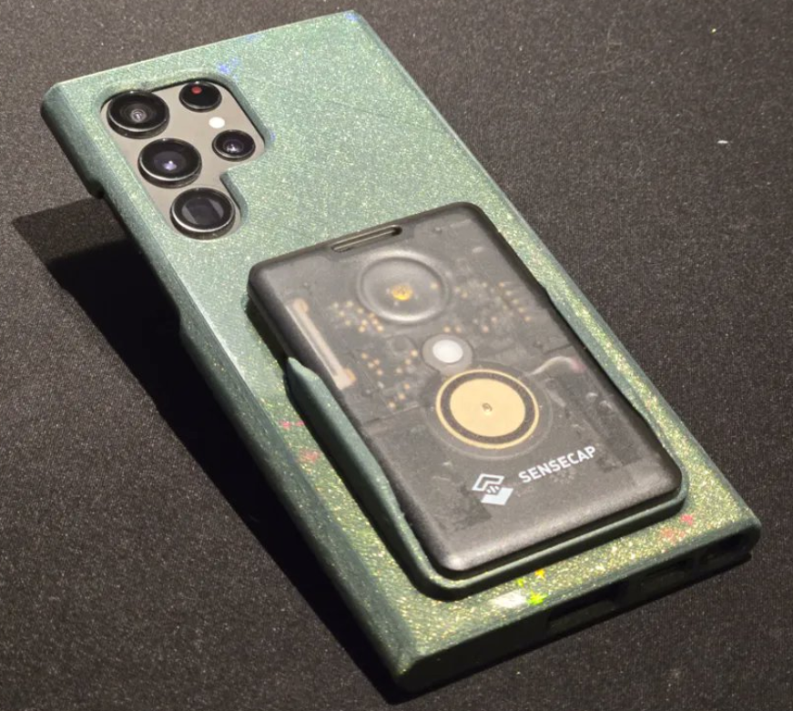
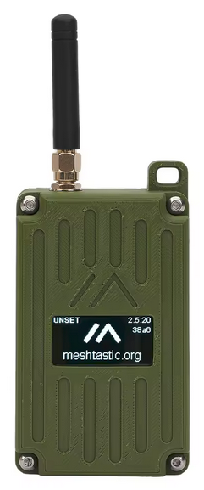
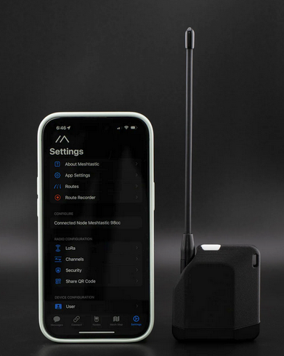
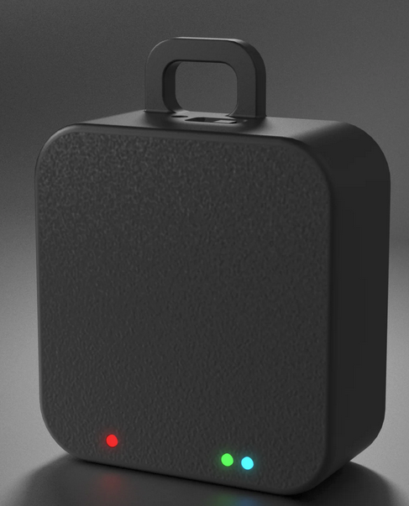
Hardware

Slide 17
Resources / Help
Mestastic: https://meshtastic.org/
Intermountain Mesh: https://freq51.net/
  Also on Discord
  Freq 51 channel on LoRa
  Supporting the greater Wasatch Front and some of Idaho
  The Intermountain Mesh is very active
Meshcore: https://meshcore.co.uk/

Slide 18
Questions?

