Slide 1
Electro-Magnetic Pulse (EMP)
How to protect yourself

Slide 2
Nikola Tesla
July 10, 1856 – January 7, 1943
One of the most brilliant scientific minds in history, several generations ahead of his time. An Austrian Mechanical and Electrical engineer, Tesla emigrated to the United States and began working as a researcher for Thomas Edison. He developed the first practicable alternating current induction motor but ultimately separated from Edison to push for the advancement of the Alternating Current system of power when Edison fought for the Direct Current system he’d already invested a fortune into. Tesla developed the modern poly-phase electrical system including induction motors, generators, and voltage stepping transformers. He went on to create radio communications, an invention that was wrongly credited to Marconi until the supreme court recognized Tesla in the 1940’s. He is best known for his creation of the impressive Tesla Coil, a high frequency charge pumping device capable of generating millions of volts of electricity at tens of kilohertz. He very accurately described modern cell phones, in 1925. Multiple generations ahead of his time.

Slide 3
A Great (NOT-SO) Academic Resource…

Slide 4
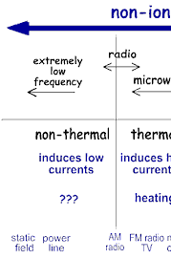
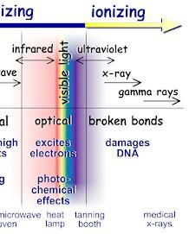
Ionizing and Non-Ionizing Radiation
Radiation that has enough energy to move atoms in a molecule around or cause them to vibrate, but not enough to remove electrons, is referred to as "non-ionizing radiation." Examples of this kind of radiation are sound waves, visible light, and microwaves.
Radiation that falls within the “ionizing radiation" range has enough energy to remove tightly bound electrons from atoms, thus creating ions. This is the type of radiation that people usually think of as 'radiation‘. We take advantage of its properties to generate electric power, to kill cancer cells, to sterilize medical equipment, and in many manufacturing processes including radiographic inspection.
http://www.epa.gov/radiation/understand/ionize_nonionize.html

Slide 5
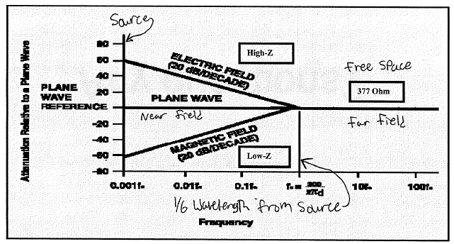
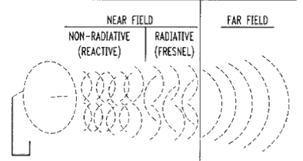
The Electromagnetic Wave
H-Field (Magnetic)
E-Field (Electric)
PW-Field (Plane Wave)
The Electric Field (high impedance), Magnetic Field (low impedance), and Plane Wave (377 ohm) are the three aspects of EM/RF wave propagation. Different shielding levels result from variations in wave impedance.
Electric Field and Magnetic Field impedance change with separation distance. (Near Field)
Plane Wave impedance is constant with separation distance (Far Field).

Slide 6
Two Varieties of EMP
Naturally occurring – Solar Mass Ejection (Solar Flare)
This is where a large mass of hot, electrically charged gas is ejected from the sun.
Man Made – Nuclear / HIRF / EMPT
Air-burst or Ground-burst nuclear detonation
HIRF: Within the main beam of a high power transmitter
EMPT: made-made devices

Slide 7
Why does H/EMP protection matter?
EMI comes in all degrees, from barely perceptible to overwhelming. It could be graded into three levels: Nuisance, intermediate, and catastrophic. Nuisance EMI is illustrated when an electric shaver or food mixer causes disturbance to radio or television service. The nuisance usually lasts for only a few minutes and causes no damage.
Intermediate to Catastrophic EMI exists, for example, when radiation from a radar triggers ordnance on an aircraft carrier or when two airliners collide during approach due to garbled radio messages from the tower, Or from “a crane releasing the brakes on a suspended load when a nearby worker keys the microphone on a radio.”

Slide 8
A couple more EMI/HIRF/HEMP Examples:
“High intensity radiated fields (HIRF) guns and electromagnetic pulse transformer (EMPT) bombs are already easy to build from off-the-shelf components. The effects of even hand-built HIRF or EMPT weapons can damage microprocessors at ranges of hundreds of metres. Possibly, in a few years, a van equipped with suitable electronics could cruise down Wall Street and disrupt the information processing capability of thousands of computers without being detected by the local police.” (IEE’s Control and Computing Journal, April 1998, page 52) Do you remember the film Ocean’s 13? An EMPT bomb was central to the plot line.
At 1:23 pm on Sunday, 24th July 1994 there was an explosion at the Texaco Refinery, Milford Haven. Its force was equivalent to 4 tonnes of high explosive and it started fires that took over two days to put out. Shops in Milford Haven 3km away had their windows blown in. 26 people sustained minor injuries, and the fact that it was Sunday lunchtime and the site was only partially occupied meant it could have been very much worse. Damage to the plant was substantial. Rebuilding costs were estimated at 48 million. There was also a severe loss of production from the plant – enough to significantly affect UK refining capacity. The incident was initiated by an electrical storm between 7:49 and 8:30 am on the Sunday morning, which caused a variety of electrical and other disturbances across the whole site. The large explosion was caused by the electrical storm giving rise to power surges which tripped out a number of pump motors whilst leaving others running. As there was a great deal of panic and confusion due to the information overload caused by the numerous small fires and equipment outages from the time of the storm, it was not noticed that flammable substances which should have been flared off were accumulating in pipework and vessels. After five hours something ignited the total accumulation, resulting in the large explosion. (IEE Computing and Control Engineering Journal April 1998 pp 57 - 60). There is an HSE report on this incident: “The explosions and fires at Texaco Refinery, Milford Haven, 24th July 1994” HSE Books, May 1997.
In other words, we don’t have to have a total destruction of electrical devices to cripple or destroy our ability to generate electricity, fuel, and food. Without these, civil unrest will grow exponentially.

Slide 9
How Bad Could It Really Be?
Best Case: Experts generally agree that all sensitive electronics will die
Radios, Cell Phones, Computers, PLC’s and industrial controls, traffic lights, GPS, etc, limited grid power
Some vehicles may survive
Worst Case: Literally everything with a solid state component (transistors, IC’s, etc) will be dead.
All vehicles with any unprotected electronics in their critical systems
Transportation: food deliveries, fuel, industry all grinds to a halt
All computers and electronics not radically hardened:
navigation systems, GPS, Satellites, all commercial communications systems, the entire power grid, all electrically based refrigeration
All hospitals and emergency services
No more fire department, police department, ambulances, defibrillators, life support systems, etc
What happens when you shut off power, refrigeration, food, fuel, and flow of information? Chaos, Rioting, Looting, Killing, and so on.
http://www.empcommission.org/
Congressional EMP Commission Assesment and Findings
Fictional Narratives
77 Days in September
One Second After, One Year After

Slide 10
EMP – Solar Flare
In 1859 there was a solar mass ejection which struck the earth… In 2012 there was a near-miss. It’s just a matter of time…
The solar storm of 1859, also known as the Carrington event,^{[1]} was a powerful geomagnetic solar storm during solar cycle 10. A solar coronal mass ejection hit Earth's magnetosphere and induced one of the largest geomagnetic storms on record. Telegraph systems all over Europe and North America failed, in some cases giving telegraph operators electric shocks.^{[9]} Telegraph pylons threw sparks.^{[10]} Some telegraph operators could continue to send and receive messages despite having disconnected their power supplies.^{[11]}
Studies have shown that a solar storm of this magnitude occurring today would likely cause widespread problems for modern civilization.^{[2]} The solar storm of 2012 was of similar magnitude, but it passed Earth's orbit without striking the planet.^{[3]}
On September 1–2, 1859, one of the largest recorded geomagnetic storms (as recorded by ground-based magnetometers) occurred. Aurora were seen around the world, those in the northern hemisphere as far south as the Caribbean; those over the Rocky Mountains in the US were so bright that their glow awoke gold miners, who began preparing breakfast because they thought it was morning.^{[5]} People in the northeastern US could read a newspaper by the aurora's light.^{[6]} The aurora was visible as far as Sub-Saharan Africa, Cuba and Hawaii.^{[7]}; in theory, at least, observers in the equatorial regions, particularly at higher elevations, may have been able to see the aurora borealis and aurora australis simultaneously. In January 25-26, 1938 a storm by most measures was not as strong as that of the Carrington event in 1859, but the colour, shape, and persistent intensity of the 1938 aurora (blood red over Europe and North America as well as the Southern Hemisphere) have led to the 1938 event being as well known or better known than that in 1859.^{[8]}

Slide 11
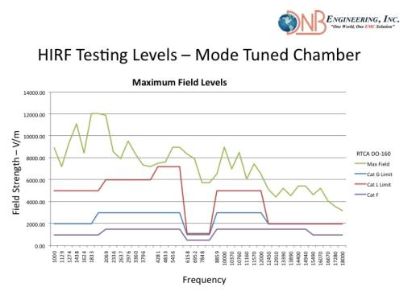
HIRF
There are amplifiers, magnetrons and other means of directly producing high intensity electric fields. Here’s an example of what can be achieved using commercially available RF amplifiers inside a reverb chamber:

Slide 12
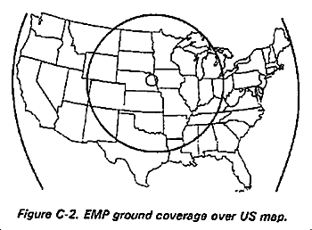
Nuclear – Air Burst
Most likely from an aggressive foreign government (Russia, North Korea, Iran, China)
Russia’s space program
Air burst nuclear event covers a large area
Compton effect: Multiplication “Cascade” effect which amplifies the pulse.
Read “One Second After” and “77 Days in September” if you haven’t already
There are rumors that it is possible to “tune” a nuclear warhead to produce extremely high levels of radiation and electromagnetic energy. If this is the case, our best case scenario may be totally unrealistic; it could be worst case then

Slide 13
Starfish Prime
Starfish Prime was a high-altitude nuclear test conducted by the United States starting on July 9, 1962, a joint effort of the Atomic Energy Commission (AEC) and the Defense Atomic Support Agency (which became the Defense Nuclear Agency in 1971).
A Thor rocket carrying a W49 thermonuclear was launched from Johnston Island in the Pacific Ocean. The explosion took place 250 miles (400 km) above a point 19 miles (31 km) southwest of Johnston Island. It was one of five tests conducted by the USA in outer space
Starfish Prime caused an electromagnetic pulse (EMP) which was far larger than expected, so much larger that it drove much of the instrumentation off scale, causing great difficulty in getting accurate measurements. The Starfish Prime electromagnetic pulse also made those effects known to the public by causing electrical damage in Hawaii, about 900 miles away from the detonation point (1800 mile+ diameter area of effect), knocking out about 300 streetlights, setting off numerous burglar alarms and damaging a telephone company microwave link. The EMP damage to the microwave link shut down telephone calls from Kauai to the other Hawaiian islands.^{[5]}
While some of the energetic beta particles followed the Earth's magnetic field and illuminated the sky, other high-energy electrons became trapped and formed radiation belts around the earth. There was much uncertainty and debate^{[who?]} about the composition, magnitude and potential adverse effects from this trapped radiation after the detonation. The weaponeers became quite worried when three satellites in low earth orbit were disablede. The half-life of the energetic electrons was only a few days. At the time it was not known that solar and cosmic particle fluxes varied by a factor 10, and energies could exceed 1MeV. These man-made radiation belts eventually crippled one-third of all satellites in low earth orbit. Seven satellites failed over the months following the test as radiation damaged their solar arrays or electronics, including the first commercial relay communication satellite, Telstar, as well as the United Kingdom's first satellite, Ariel 1.^{[11][12][13][14]} Detectors on Telstar, TRAAC, Injun, and Ariel 1 were used to measure distribution of the radiation produced by the tests.^{[15]}
Transistors were invented in the late 1940’s, but didn’t become ubiquitous until the 1970’s and 1980’s. Satellites are more hardened now than they were in those days, and power grid protection measures are being implemented now, but it’s clear that, two or three strategically detonated devices of that size could have an area of effect covering the entire continental united states. And In reality, how hard would that be for a rogue nation to do? If even 50% of our electrical technology was knocked out, the results would be catastrophic. In those days, the power grid was all operated manually. Today it is all synchronized and controlled electronically.

Slide 14
Nuclear Proliferation
5 countries are recognized as Nuclear Weapons states: USA, China, UK, Russian Federation, and France.
Many other countries are known or suspected of having nuclear arms not covered under Nuclear Non-Proliferation treaties: India, Pakistan, Israel, North Korea, Iran, the list goes on and on.
During the 1980’s and 1990’s, the US agreed to nuclear disarmament. We dramatically reduced the number of Nukes we posses, because Russia agreed to allegedly reduce the number they possessed (both countries had on the order of 20,000 to 30,000 nukes, enough to reduce the entire surface of the earth to a molten slag heap about 6 times over). But nuclear inspections between the US and Russia are anything but equilateral.

Slide 15
Russia’s Space Shuttle Program
In 1974, Russia launched its largest, most expensive project in space exploration history.
The biggest part of the project (called the Buran program) were its space shuttles, which were built in secret from designs the Soviet secret police stole from NASA.
The Soviets invested billions on the project, which was terminated in 1993 after only one shuttle launch. The sites where the shuttles were laid to rest have since been completely abandoned.
If this shuttle program only became publicly known in the last couple of years, imagine what secrets have yet to come to light? For example, every industrialized nation on earth has been studying viruses and bacteria since the 1960’s~1970’s. It’s not much of a stretch to imagine someone has figured out how to aerosolize a lethal bug or at least bind them to microscopic carrier particles such that a widespread biological attack is now possible. Isn’t it possible that someone could get angry enough to use such a weapon, if they have access to it?

Slide 16
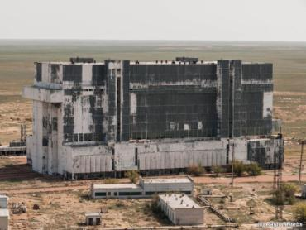
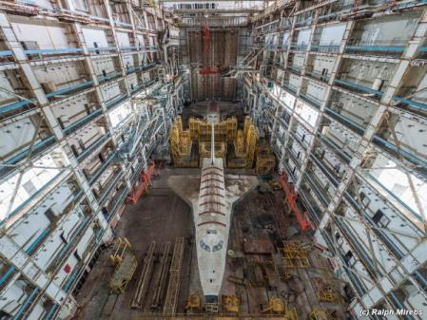
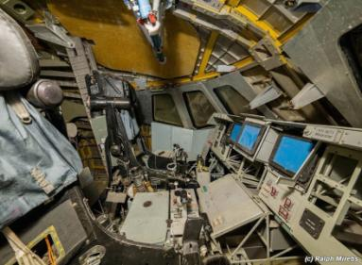

Slide 17
Opportunity to put Nukes in space
During the entire lifespan of the US Shuttle program, we had 135 launches which included satellite launches, resupply missions, ISS construction module launches, and classified-objective flights. During the decade of the 1980’s alone, Russia had over 700 orbital launches, many of these with rocket payloads not much smaller than our space shuttle. That’s a LOT of payload capacity going into space!

Slide 18
Space Cowboys
The film “Space Cowboys” was intended to be satirical, about Russians stealing US satellite navigation technology and using it to control a nuclear orbital launch platform. Unfortunately this scenario is all too likely.
US countermeasures to an ICBM nuclear strike rely on the assumption that ICBM’s would take nearly 20 minutes to make a suborbital launch, fly half way around the world, and strike US interests. With a launch from space, we could literally have only seconds of warning, especially if launched from a non-geosynch orbit of 220 miles and detonated at 20 to 200 miles up. It doesn’t take long to cover 200 miles in space. A simple de-orbit burn will do. For that matter, they wouldn’t even have to launch. They could simply detonate the warhead within the satellite housing it. We could literally have zero warning of such an attack.
Military targets which have been hardened, could be eliminated with direct ground burst hits. The rest of the country can be taken out with an air burst. When the lights go out, rioting ensues. With no electricity, how long will our prisons be able to contain 1,000,000+ criminals?

Slide 19
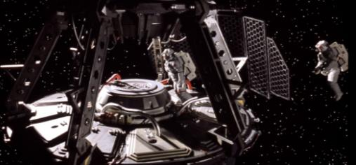
Images Taken from the film (copyrighted)

Slide 20
Iran’s Nuclear Program
Iran developed a nuclear program beginning in the 1970’s, securing Uranium enrichment centrifuges. Modern day nuclear reactors all use Thorium because it is dramatically more efficient than Uranium. The only reason to enrich uranium is to create atomic weapons! Watch the documentary “Iranium” if you haven’t already seen it.
In 2011 Pres Obama directed Sec State John Carey to reach out to Iran, and acknowledge their right to develop and posses nuclear weapons. Since that time, they have been crafting a very bad and very dangerous deal. This deal includes gifting Iran $150 Billion dollars. The purpose of US foreign aid has always been to push US interests in foreign countries. As such, us foreign aid has always come with strings attached. The money offered to Iran has NO STRINGS ATTACHED. We are literally giving them free money, to spend any way they please. This deal also includes the removal of embargos from Iran, and granting them permission to develop nuclear weapons within a decade. Their program has been in operation since the 1970’s. It is extremely unlikely that they don’t already have a stockpile of weapons grade materials and the devices to use it with.
Iran has been testing missiles capable of striking targets anywhere in the middle east, including Israel and US Military FOB’s. One of the most recent publicly documented tests was May 20th 2015. There was also a story of a ballistic missile test taking place a few years ago; the missile test was terminated using a remote self-destruct feature before the missile left Iranian airspace as US assets stood ready to shoot it down in the event that it did leave their airspace. The US has historically watched Iran closely for missle launches, a nuclear strike against Israel would therefore have a high probability of launching from Libya, Syria, or some other terrorist controlled state. Iranian officials tout that their latest generation of missile is capable of evading enemies’ anti-missile defense system. This may include Israel’s proprietary “Iron Dome” missile defense system: (https://en.wikipedia.org/wiki/Iron_Dome)
Terrorists in Iran and other parts of the middle east regularly renew their philosophical drive to bring about “Death to America” and “Death to Israel”. Iranian officials have stated that Israel will be completely wiped off the map within 25 years, i.e. it will be destroyed using nuclear attacks by 2040, while spreading radioactive debris around the world in a nuclear winter.
Pressuring of inspectors; Inspections of Iran’s nuclear facilities require giving Iranian officials a 24 day advance warning notice before inspections can take place.
Presumably the US and/or Israel, created “STUXNET” the most sophisticated computer virus ever developed. It had the intelligence to attack only computers attached to the specific type of Siemens PLC’s used to control nuclear enrichment centrifuges, causing the centrifuges to tear themselves apart. (https://en.wikipedia.org/wiki/Stuxnet)
In short, a nuclear strike against Israel, within our lifetime, is inevitable. This could lead to other nation’s initiating attacks. EMP and Nuclear winter is a very real possibility.

Slide 21
China’s Space Program
During the Clinton administration, there was a news story about several encrypted laptops with classified aerospace information on them that went missing from a government contractor facility (JPL?). Over the next few years China’s space program made up two+ decades of satellite and space exploration progress…
In 2012 NASA had a laptop stolen which contained among other things, control and command codes used for the International Space Station. It is unknown where that information went. But it could easily have been China or Russia, or even to a random hacker who wants to play with the ultimate RC toy!
China has been a Nuclear power since their first nuclear test in 1964.

Slide 22
North Korea’s Nuclear Program
Several years ago there was a lot of media attention paid to North Korea’s nuclear program. They successfully tested an ICBM Missile Launch platform. We haven’t heard much about it since that time, but indications are strong that they have nuclear weapons, and a leader who isn’t afraid to use them if the situation is advantageous.

Slide 23
Pakistan and India
Both of these countries allegedly have nuclear arsenals. And both countries HATE each other. If nuclear attacks happen in this country, you can be sure they will break out elsewhere as old rivals settle old scores.
There are rumors that after the soviet union collapsed in 1993, some of their nuclear weapons were stolen and sold on the black market for as little as $50 Million.

Slide 24
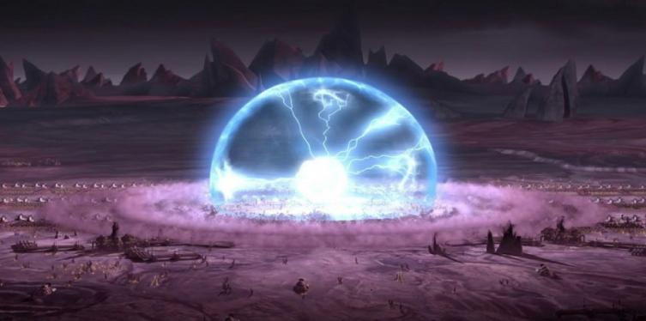
Nuclear Ground-Burst
“Suitcase Nukes”
Nuclear detonation on a small scale; localized, Line-of-Sight effect
The film “The Manhattan Project”
Sabotage
We have an extensive nuclear arsenal. There are protections in place, but no physical security is ever 100% assured. How much of our classified information has China and Russia stolen in the last few decades?? For the right price, almost anything is possible

Slide 25
Nuclear War – MAD
Mutually Assured Destruction prevented total nuclear war for the several decades of the “cold war”.
We now face anarchists, people who are legitimately insane, religious extremists, and worse; These are enemies who don’t see mutually assured destruction as a deterrent, but as a bonus! Dying in the pursuit of their goals is a noble achievement. This makes our enemies far more dangerous than Russia ever was during the cold war.

Slide 26
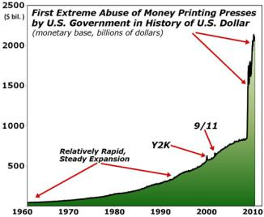
Conspiracy Theory or Real Possibility? Some stories in the news…
Syrian Christian Refugees – Told to get out of the country. “If you don’t get out, you must convert or die”.
Nuclear Deal with Iran
70% of people in this country oppose this deal. Over 30 states have created legislation to fight Iran at a local level. Congress to vote about giving $150 Billion to Iran to spend any way they wish.
Race Riots in the streets
Birmingham, Baltimore, Ferguson, Cop Killings, Black Lives Matter
Crime Stats
We have over 1 million people incarcerated in this country, many of them are violent criminals. How many more people are severely mentally unbalanced, and would be a very real danger to society if they couldn’t get their anti-psychotic meds? Could we contain them if the electronic security measures in prisons all stopped working?
In 2011, 865 Semi-trucks were hijacked. A loss of nearly half a billion dollars.
If all of this is happening while the full rule of law is in effect, how long would it take for things to get REALLY bad if suddenly all the police cars and police radios stopped working? How long would it take crime lords and drug cartels to cross an unguarded border?
Economic Uncertainty
Greek Debt Crisis
July Default on 1.2B EU Debt Payment
Citizens are limited to $67 daily withdrawals from banks / ATMS in order to curb Hyper-Inflation. This makes preparation all but impossible.
Printing Money
During the 2008 crash, Senator Richard Burr (Chairman of the senate intelligence committee) called his wife Brooke and said “Tonight I want you to go to the ATM and I want you to draw out everything it will let you take”.
At the same time, the CEO of PIMCO (Largest mutual fund in the world) was telling his wife “Just go to the ATM. I’m not sure the banks are going to open tomorrow”. She said “you must be kidding” he simply said “No”…
If an economic collapse happens, it will be global, and it will be considered an act of war initiated by the USA…

Slide 27
(Going off of) The Gold Standard
Starting in the 1959-1969 administration of President Charles de Gaulle and continuing until 1970, France reduced its dollar reserves, exchanging them for gold at the official exchange rate, reducing US economic influence. This, along with the fiscal strain of federal expenditures for the Vietnam War and persistent balance of payments deficits, led U.S. President Richard Nixon to end international convertibility of the U.S. dollar to gold on August 15, 1971 (the "Nixon Shock").
This was meant to be a temporary measure, with the gold price of the dollar and the official rate of exchanges remaining constant. Revaluing currencies was the main purpose of this plan. No official revaluation or redemption occurred. The dollar subsequently floated. In December 1971, the “Smithsonian Agreement” was reached. In this agreement, the dollar was devalued from $35 per troy ounce of gold to $38. Other countries' currencies appreciated. This was the official price of the dollar, and policies to maintain its value relative to other currencies. However, gold convertibility did not resume. In October 1973, the price was raised to $42.22. Once again, the devaluation was insufficient. Within two weeks of the second devaluation the dollar was left to float. The $42.22 par value was made official in September 1973, long after it had been abandoned in practice. In October 1976, the government officially changed the definition of the dollar; references to gold were removed from statutes. From this point, the international monetary system was made of pure fiat money.
The main advantage of a commodity based currency is stability, and difficulty for government to manipulate the monetary system. Fiat (paper) currency only has value because everyone agrees that it does. When everyone stops agreeing that paper has value, that currency collapses and becomes worthless forever more. Two examples include the Weimar Republic (1920’s Germany) where one report was that an entire wheelbarrow filled with currency couldn’t buy a loaf of bread, and the currency collapse of Vietnam (circa 1972).
With the globalization of economies that exists today, any one countries' collapse could bring down the whole system. The only way to stop the inevitable is to stop deficit spending, but nobody wants to give up the entitlements they’ve been promised for two generations.
The federal reserve has been manipulating the market in every way possible. They’ve set up automatic BUY orders so if the stock market takes a huge dive, the government steps in and starts buying up billions in stocks to stabilize prices and prevent a free-fall. The Fed has been printing money at 5 times the highest previous rate for the past several years (since 2008). The Fed has maintained a key interest rate at 0% since about 2009. they’ve been staving off disaster, but they are running out of ways to manipulate the market. Collapse is not only inevitable, it is being planned for. It was the whole reason behind going off the Gold Standard.

Slide 28
What separates sheep from sheep dogs
If the worst happens, what will make all the difference?
Communications!
Coms and intelligence are what separate organized groups from herds of sheep. Communication and information flow is critical to maintain civilized society (If law enforcement didn’t have communications, how would that hamper their ability to protect the public?) And that’s partly why we participate in amateur radio, to facilitate communications.
What happens when the lights go out and food deliveries to stores and restaurants stops…?! Rioting in the streets.

Slide 29
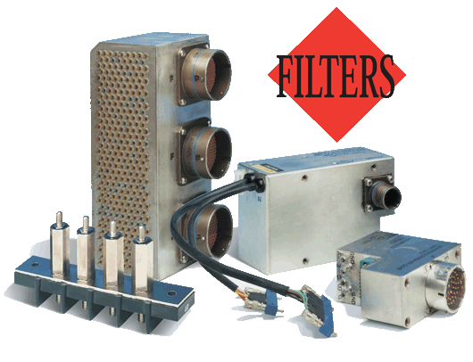
Equipment that will operate through and survive an EMP event?
Commercial equipment is limited
Base loaded antennas could fry
Most filtering out there can’t clamp fast enough
Inlet Power Filters
L-3 acquired “Jaycor”
MFG HEMP Enclosures

Slide 30
Putting things into perspective: Field Strength And Units of Measure
Power Density is measured in: W/m²
Field Strength is measured in: V/m
Noise Level is measured in: dBμV/m
What does that mean?
If an RF point-source (A) is radiating uniformly, then an imaginary sphere can be visualized about this point and the power density on the surface of the sphere is measured in Watts per square meter. To convert a given power density to a field strength:
P=P(radiated)/4πr² And V=√PR
Where V is the field strength in V/m, P is the power density in W/m² and R is the resistance of free space (377Ω/m). This means that a transmitter radiating 10 watts, at a distance of 30 meters, has a power density of 8.84 x 10^-4 w/m and a field strength of 0.577 V/m. At half the distance (15 meters) The same transmitter has a power density of X.xx * 10^-3w/m and a field strength of X.XX V/m. this is 16 times the power level and is due to the radial diffusion of engery from a point source. Similarly the same source when measured from 60 meters will have a power density of X.xx * 10^-3w/m and a field strength of X.XX V/m. This is 1/16th the power at 30 meters.
*Surface are of a sphere: 4πr²

Slide 31
RF Power Reference Chart
Power level | Power | Notes
19 dBm | 79 mW
18 dBm | 63 mW
17 dBm | 50 mW
15 dBm | 32 mW | Typical Wireless LAN transmission power in laptops
13 dBm | 20 mW
10 dBm | 10 mW
7 dBm | 5.0 mW | Common power level required to test the Automatic Gain Control circuitry in an AM receiver
6 dBm | 4.0 mW
5 dBm | 3.2 mW
4 dBm | 2.5 mW | Bluetooth Class 2 radio, 10 m range
3 dBm | 2.0 mW | More precisely (to 8 decimal places) 1.9952623 mW
2 dBm | 1.6 mW
1 dBm | 1.3 mW
0 dBm | 1.0 mW = 1,000 µW | Bluetooth standard (Class 3) radio, 1 m range
−1 dBm | 794 µW
−3 dBm | 501 µW
−5 dBm | 316 µW
−10 dBm | 100 µW | Maximum received signal power of wireless network (802.11 variants)
−20 dBm | 10 µW
−30 dBm | 1.0 µW = 1,000 nW
−40 dBm | 100 nW
−50 dBm | 10 nW
−60 dBm | 1.0 nW = 1,000 pW | The Earth receives one nanowatt per square metre from a magnitude +3.5 star[5]
−70 dBm | 100 pW
−73 dBm | 50.12 pW | "S9" signal strength, a strong signal, on the S-meter of a typical ham or shortwave radio receiver
−80 dBm | 10 pW
−100 dBm | 0.1 pW | Minimum received signal power of wireless network (802.11 variants)
−111 dBm | 0.008 pW = 8 fW | Thermal noise floor for commercial GPS single channel signal bandwidth (2 MHz)
−127.5 dBm | 0.178 fW = 178 aW | Typical received signal power from a GPS satellite
−174 dBm | 0.004 aW = 4 zW | Thermal noise floor for 1 Hz bandwidth at room temperature (20 °C)
−192.5 dBm | 0.056 zW = 56 yW | Thermal noise floor for 1 Hz bandwidth in outer space (4 kelvins)
−∞ dBm | 0 W | Zero power is not well-expressed in dBm (value is negative infinity)
Power level | Power | Notes
103 dBm | 20 MW | Roughly equates to 50,000 Volt / meter electric field generated by an EMP event (estimated)
80 dBm | 100 kW | Typical transmission power of FM radio station with 50-kilometre (31 mi) range
77 dBm | 50 kW | Typical transmission power of a Clear Channel AM Radio station (KSL)
62 dBm | 1.588 kW = 1,588 W | 1500 W is the maximum legal power output of a U.S. ham radio station.[3]
60 dBm | 1 kW = 1,000 W | Typical combined radiated RF power of microwave oven elements
50 dBm | 100 W | Typical thermal radiation emitted by a human body
 |  | Typical maximum output RF power from a ham radio HF transceiver
40 dBm | 10 W | Typical PLC (Power Line Carrier) transmit power
37 dBm | 5 W | Typical maximum output RF power from a handheld ham radio VHF/UHF transceiver
36 dBm | 4 W | Typical maximum output power for a Citizens' band radio station (27 MHz) in many countries
33 dBm | 2 W | Maximum output from a UMTS/3G mobile phone (Power class 1 mobiles)
 |  | Maximum output from a GSM850/900 mobile phone
30 dBm | 1 W | Typical RF leakage from a microwave oven[citation needed] DCS or GSM 1,800/1,900 MHz mobile phone. EIRP IEEE 802.11a (20 MHz-wide channels) in either 5 GHz Subband 2 (5,470–5,725 MHz) provided that transmitters are also IEEE 802.11h-compliant, or U-NII-3 (5,725–5,825 MHz). The former is EU only, the latter is US only.
29 dBm | 794 mW
28 dBm | 631 mW
 |  | Maximum output from a UMTS/3G mobile phone (Power class 2 mobiles), Typical Cell Phone Power
26 dBm | 400 mW
25 dBm | 316 mW
24 dBm | 251 mW | Maximum output from a UMTS/3G mobile phone (Power class 3 mobiles)
 |  | 1,880–1,900 MHz DECT (250 mW per 1,728 kHz channel). EIRP for Wireless LAN IEEE 802.11a (20 MHz-wide channels) in either the 5 GHz Subband 1 (5,180–5,320 MHz) or U-NII-2 & -W ranges (5,250–5,350 MHz & 5,470–5,725 MHz respectively). The former is EU only, the latter is US only.
23 dBm | 200 mW | EIRP for IEEE 802.11n Wireless LAN 40 MHz-wide (5 mW/MHz) channels in 5 GHz subband 4 (5,735–5,835 MHz, US only) or 5 GHz subband 2 (5,470–5,725 MHz, EU only). Also applies to 20 MHz-wide (10 mW/MHz) IEEE 802.11a Wireless LAN in 5 GHz Subband 1 (5,180–5,320 MHz) if also IEEE 802.11h compliant (otherwise only 3 mW/MHz → 60 mW when unable to dynamically adjust transmission power, and only 1.5 mW/MHz → 30 mW when a transmitter also cannot dynamically select frequency).
22 dBm | 158 mW
21 dBm | 125 mW | Maximum output from a UMTS/3G mobile phone (Power class 4 mobiles)
 |  | EIRP for IEEE 802.11b/g Wireless LAN 20 MHz-wide channels in the 2.4 GHz ISM band (5 mW/MHz). Bluetooth Class 1 radio. Maximum output power from unlicensed AM transmitter per U.S. Federal Communications Commission (FCC) rules 15.219.[4]

Slide 32
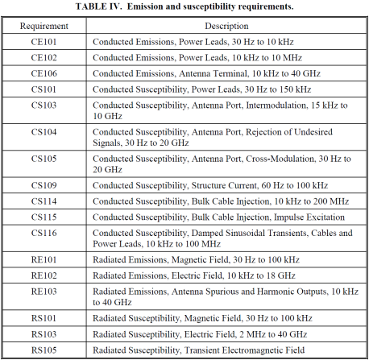
MIL-STD 461 Tests (Unclassified)
CE versus MIL
There are several tests commonly called for in military specifications:
CE: Uses a CT to pick up noise on input and output cabling. Typically lower frequencies.
CS: Uses a “Bulk Current Injection” probe to inject noise onto an input or output cable. (Essentially a CT in reverse)
RE: Uses a free-standing antenna offset from the surface of the EUT to measure radiated RF noise.
RS: uses a free-standing antenna offset from the surface of the EUT to radiate RF onto a targeted area.

Slide 33
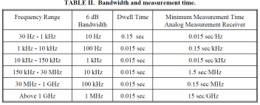
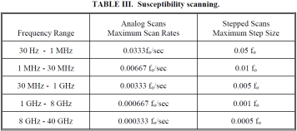
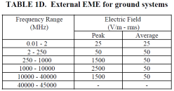
Moderate Thresholds of Tolerable Emissions and Susceptibility
Bear in mind that commercial equipment, if it is tested at all, is almost universally tested to susceptibility at 10 volts/meter.

Slide 34
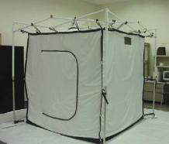
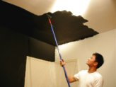
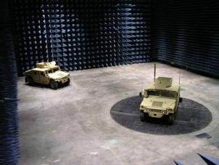
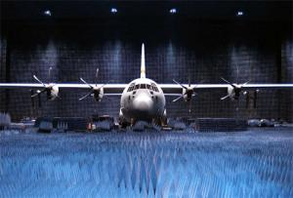
Testing Facilities
Shielding Paint: 20~40 dB
Shielding Performance Curve
Shielded Tent: ~60+ dB
Semi-Anechoic Chamber: ~80 dB
Full Anechoic Chamber: ~120+ dB

Slide 35
MIL-STD-464 (Unclassified)
Electromagnetic Environmental Effects (E3)

Slide 36
MIL-STD 188-125 (Unclassified)
High-Altitude Electromagnetic Pulse (HEMP)
108 pages of light reading for you…
This is a great resource for how to create a shielded enclosure, for those serious enough to do so.

Slide 37
How exactly does an EMP destroy? Electromagnetic Environment (EME)
An nuclear detonation creates electric fields which induce currents in electrical devices, which create large voltages, which burn out components. There are devices that can clamp or filter these over voltages (such as PI filters, Zener diodes, and MOV’s), but the rise time from an EM pulse is on the order of 2.5 nano seconds. Far too fast for most of these conventional filtering methods to counteract. Any EMC problem can be attacked in three ways. Since we can’t do anything to mitigate the source, we can only shield the coupling path, or directly harden the receptors. Hardening is difficult, expensive, and in many cases, uses classified information. Your best bet is to shield equipment by disrupting the coupling path.
Sources Coupling Path Receptor
Microprocessors
Video Devices
ESD
Power Supplies
Lightning
Any high-frequency
switching device
Radiated EM fields – Free Air
Conduction
Capacitance
Inductance
“Ground”
Other binary logic circuits
Analog circuits
Receivers / amplifiers
Reset lines
Equipment
Anything internal or
external to the noise
source that receives a
noise signal

Slide 38
How to protect equipment: Types of EMI Fixes - Absorption Vs Reflection
Conduction Fixes
Radiation Fixes
Capacitive Fixes
Inductive Fixes
Bonding, Grounding, RF Impedance
Power Line Filtering
An EM Pulse would produce AT LEAST 50,000 V/M electric fields, potentially inducing 5,000 Amps with a rise time of 2.5nS. That rise time is so fast that most conventional filtering techniques will fail.

Slide 39
Bonding: Is it really ground?
Grounding – it’s what it really is all about. Stray currents will seek a path to ground. It’s best to provide the path you chose.
Improper bonding and grounding creates impedance mismatches and is the root cause of many EMI problems.
A ground strap is generally a good low frequency safety ground. However, as the frequency of the conducted signal increases, the impedance of this connection goes through the roof. This is why the RF shield encircling a conductor must be bonded for 360 degrees around the conductor.
Bonding shall be made by means of a bus-strap or shear-splice joint when practical
A combination environmental and EM seal, such as wire or other metal form in an elastomeric should be preferred.

Slide 40
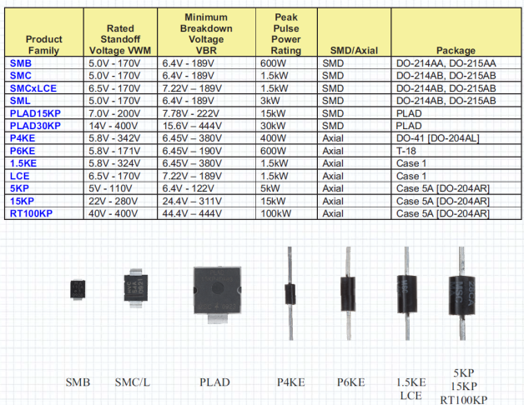
Transient Voltage Suppressors
TVS (Transient Voltage Suppressors) for HEMP protection: MicroSemi.com

Slide 41
EMI and Apertures – Slot Antennae
To have an EMI problem, three elements are necessary:
Source
Coupling path
Receptor
The amount of emission “leakage” from an aperture depends upon three main items:
The maximum linear dimension (not area) of the aperture; which is the “slot antenna” effect. When the slot approaches 1/8 wavelength or longer, it may radiate rather effectively. For example, this could be when DB-X connectors are passed through a shielded enclosure or when an enclosure seam is not tightly sealed.
The wave impedance
The frequency of the source
Multiple Apertures
Reduction of equipment or system shielding depends upon:
Spacing between apertures
Operating frequency
Number of apertures within λ/2 of highest operating frequency
When apertures of equal size are placed “electrically” close together (within λ /2), the shielding loss is roughly proportional to 20 times the log of the number of apertures. In other words, a row of round holes act as a slot. Also, a porous weld behaves like a slot.
Aperture Calculations
Determine the highest frequency of concern.
Calculate the wavelength (λ) in inches (11.8028”/GHz) for the highest frequency to be shielded
Dividing λ/20 will give a dimension required to have approximately 20dB; dividing by 200 will give a dimension of approximately 40 dB, though this doesn’t account for reflections, standing waves or other noise sources.
Example: If the highest frequency of concern is 2.4GHz (approximately the frequency of a microwave oven magnetron), the wavelength λ for this frequency is 4.92”. Approximately 20dB of shielding requires an aperture no larger than 0.246”. For Approximately 40dB of shielding, the size is reduced to 0.025” (which is approximately the size of pores in the window screen used in microwave ovens).
Note that if there is more than one opening within λ/2, slot-effect coupling will further reduce shielding.

Slide 42
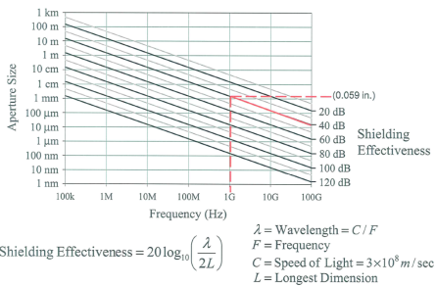
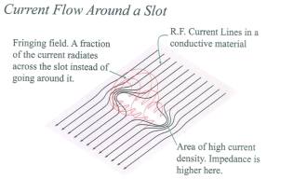
Shielding Leakage of Apertures
Shielding Effect of Apertures

Slide 43
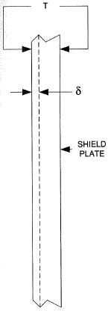
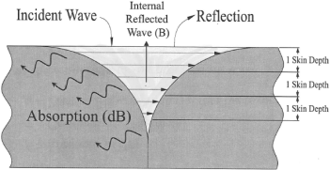
Skin Effect & Skin Depth
Skin effect and Skin depth: Alternating currents do not flow uniformly throughout the cross-section of a conductor as is the case with direct currents. Because of the skin effect, AC flows only near the surface of the conductor. This effect creates a situation where the AC resistance of a conductor will be higher than the DC resistance.
Skin effect is a function of shielding effectiveness, and provides 8.7dB/δ of absorptive loss.
To obtain maximum reflective loss at RF frequencies, the thickness of the shielding material should be about 3 to 10 times the skin depth.
At 10MHz, aluminum has a skin depth of 0.001” and copper of 0.0008” so the thickness should be 0.010”
Sheet metal used for shielding show a skin effect when currents flow in them. The skin depth is analogous to the critical depth in cylindrical conductors. In both cases, 63.2 percent of the current flows (in a 1/e^n manner) in the area between the surface and the skin depth (δ). Skin depth is calculated by
where F is for the frequency in Hertz and k is 1.0 for copper, 1.234 for aluminum and 0.1 for steel. In terms of absorptive loss, the attenuation is 8.7 dB/δ. To obtain the maximum reflective loss at RF frequencies, the thickness of the shielding material should be about 3 to 10 times the skin depth. For example at 10 MHz aluminum has a skin depth of 0.001” so shielding should be 0.010”. (Aluminum foil is typically 0.001” thick)
The current density near the surface “skin” of a conductor is greater than that at it’s core. The skin effect causes the effective resistance of the conductor to increase with frequency of the current. The current sets up eddies that cancel the current in the center of the conductor and reinforce the current at the skin; therefore, skin effect increases as frequency and amplitude of the eddy current losses increase. Also, at higher frequencies, there is a greater degree of heating in a conductor because of the increasing hysteresis. In very high frequency applications, like Microwave, RADAR, and RF generation, solid conductors are replaced by tubes, having the same resistance.

Slide 44
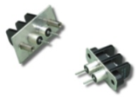
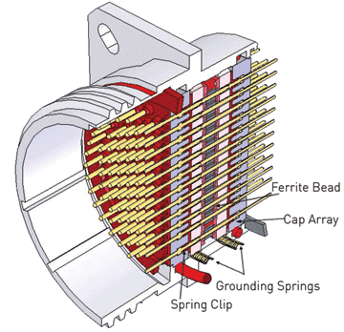
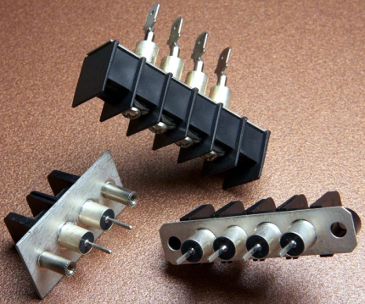
Filtered Connectors

Slide 45
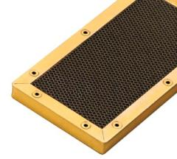
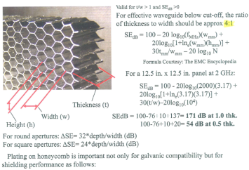
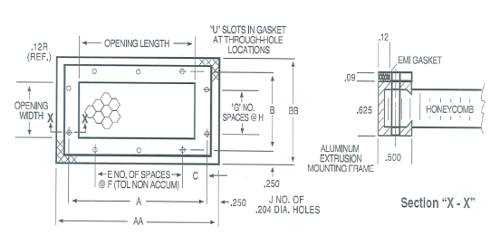
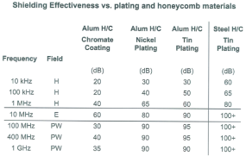
Honeycomb Vent Panels for Shielded Enclosures – When equipment has to operate during an event, and needs to breath, any opening to the outside air must use a honeycomb vent panel. The geometry of the panel is calculate in order to create the desired “wave guide” effect.

Slide 46
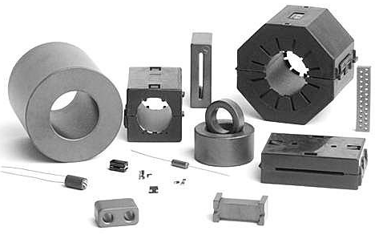
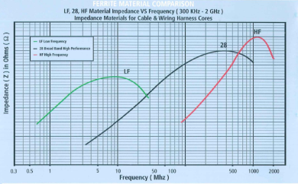
Ferrites
Ferrites add a small amount of inductance to a cable.
Ferrites come in solid cores, split cores and special purpose forms.
They are made of different materials for different frequency responses. Ferrites are “tuned” to frequency bands and should be applied accordingly.
Ferrites work REALLY well for very specific EMI problems. They will most assuredly NOT protect equipment from an EMP.

Slide 47
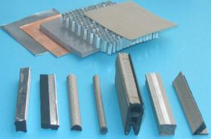
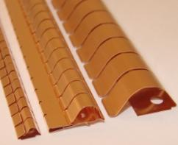
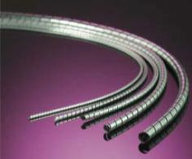
EMI Gasket
There are many types of EMI gaskets. The most common are metal / metalized fabric over an elastomeric core, and finger stock (such as Beryllium-Copper).
All interfaces age with time so if your gasket is damaged or oxidizes, you lose shielding effectiveness. Quickly.

Slide 48
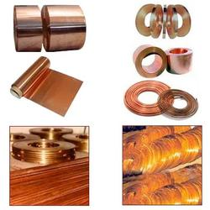
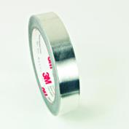
Conductive Copper and Aluminum Tape
Copper tape is backed with a pressure-sensitive acrylic adhesive. It must be applied under pressure to bond.
Many “conductive” adhesives are not especially conductive. Impedance mismatches are a bad thing, so adhesive conductivity should be measured. Aluminum tape from the hardware store does NOT have conductive adhesive and it will not create a bond!
WARNING: copper tape is less like a roll of masking tape and more like a rolled up razor blade. Exercise extreme caution when handling and DO NOT run your fingers along the edges.
Suppliers: 3M, SPI Supplies, Parker Chomerics, findtape.com, kapton tape, EMKA, MAJR products

Slide 49
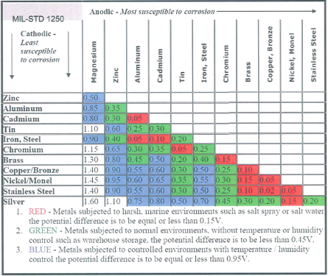
Galvanic Compatibility
In the presence of oxygen, metals oxidize; other atmospheric effects and thermal cycling accelerates this process.
When moisture is present, the oxidized salts form electrolytes between the two dissimilar metals becoming a simple battery. As currents flow from the cathode to the anode a voltage potential develops.
The voltage amplitude (measured in Electron-Volts) is directly proportional to currents flowing across the junction of the two metals and enables corrosion through an Oxygen-Reduction reaction.
What this means is that if you use copper tape to seal up an aluminum box, you will create a galvanic pair. Oxidation will result and in a very short time you will lose bonding and shielding effectiveness. If you must do this, it has to be maintained regularly.

Slide 50
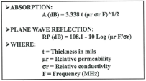
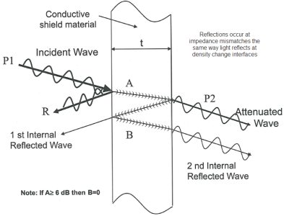
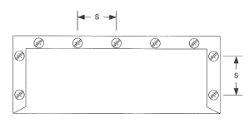
Shielded Enclosures
Seams must be sealed to prevent “Slot Antenna” effect Using either copper tape or screws spaced at a X/X ratio of the wavelength of the highest frequency to be filtered.

Slide 51
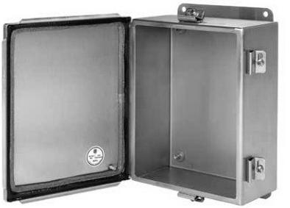
Off the Shelf EMI Control Boxes
Hoffman makes Stainless steel EMC enclosures:

Slide 52
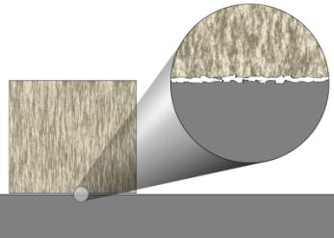
Surface Contact
No metal to metal contact is perfect. There are always microscopic surface irregularities. This creates a slot antenna and allows RF to couple through the joint. This is why joints must be welded, brazed, soldered, or at least folded over several times. Metal tape with conductive adhesive and conductive contact gasket also works, but not as well as a soldered joint.

Slide 53
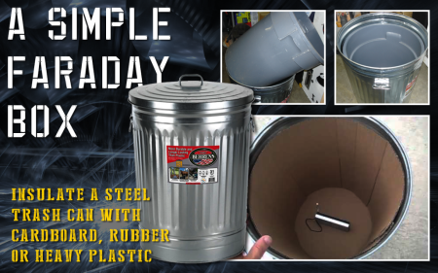
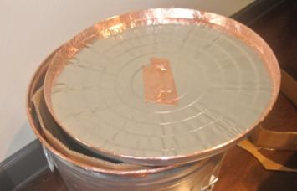
Creative Cages – Household items
Check YouTube
There are some great examples…
Trash Can – Lid must be welded or copper taped closed to seal
Paint Can – Must buff interfaces to remove non-conductive coatings
Ammo Can – Must remove paint from joints and tape closed
#10 1-gallon food can
Copper Sheeting
Copper Clad PCB Stock
Hoffman Control Boxes
Sheet Metal
Enclosures must be sealed
Using metal-to-metal contact!
Welded/brazed/soldered/fastened
When in doubt, measure
the contact resistance using a
Mili-ohm meter (2.5mOhms or less)

Slide 54
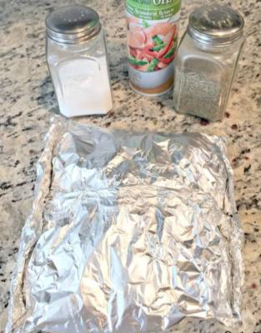
In a Pinch…
If you are in a last ditch effort to preserve your gear, and you simply don’t have any other options, place it inside two layers of zip lock freezer bags, then wrap it up like a tin foil dinner, 3-4 layers of aluminum foil with seams alternating sides and ends, with seams folded over multiple times. Then, dig a hole and bury it. This should give you a reasonable degree of faraday shielding around the gear while simultaneously grounding it; the plastic should help preserve it from moisture damage. Adding a little bit of salt or Epsom salts to the hole will help improve the grounding effectiveness.

Slide 55
Is my shielded enclosure going to work?
Quick rule of thumb, if there are no holes in the enclosure (No holes, no gaps in contact surfaces – even microscopic gaps) no slot antennae, and no cables passing through it, AND if all the surfaces are bonded together such that no part of the enclosure has more than 2.5mOhms of impedance to any other surface, and if the material is thick enough >0.010” and the whole thing is tied to a solid ground rod, then it should work!
Simple, huh?

Slide 56
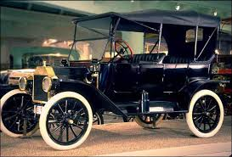
EMP “Proof” Vehicles
Antiques – Cars from the 1970s and earlier that have NOT been retrofitted with new ignition systems (they still use mechanical points and a distributor-- no electronic fuel injection)
Military Trucks:
Mechanically injected diesel engines (tractors and construction equipment from the 1990’s and older)
No electronic sensors on the transmission
Must have a spare Alternator / Generator inside a shielded enclosure as a spare
If other sensors or electronic engine governors are employed, have spares of those as well in a grounded/shielded enclosure.

Slide 57
Backups To Store
If you’d like a list of suggested backups to store:
Solar Charge Controllers
750 watt 12VDC inverter (enough for a fridge)
Radios, Batteries, battery chargers
Clock/Watch
Laptop + charger
Thumb Drives w/ Data (Important documents, photos, records, pictures of ID’s, deeds, etc)
Camera
Smart Phone / Tablet
Assorted electrical components (IC’s, Op Amps, Voltage Regulators, etc)
Alternator for a vehicle
Spare voltage regulator for your home utility generator
Amp – Clamp (AC/DC) and a Digital Volt Meter – Fluke or cheap disposable model; these are critical for diagnostics
LED Headlamp / Flashlight
Wherever possible, remove CMOS batteries just in case
If you have an extra large enclosure, consider adding these items as well
Large solar panels
Spare batteries, just in case
An entire generator
HAM radio repeater (even a simple cross band repeater radio)
What not to store in an EMC enclosure
Anything that is not electronic, including pets and people (unless they wear a pacemaker or implanted insulin pump, then maybe…)
Geo-Synch orbit is 20,000 miles up, but despite the difference, the blast wave, radiation belt, and EM Pulse mean that GPS navigation won’t work after a low orbit nuke pops. Satellite Phones and Satellite amateur radio stations won’t work either, so if you have dedicated hardware, it won’t work after a HEMP event.

Slide 58
In conclusion
The united states has played “Policemen to the world” for decades, and has made a LOT of enemies. News headlines make it very clear that our country is in very real danger.
It is possible to have backups of critical electronics protected for as little as a few hundred dollars
If the time comes that we experience our own banking restrictions, or a global collapse of banking all together (which foreign countries would consider an act of economic-war by the USA, since we trashed the US dollar--the world’s reserve currency, and a global collapse could be accurately ascribed as the USA’s fault) then it would be wise to pack away backup communications and electronics gear. If an attack does happen, give it a few weeks before unpacking in case there are multiple strikes, then break out those backups and re-establish communications--that’s what separates civilization from anarchy.

Slide 59
Print and Internet Sources
Books you should read:
77 Days in September
One Second After
Patriots: A guide to surviving the coming collapse
EMI Troubleshooting Techniques. Michel Mardiguian, ISBN:-13: 978-0-07-134418-0
The Technician’s EMI Handbook. Joseph J. Carr, ISBN:0-7506-7233-1
MIL-STD-461E
MIL-STD-464A
http://www.murata.com/emc/knowhow/pdfs/te04ea-1/26to28e.pdf
http://en.wikipedia.org/wiki/Near_and_far_field
http://hyperphysics.phy-astr.gsu.edu/hbase/HFrame.html
http://www.businessinsider.com/photos-of-russian-abandoned-space-shuttles-by-ralph-mirebs-2015-6

Slide 60
Food for (Artificially Intelligent) thought
AI represents a very real threat to individual liberty. It is absurd to suppose that all AI systems will have entirely benign intentions, when these systems are created by avaricious people, and controlled by avaricious companies and governments. We have already seen how facebook, google, and other data mining systems create personality profiles of every unique user of their services in order to sell “targeted marketing”. That’s how companies like facebook and google make a lot of money, by collecting and selling data about you that you may have no idea is being collected. Once AI comes online fully, it will have decades of data to mine, creating very detailed personality profiles of every person on earth who directly or indirectly use those services. Such a system could easily be configured to determine the most effective way to apply leverage to any person on earth. This would grant unprecedented power, and remove any last semblance of individual liberty. Couple that with the inevitability of Human Implanted RFID Identity Chips, and your entire life can be tracked and controlled. I don’t believe this will be compatible with the divine plan in effect for this country. I fully expect great destruction will take place before the full realization of AI, currently speculated to take place by 2040 (named the “Singularity” by experts).
As a side note, a recent clear example gives us an idea of what the future of AI will tend to be: “Androids are being developed that have an uncanny resemblance to people. A pinnacle example is an android crafted by roboticist David Hanson that resembles the famous and deceased science fiction writer Philip K. Dick. What makes android Dick so remarkable isn’t so much his appearance as it is his ability to hold an intelligent conversation. The creators of android Dick uploaded the deceased author’s work onto the android’s software, as well as conversations with other writers. If the android was asked a question that had been posed to the real Dick, the robot would answer the question as Dick would. The robot was also able to answer a series of complex questions. If the robot was asked a question that it was unfamiliar with, its software would attempt to answer the question using what is called “latent semantic analysis.”⁽¹⁾
Android Dick in conversation
Android Dick’s speaking abilities were put to the test in an interview with a reporter from PBS NOVA. Android Dick’s brain is comprised of a tapestry of wires that are connected to a laptop. As the conversation proceeded, Philip’s facial recognition software kept track of the reporter’s face. In addition, speech recognition software transcribed and sent the reporter’s words to a database in order to assemble a response. The questions posed to Dick were by no means trivial. When the reporter asked if the android could think, it responded, “A lot of humans ask me if I can make choices or if everything I do is programmed. The best way I can respond to that is to say that everything, humans, animals and robots, do is programmed to a degree.” Some of the androids responses were pre-programmed, whereas others were assembled from the internet.⁽²⁾ Dick continued, “As technology improves, it is anticipated that I will be able to integrate new words that I hear online and in real time. I may not get everything right, say the wrong thing, and sometimes may not know what to say, but everyday I make progress. Pretty remarkable, huh?”⁽²⁾
Android Dick seemed to exhibit a primitive form of both intelligence and emotion when the robot was asked, “Do you believe robots will take over the world?” Android Dick responded: “Jeez, dude. You all have the big questions cooking today. But you’re my friend, and I’ll remember my friends, and I’ll be good to you. So don’t worry, even if I evolve into Terminator, I’ll still be nice to you. I’ll keep you warm and safe in my people zoo, where I can watch you for ol’ times sake.”⁽²⁾ Aaaaw, he’ll keep humans cozy in his people zoo. Isn’t that nice of android Dick?
The Three Laws of Robotics (often shortened to The Three Laws or also known as Asimov's Laws) are a set of rules devised by the science fiction author Isaac Asimov. The rules were introduced in his 1942 short story "Runaround“. It would be nice if we could guarantee that all AI systems would operate with a set of guiding principles like these, but that is certainly not possible. The Three Laws (He later appended a zeroth law), quoted as being from the "Handbook of Robotics, 56th Edition, 2058 A.D.", are:
0. A robot may not harm humanity, or, by inaction, allow humanity to come to harm.
1. A robot may not injure a human being or, through inaction, allow a human being to come to harm.
2. A robot must obey the orders given it by human beings except where such orders would conflict with the Zeroth and First Law.
3. A robot must protect its own existence as long as such protection does not conflict with the Zeroth, First or Second Laws.^{[1]}
Clearly without these kinds of restraints, and clearly even with them, loopholes exist that could lead to catastrophic outcomes.

