Slide 1
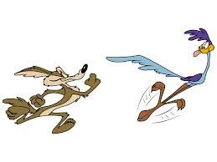
Moab 240 Endurance Run COMMUNICATIONS
Edward Jones N7RTG ALL RIGHTS RESERVED 2020.11.11

Slide 2
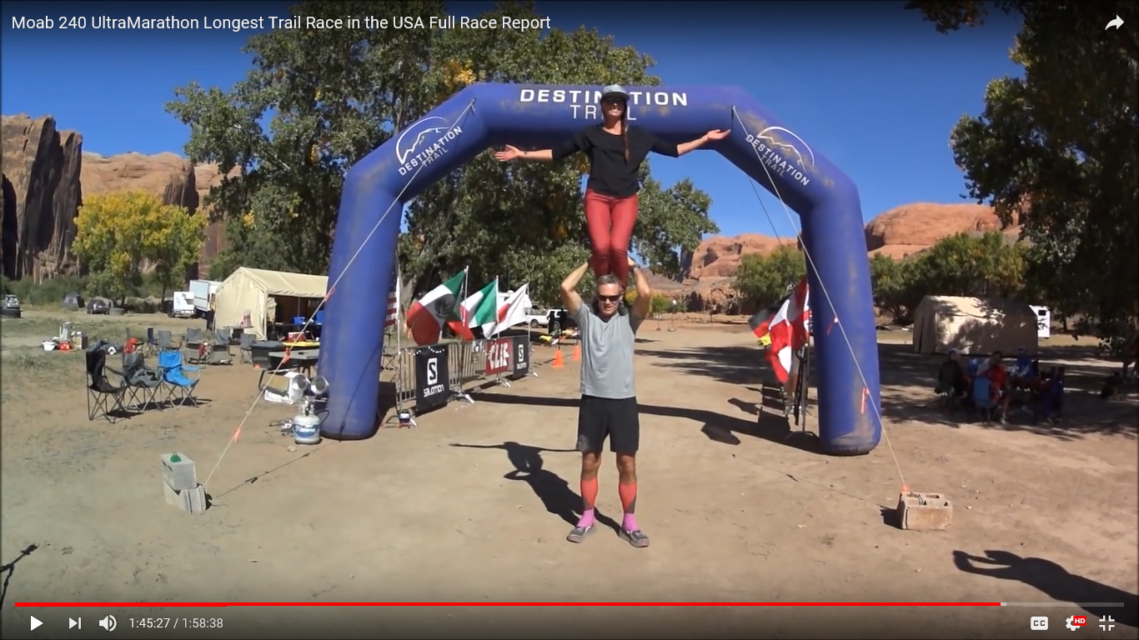
FINISH-END-FINI-73
CANDICE BURT, RACE DIRECTOR
DESTINATION TRAILS

Slide 3
2020 COVID 19 REQUIRED MANY CHANGES
RUNNERS AND STAFF WORE MASKS WHEN GROUPED
HAMS WORE MASKS WHEN NEAR OTHERS
ENHANCED SANITATION AT AID STATIONS
PERMITS REDUCED FROM 250 TO 200

Slide 4
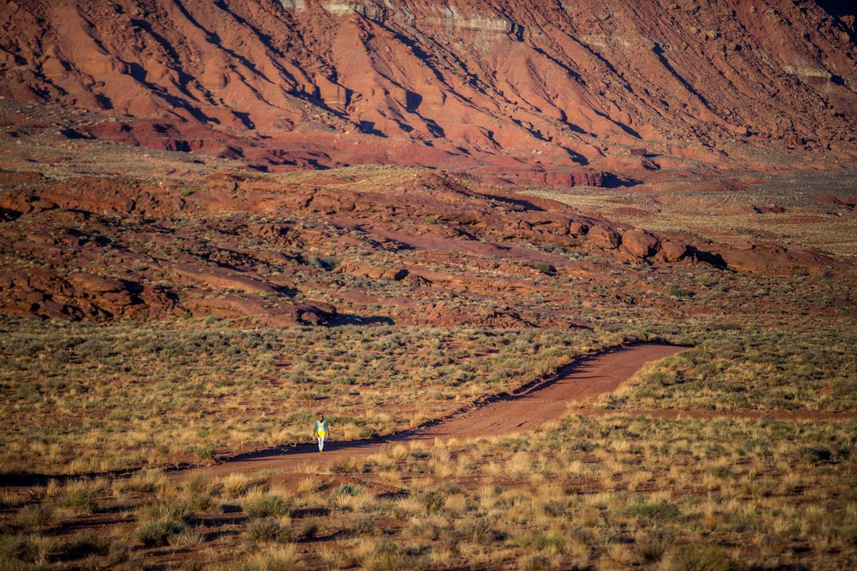
Moab 240 Endurance Run First Run October 2017
Colorado River-West canyons-Abajo Mountains-LaSal Mountains-to start
238.3 miles with 29,467 ft. total ascent and descent
112 hours cutoff time
Sleep permitted but clock continues to run
Notes:
Not a traditional competitive race. Runners help each other.

Slide 5
Moab 240 Endurance Run
First run in October 2017.
250 Permits
121 registered, 98 finished
200 permits available in 2020
All sold out in first 3 days
127 finished
Notes:
Not a traditional competitive race. Runners help each other.

Slide 6
Record Set in 2017
Courtney Dauwalter, 33,
Golden CO teacher
57 hours - 10 hours ahead of second
Record stands in the 4 th year.

Slide 7
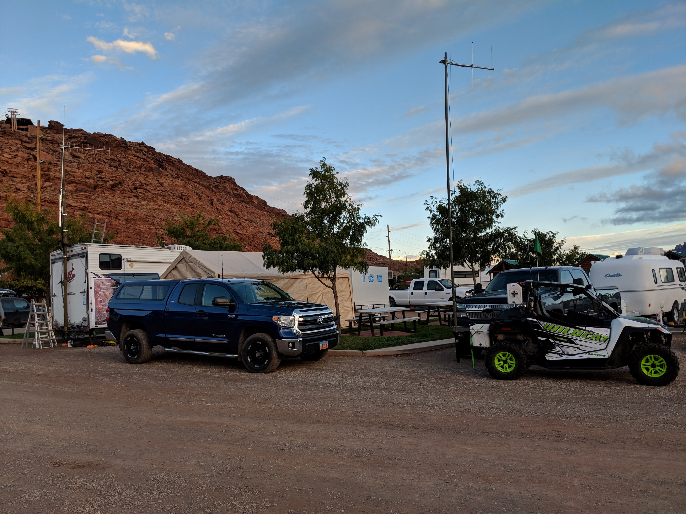
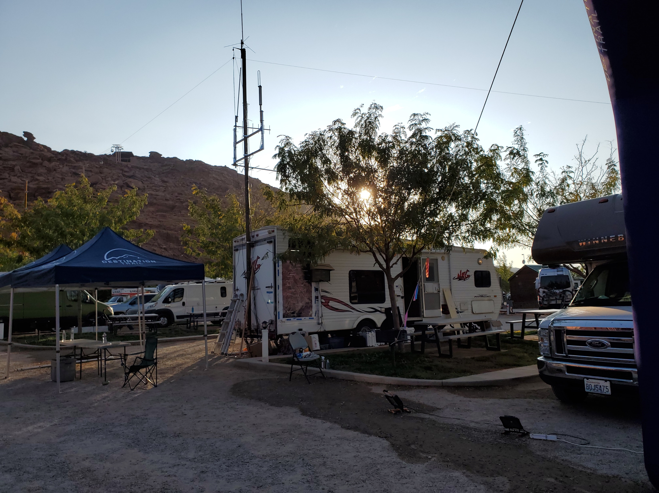
2020 Net Control
UHF to Repeater
VHF Simplex Talkaround
VHF Skyline/Sinbad Repeater System
HF for Testing
2 Meter Single Sideband for Testing
WiFi Internet
2018 NET CONTROL

Slide 8
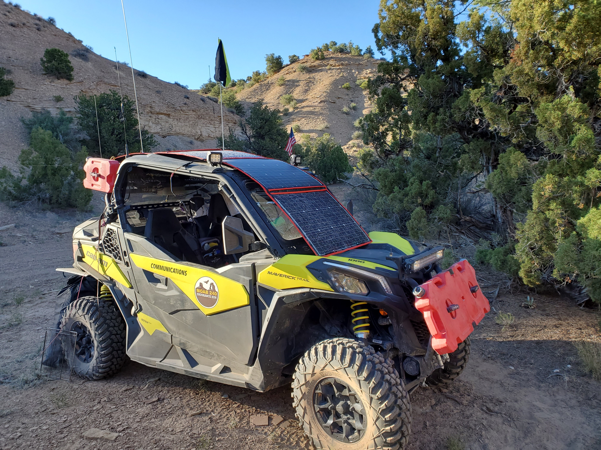
BACKUP RADIO SYSTEM TO FILL IN FOR ANY STATION

Slide 9
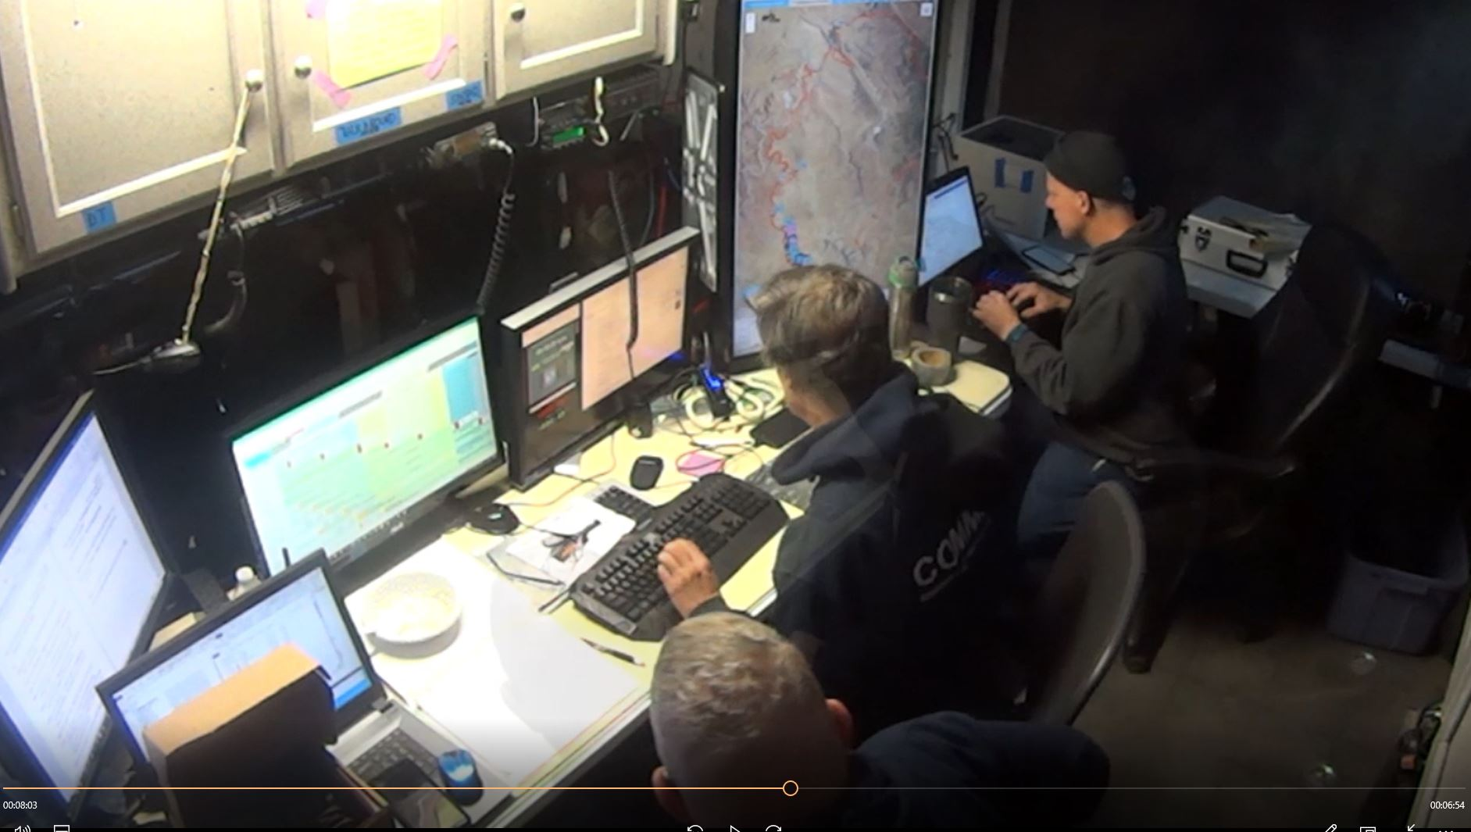
Ham Radio Operators
22 Hams
14 Aid Stations
5.5 hours to 56 hours
4 at Net Control
~10 new Hams

Slide 10
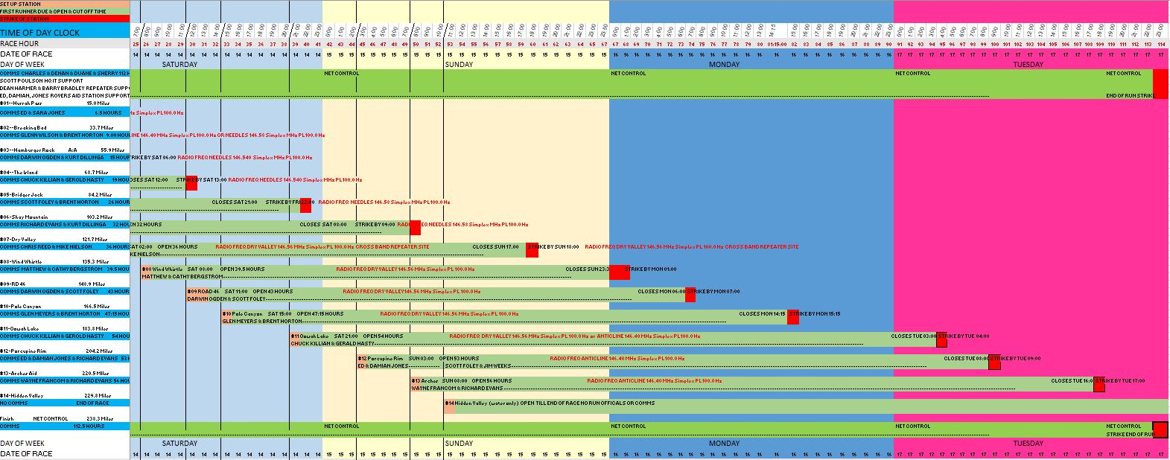
Scheduled to Fit Ham’s Availability
Some Hams worked partial day – Others 5+ days
All were needed and appreciated.

Slide 11
Search and Rescue from Ham Team KA7OLB

Slide 12
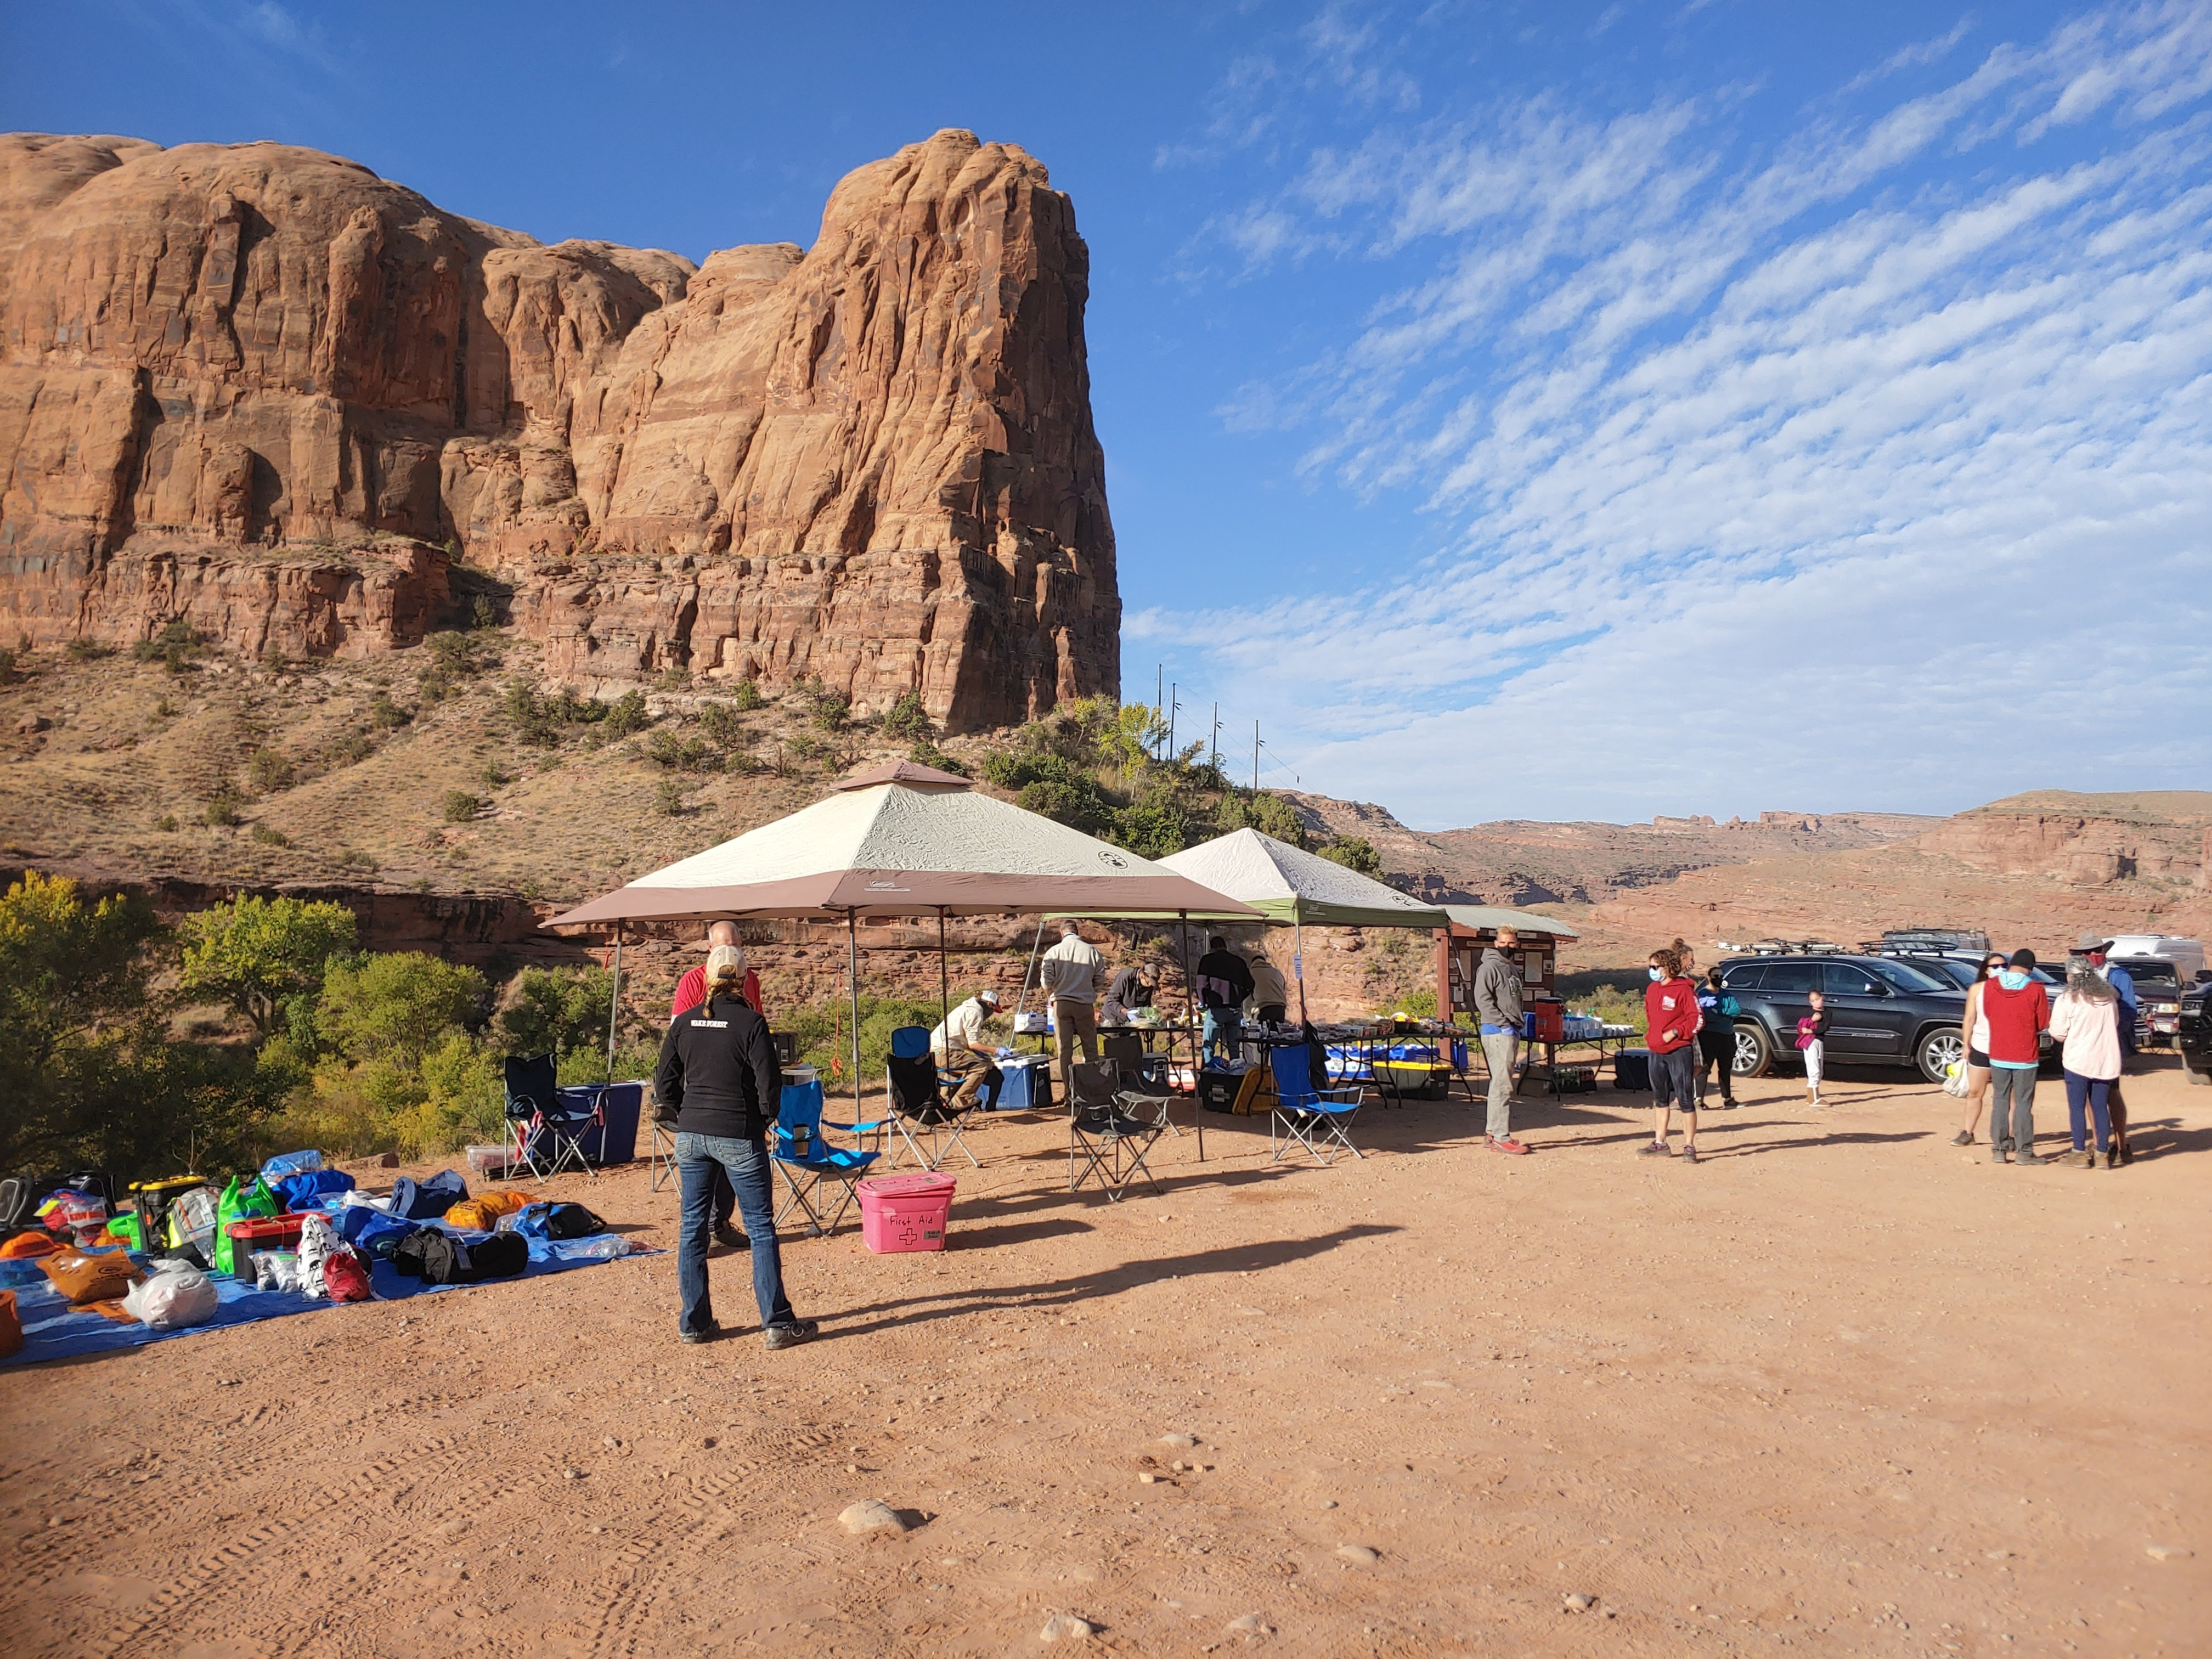
Aid Stations
Food, water, snacks, pickle juice, energy food,
Sleep stations – clock keeps running
Notes:
Some runners have learned to sleep while running

Slide 13
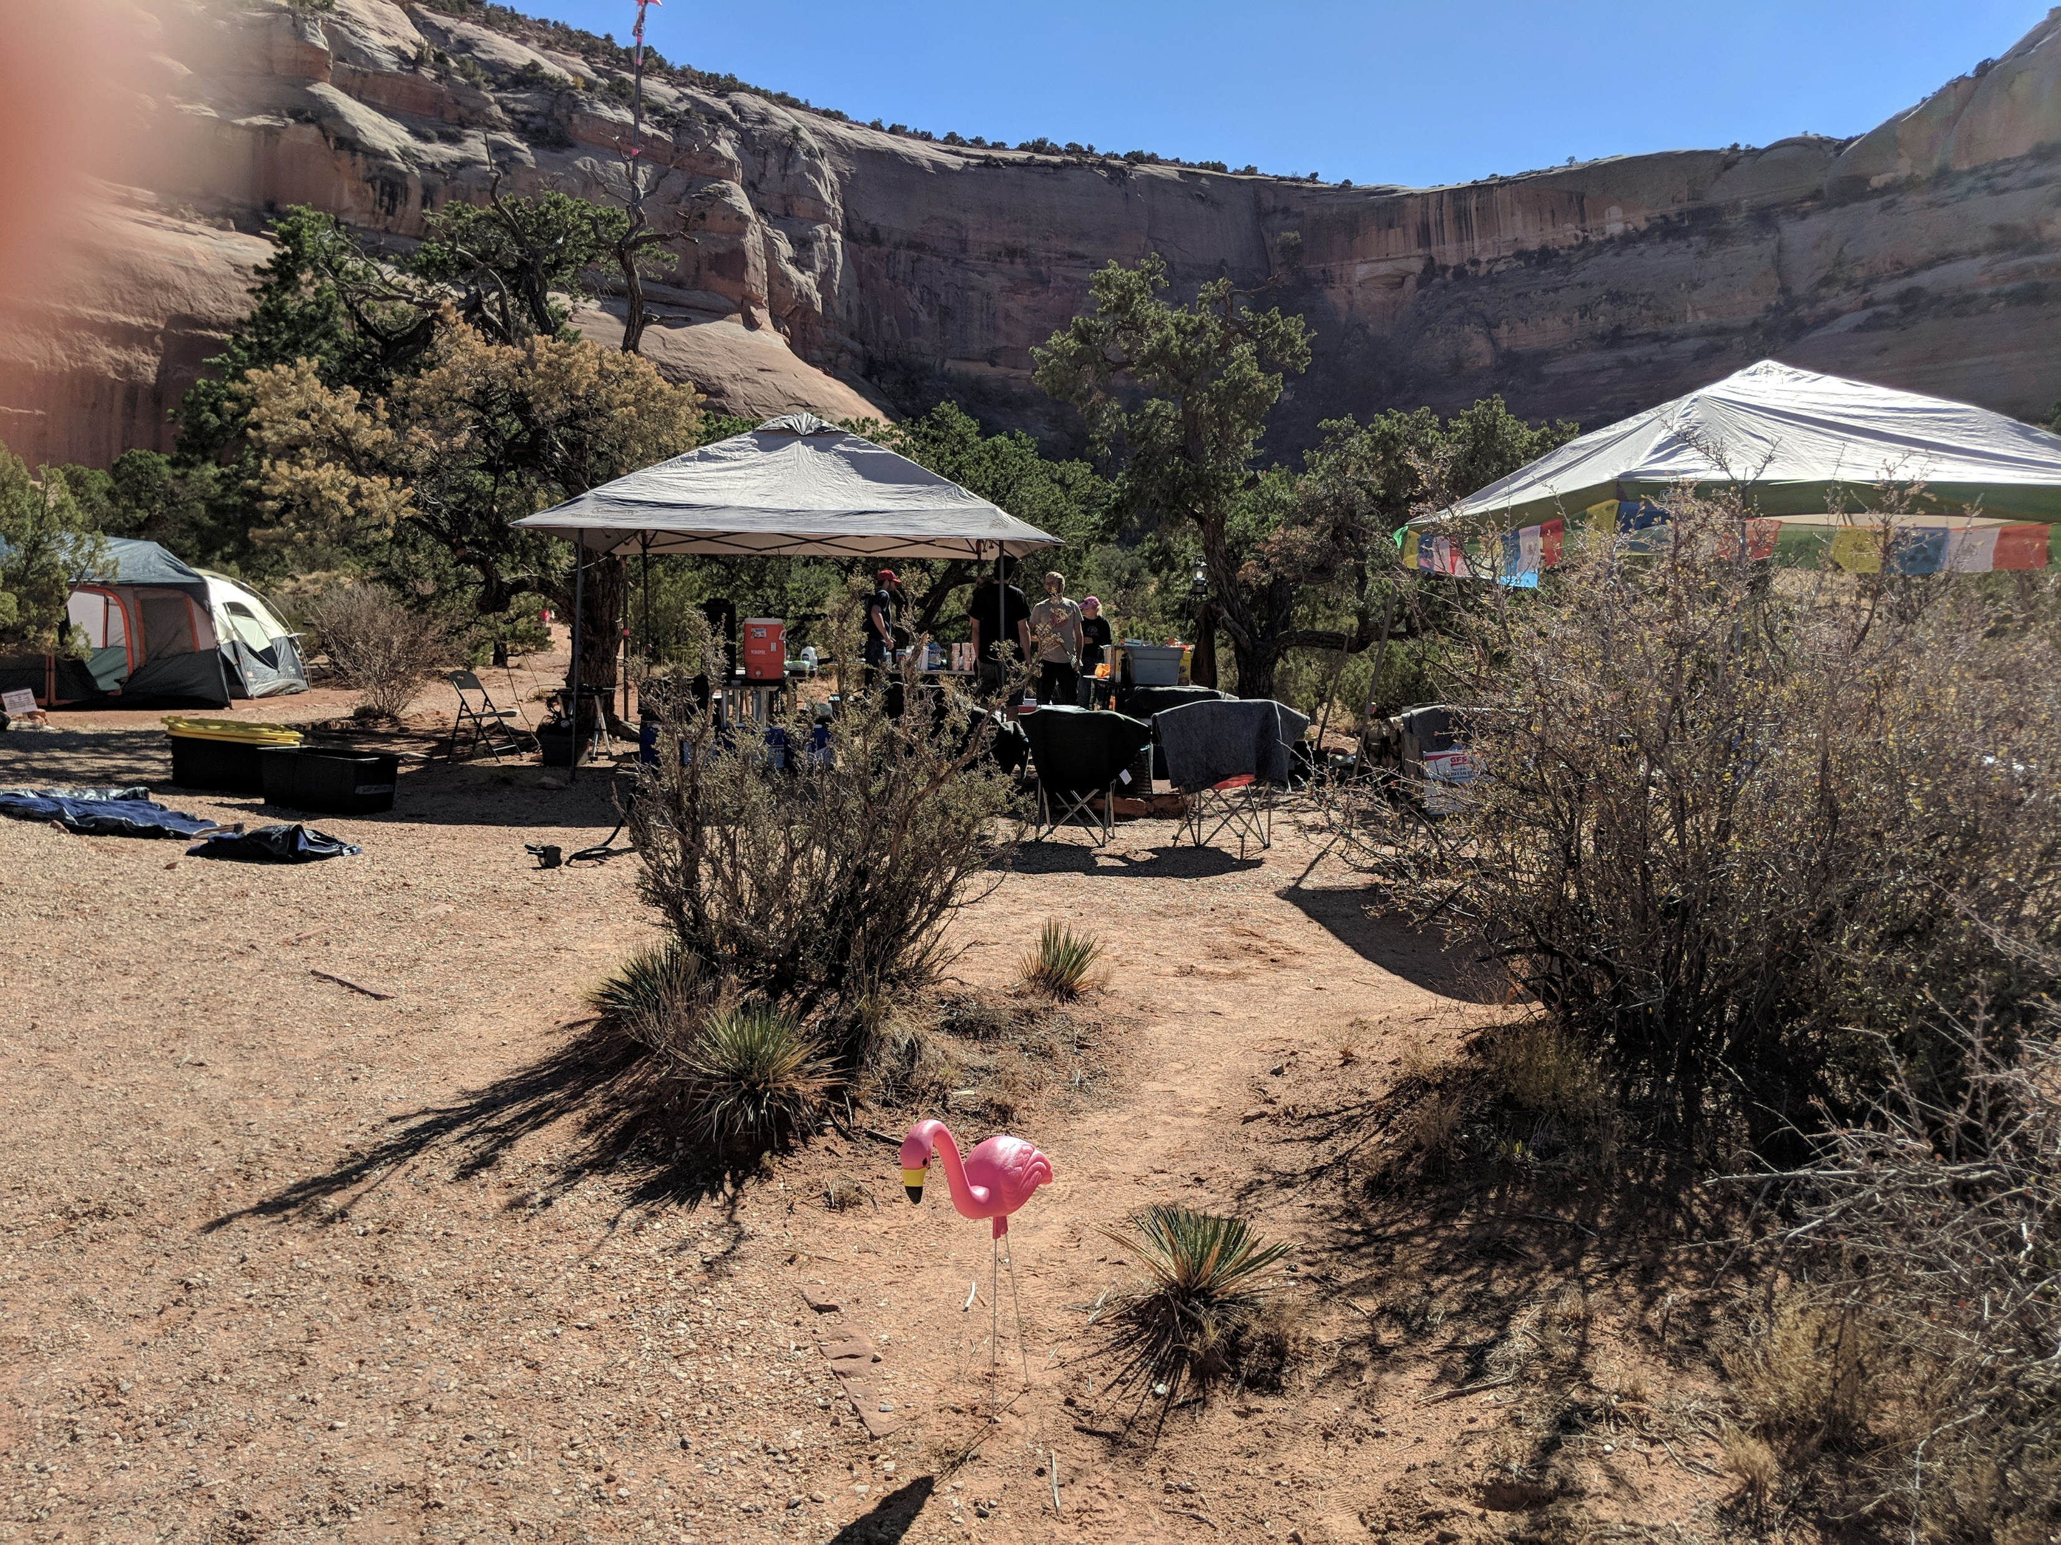
Some stations have a theme. Wind Whistle’s was pink flamingoes.

Slide 14
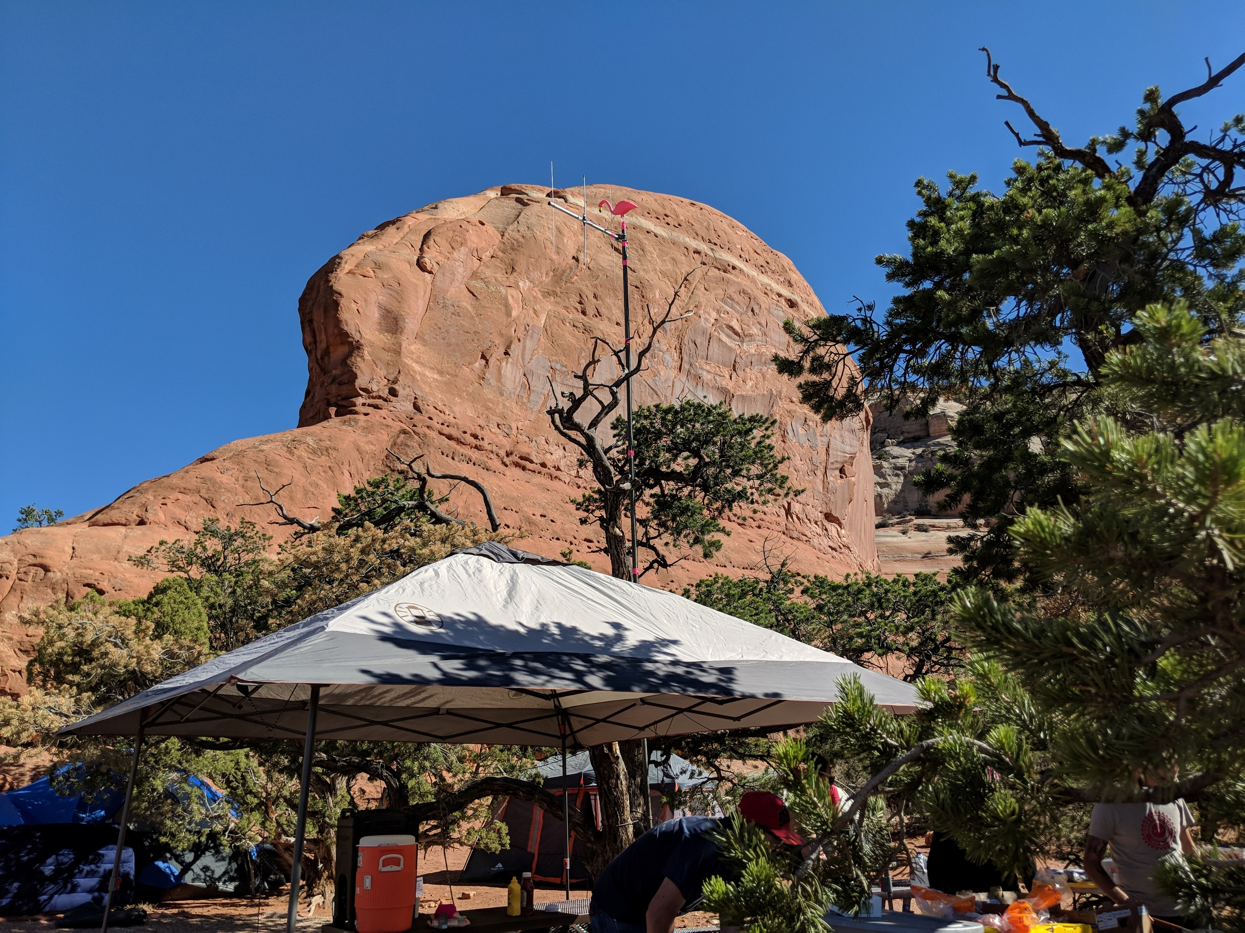
We set up the radio at Wind Whistle and there was a loose connection that persisted after several re-assemblies.
The captain suggested a pink flamingo
might help.

Slide 15
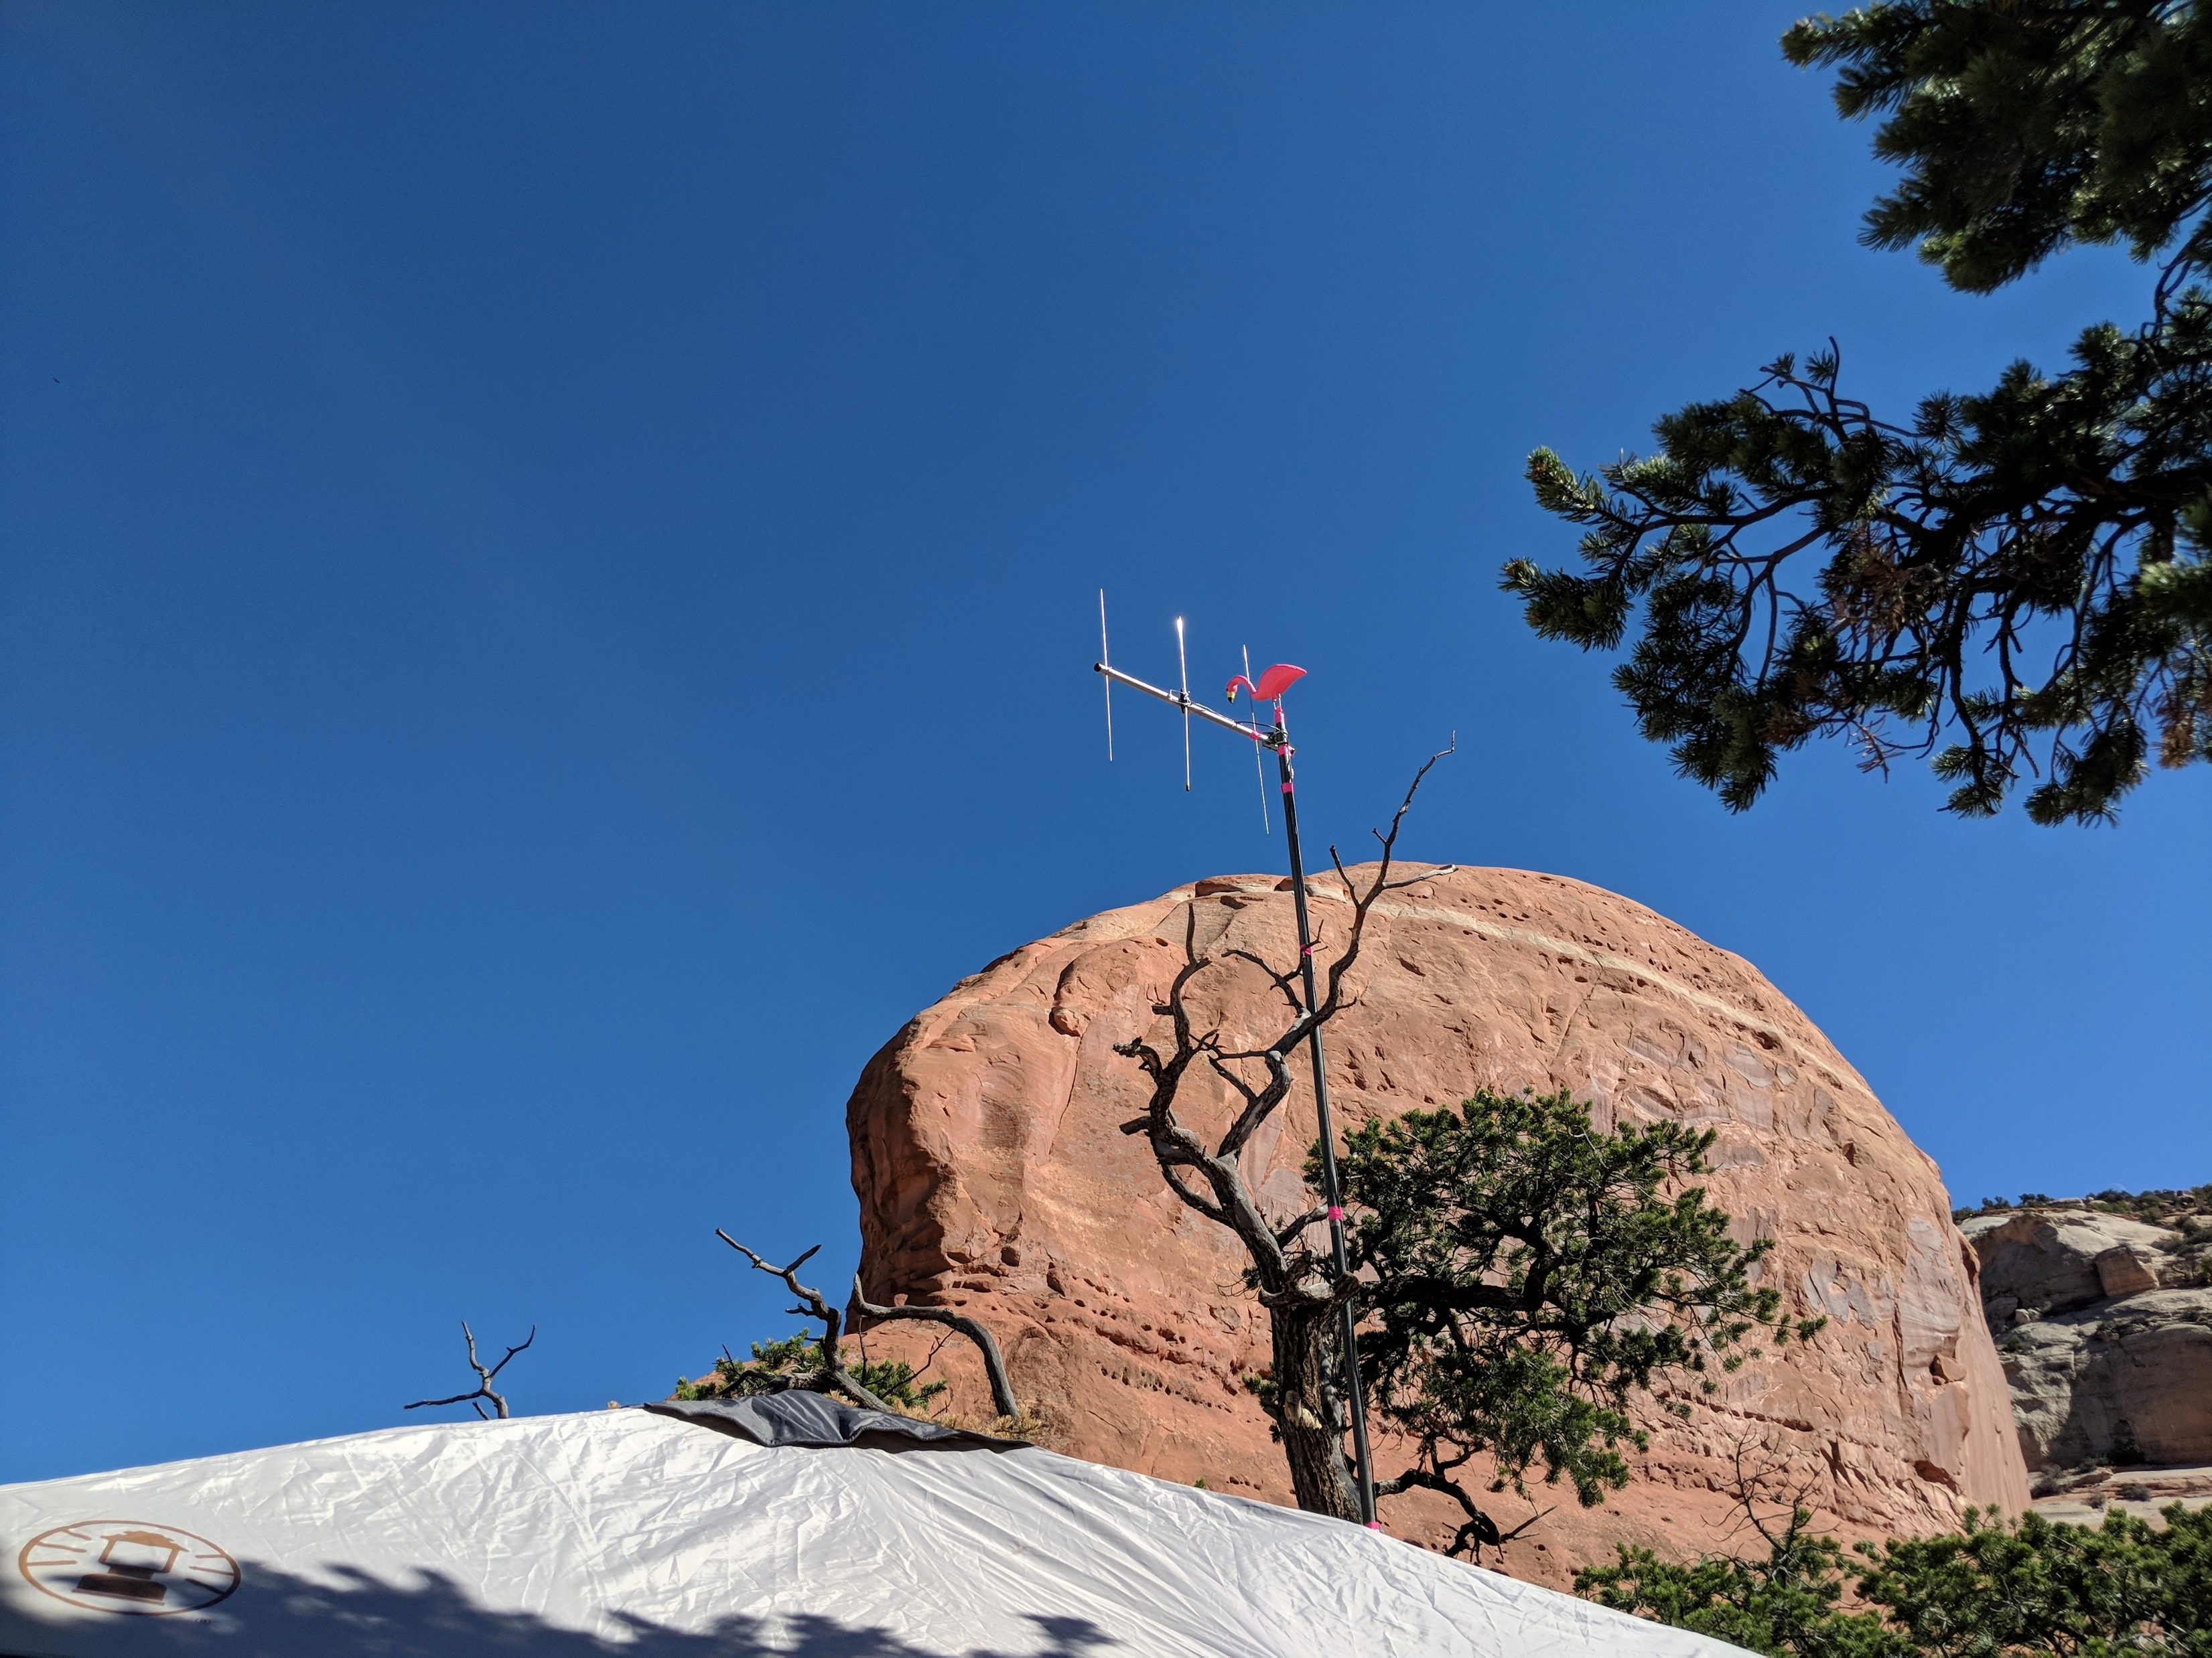
The flamingo fixed it!

Slide 16
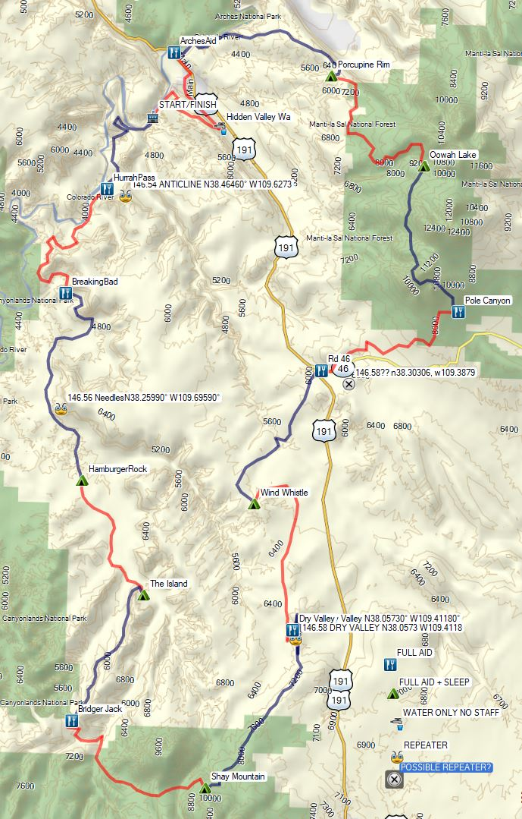
START/FINISH
NET CONTROL
REPEATERS
`
AID STATIONS

Slide 17
AID STATIONS
AID STATIONS
146.58
SIMPLEX
NEEDLES
CROSSBAND
447.30 MHz
ANTICLINE
REMOTE BASE
146.54
SIMPLEX
442.30 MHz
447.30 MHz
442.30 MHz
NET CONTROL

Slide 18
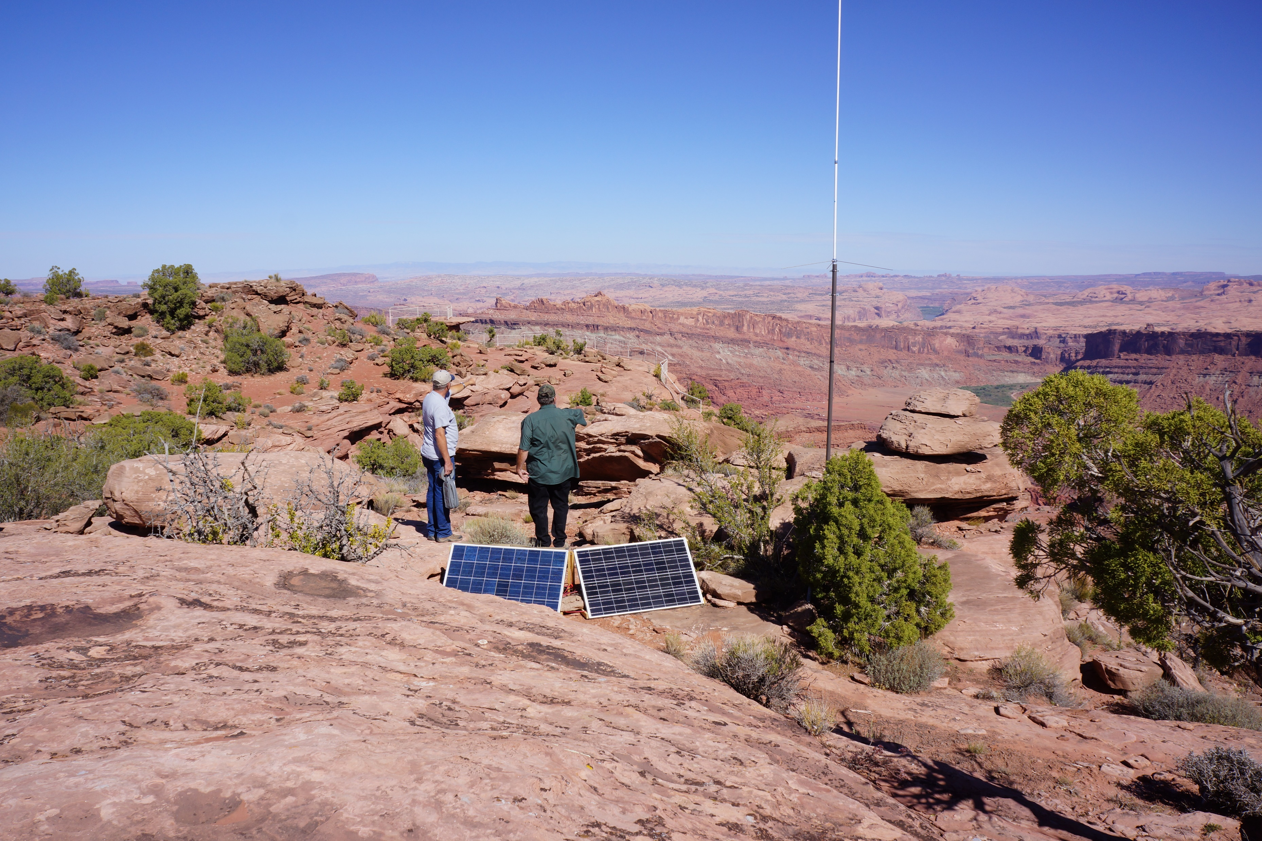
REPEATER ENGINEERS
DEAN W7DHH & BARRY BRADLEY KB7K
AT
ANTICLINE LOOKOUT SITE

Slide 19
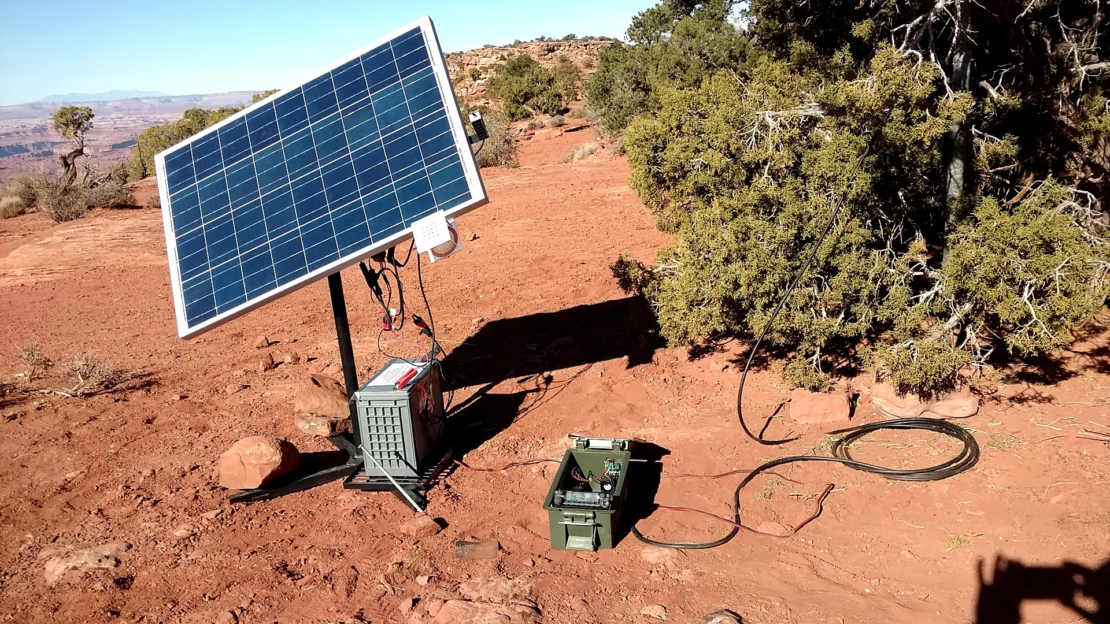
NEEDLES REPEATER

Slide 20
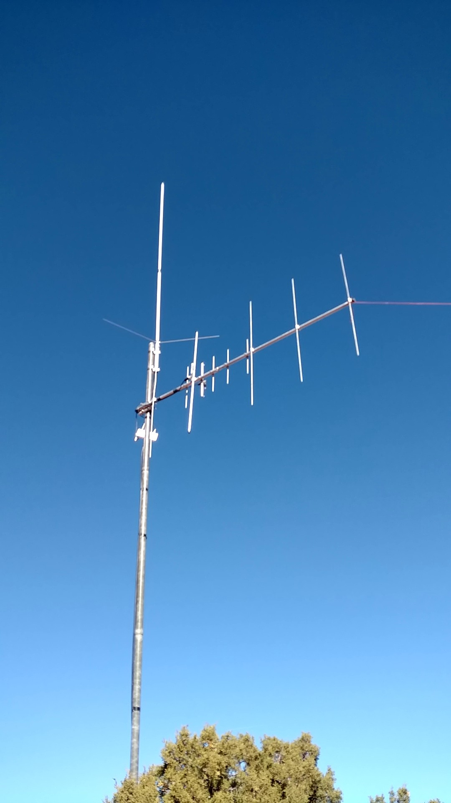
NEEDLES REPEATER

Slide 21
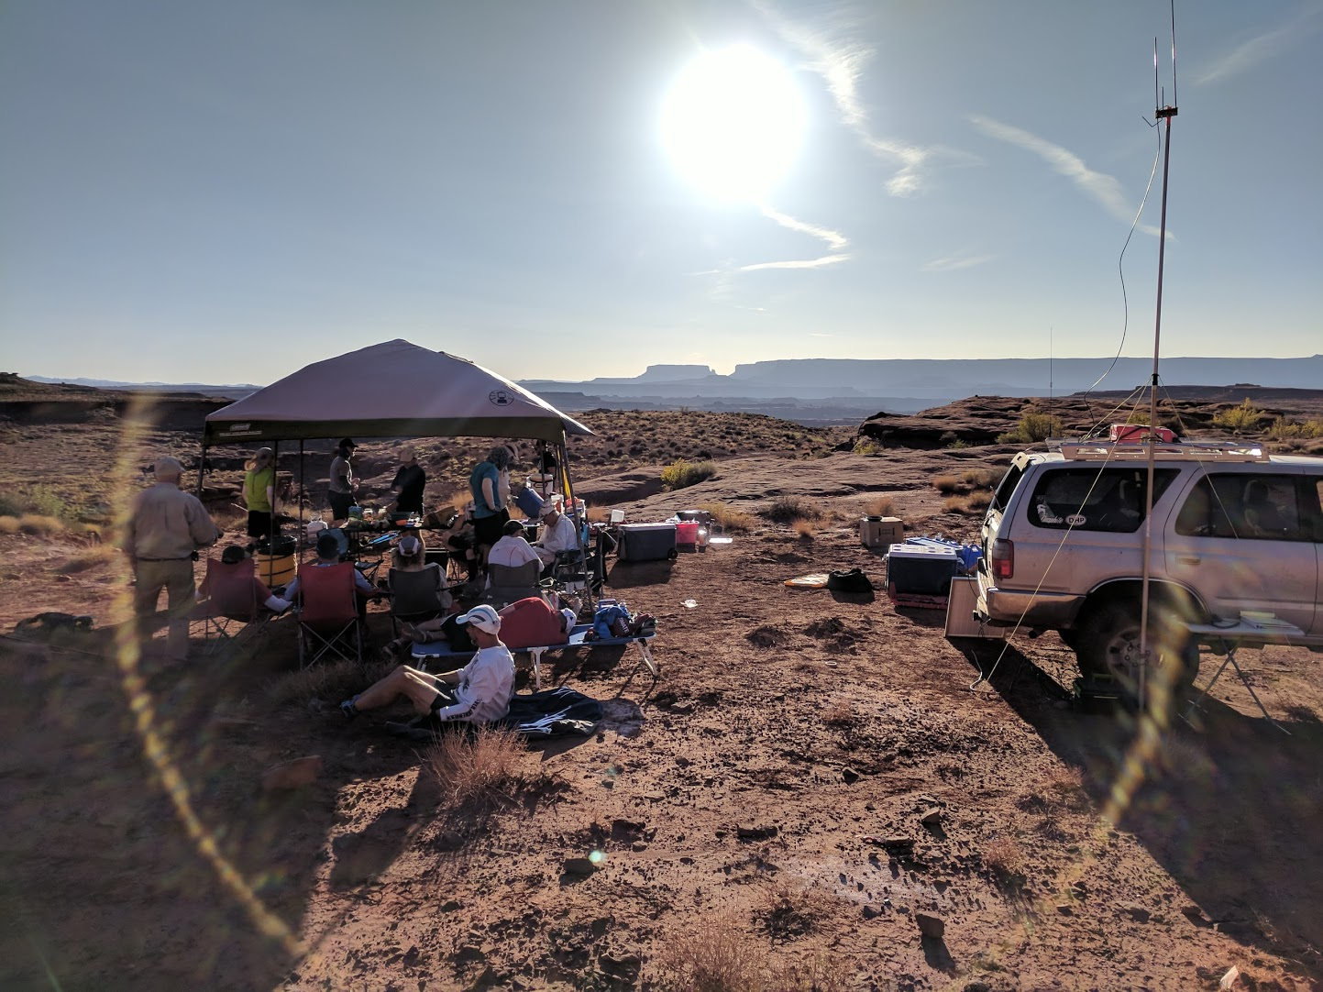

Slide 22
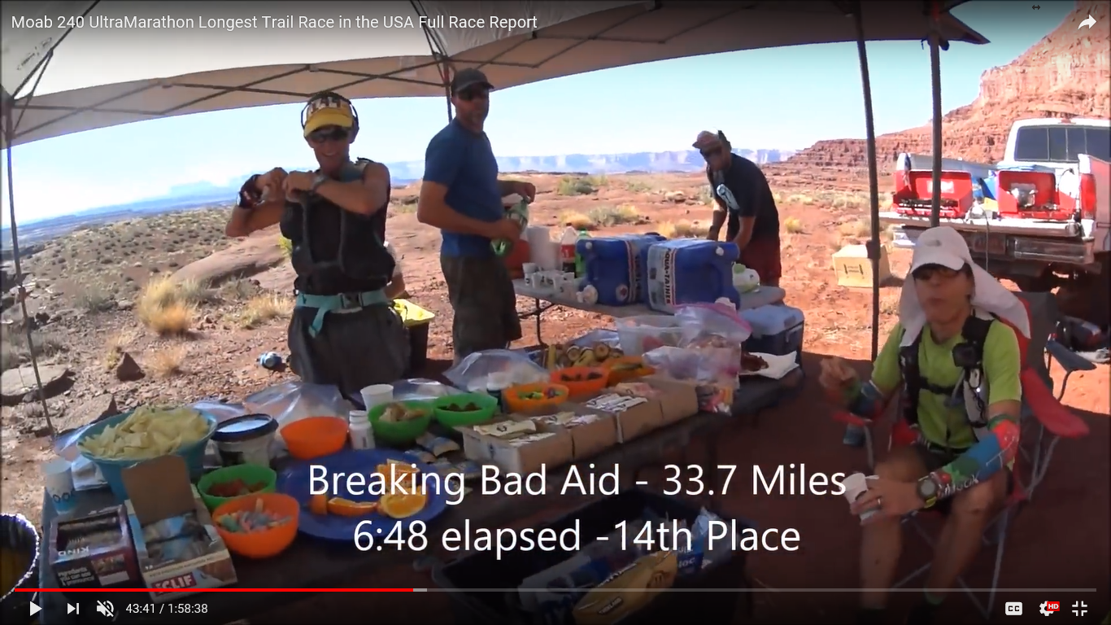

Slide 23
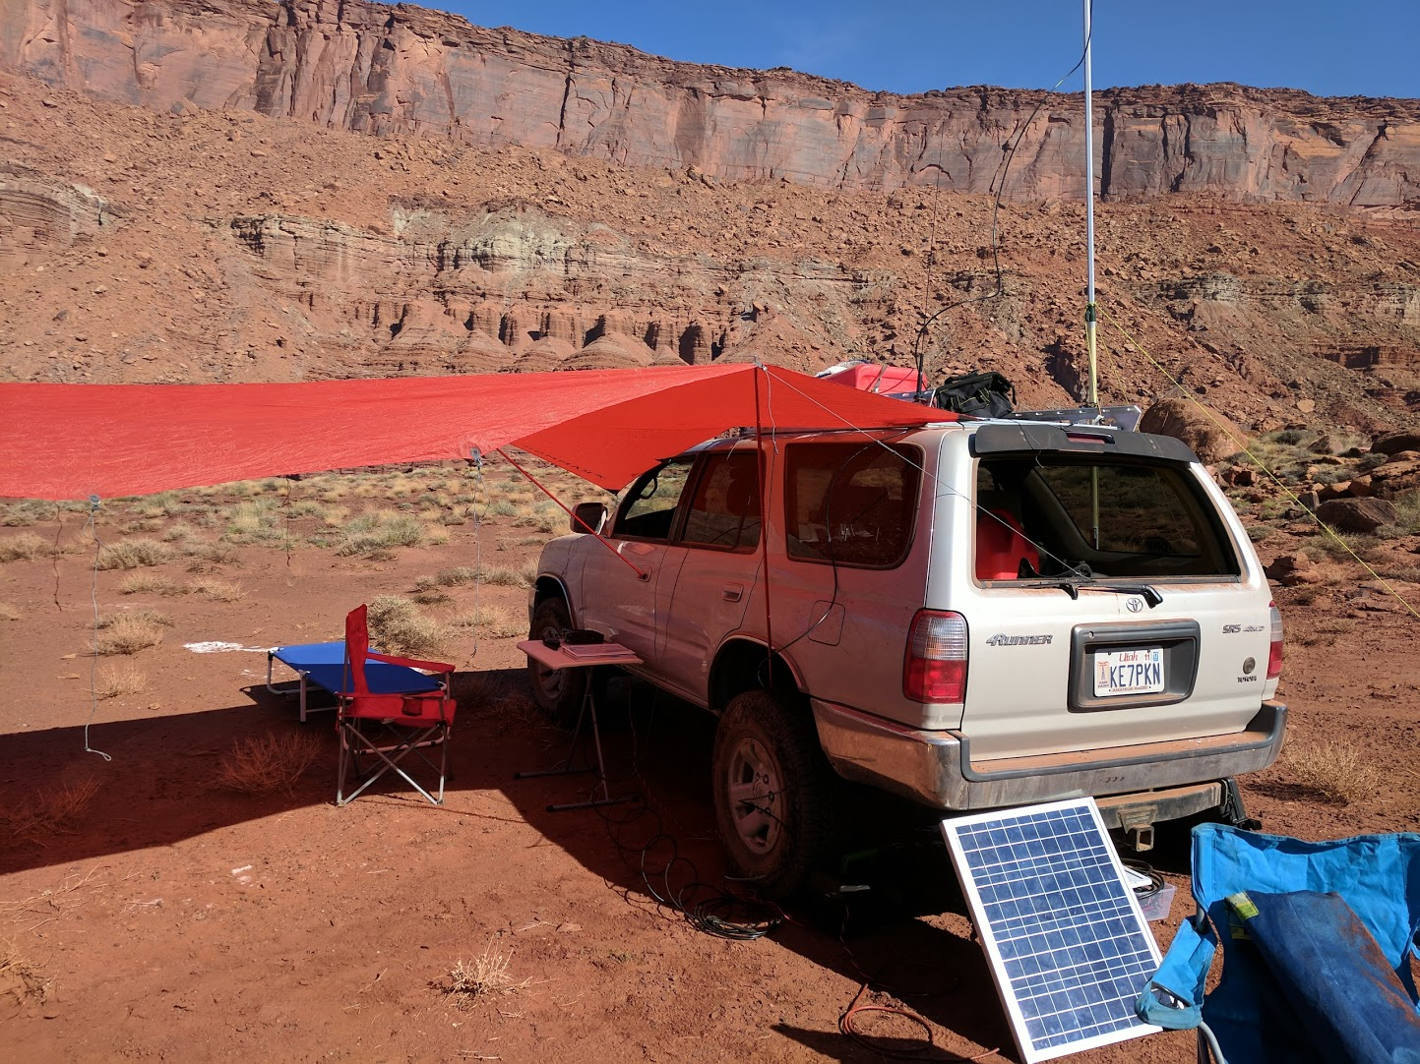

Slide 24
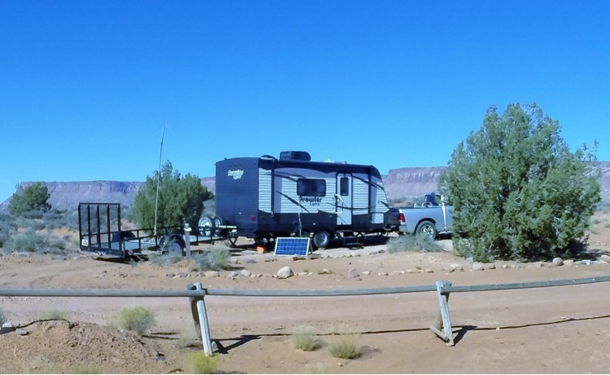
Hamburger Rock

Slide 25
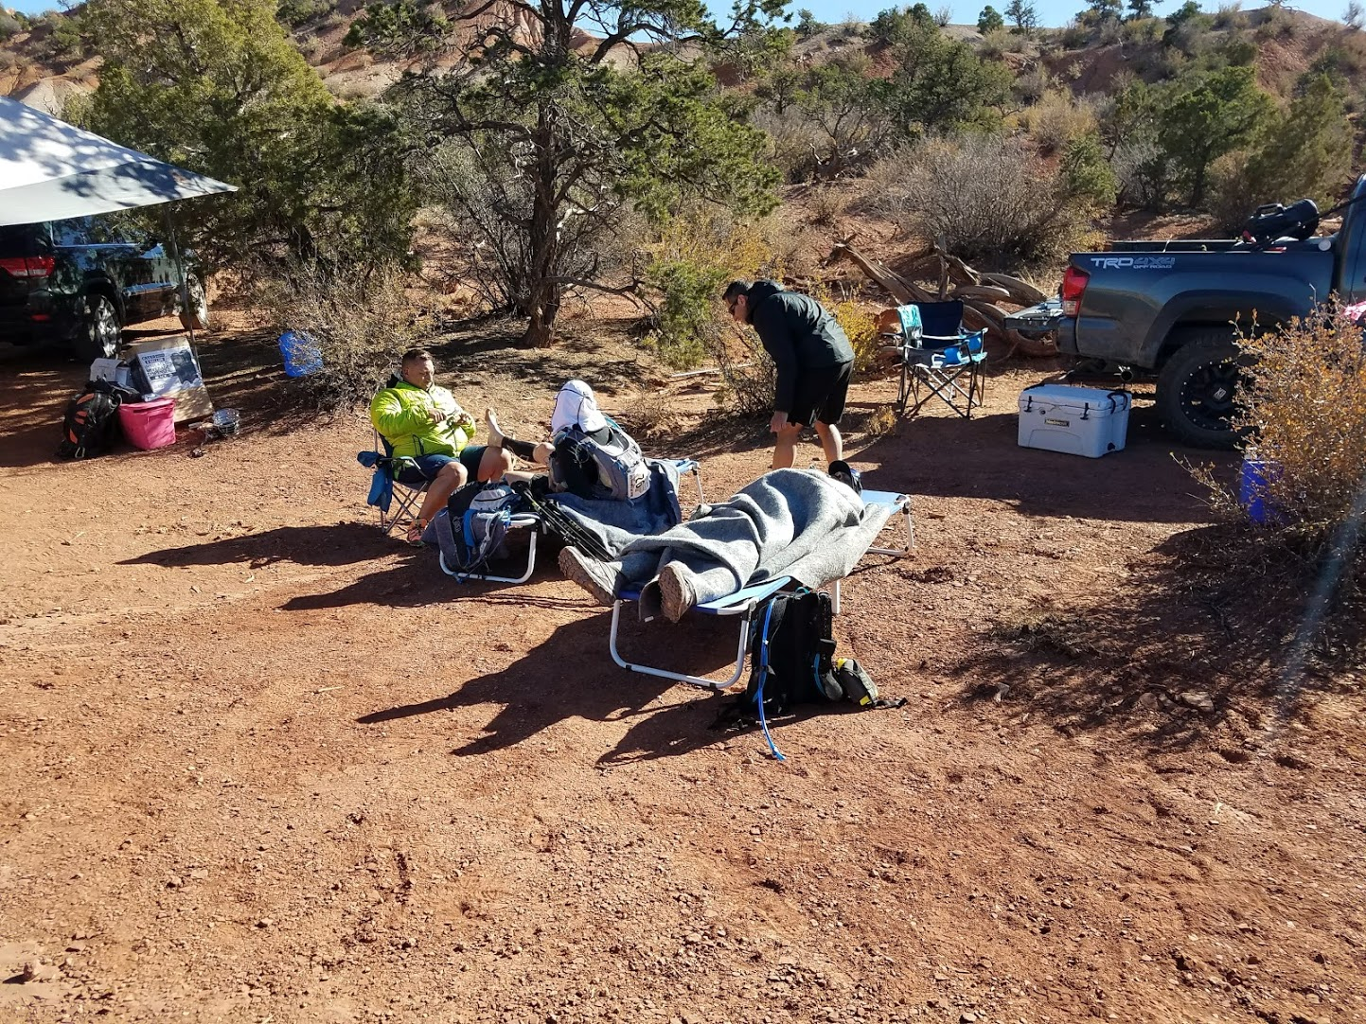
Bridger Jack
Sleep Station

Slide 26
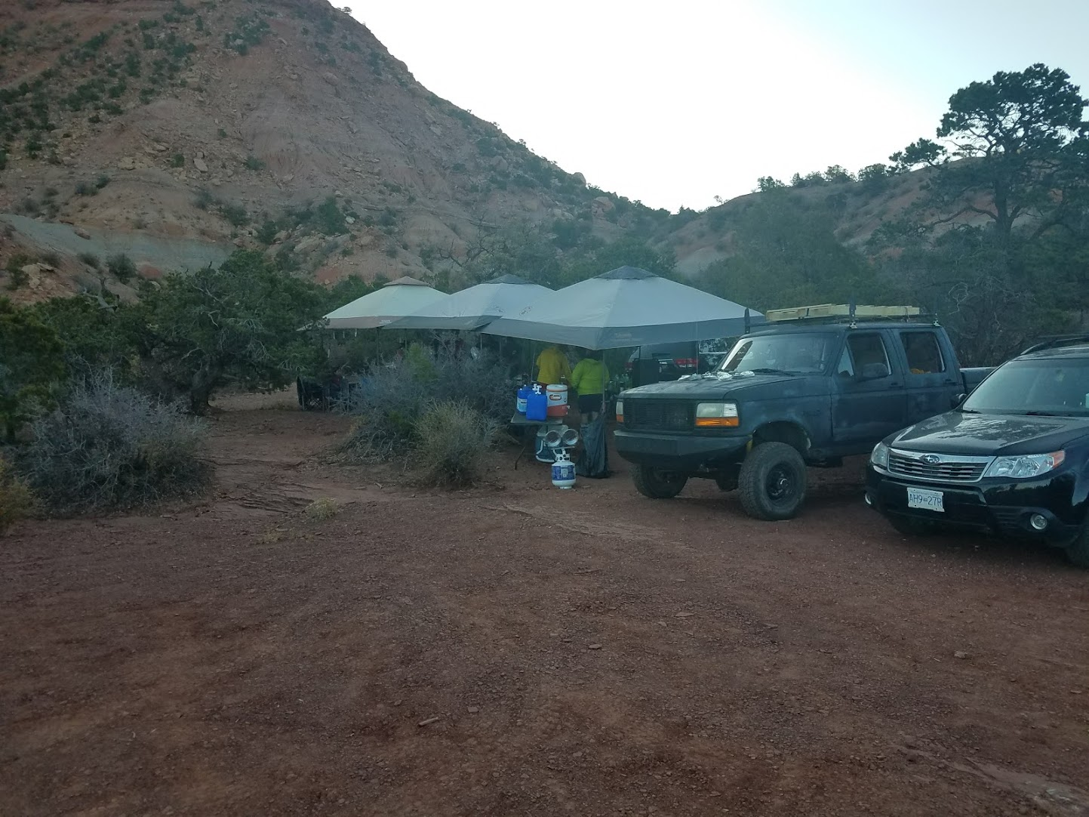

Slide 27
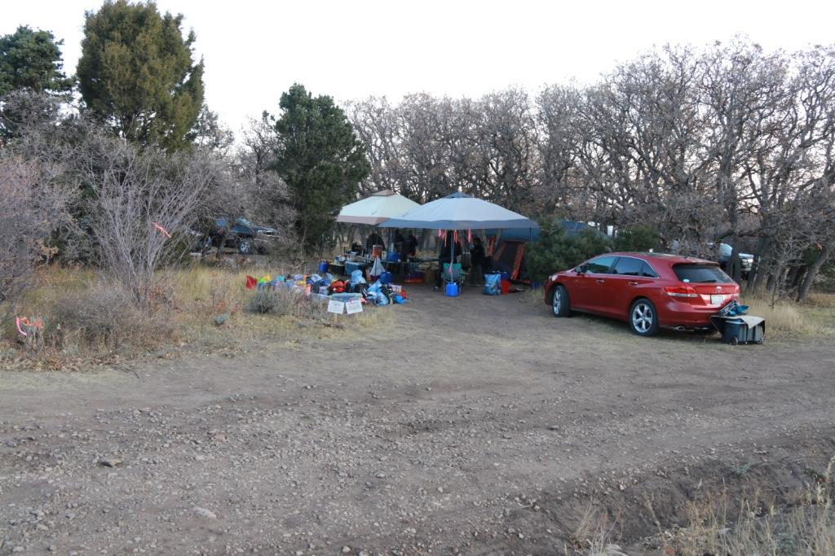
Shay Mountain
Abajo Mountains-Just North of Monticello

Slide 28
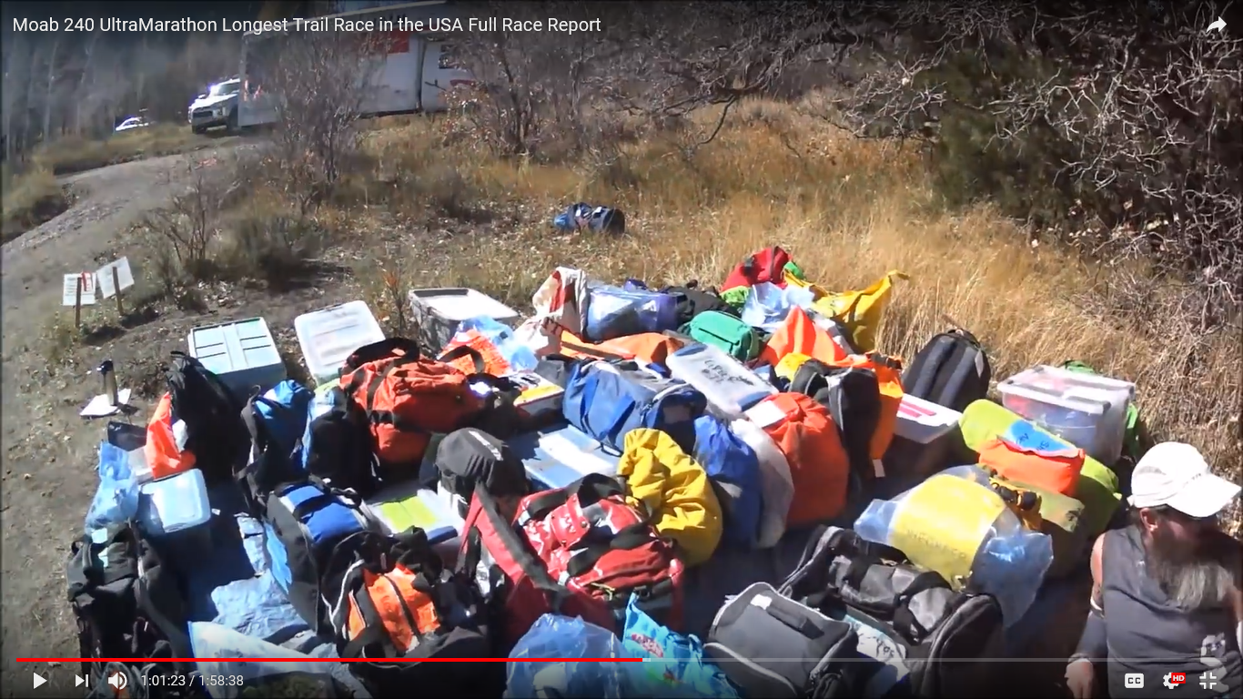
Typical Drop Bags
Shay Mountain

Slide 29
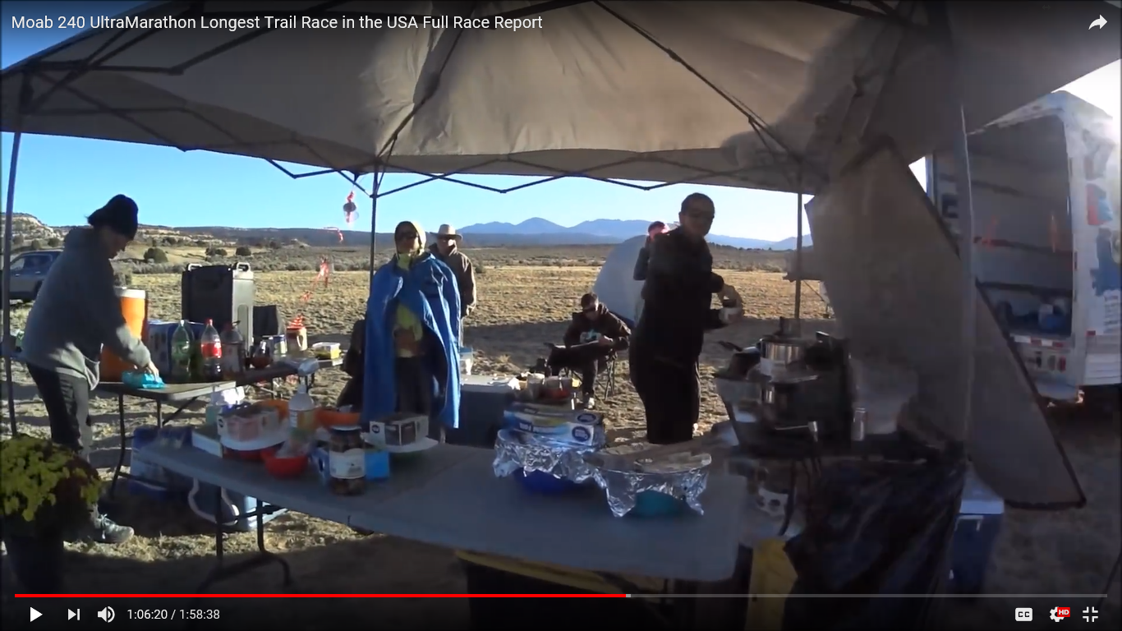

Slide 30
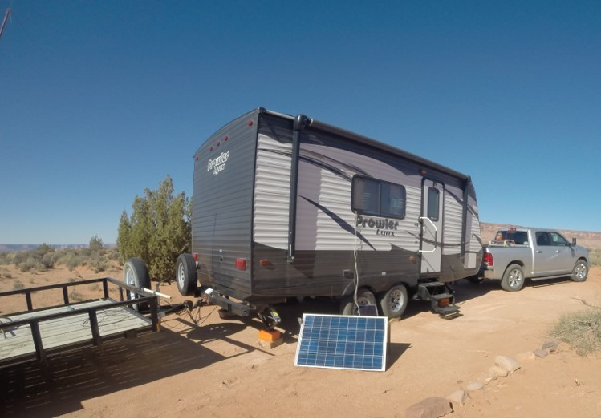
Road 46

Slide 31
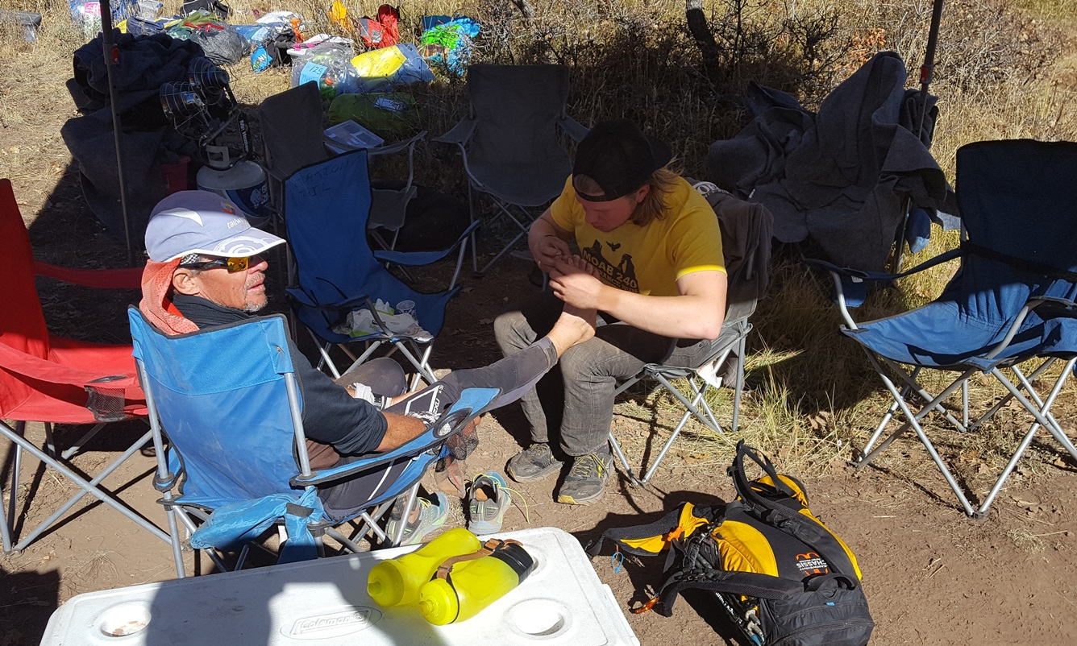

Slide 32
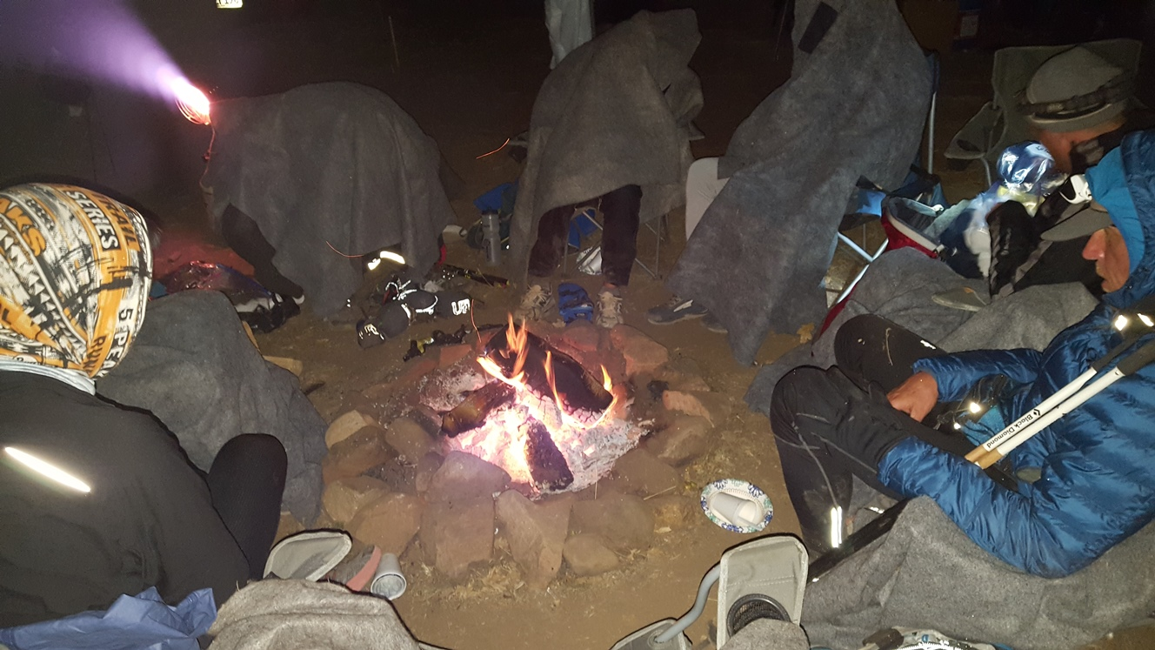

Slide 33
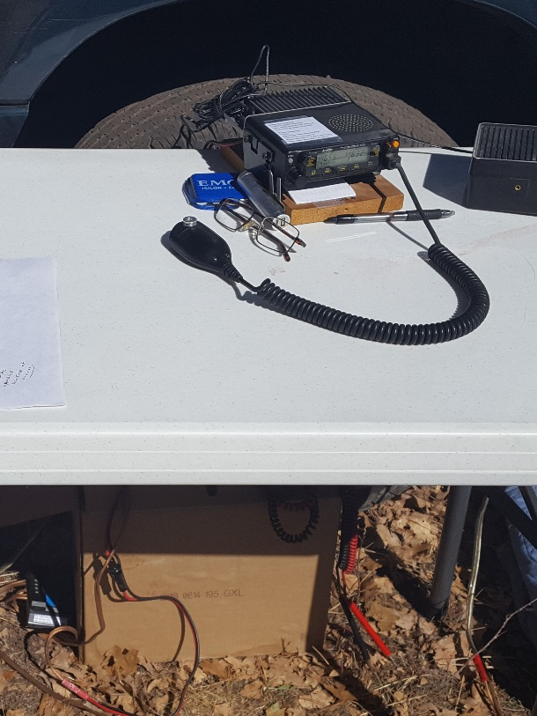
SOME STATIONS WERE QUITE SIMPLE

Slide 34
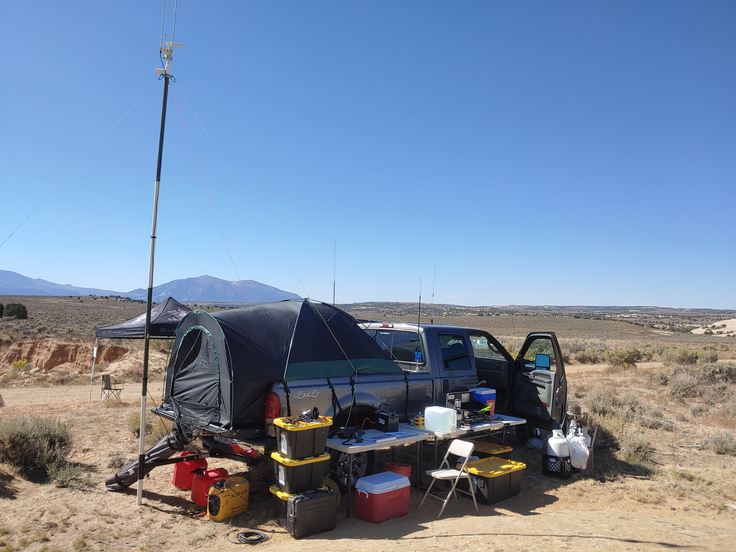
OTHER STATIONS REQUIRED MORE

Slide 35
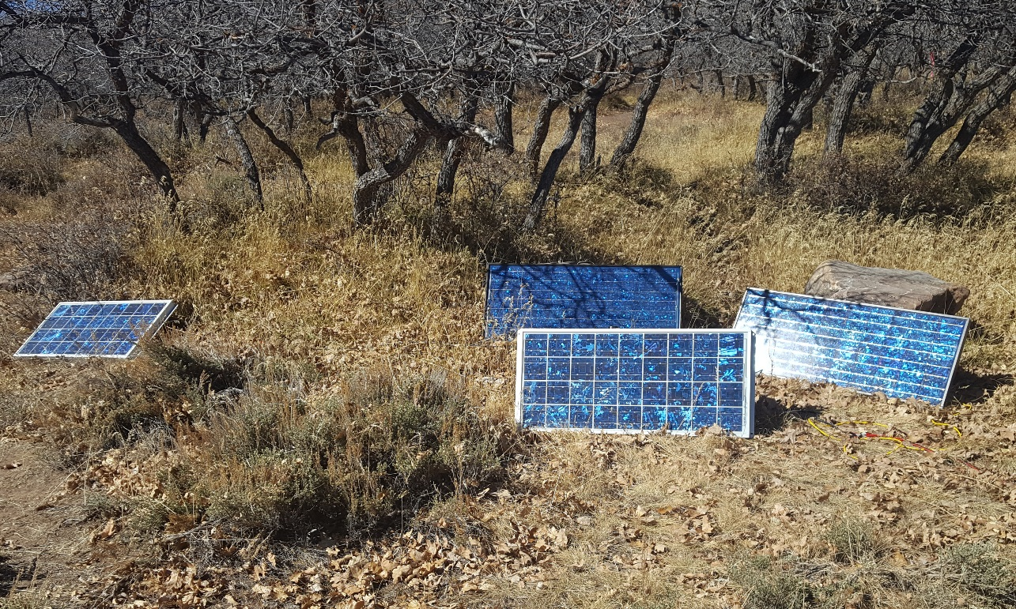

Slide 36
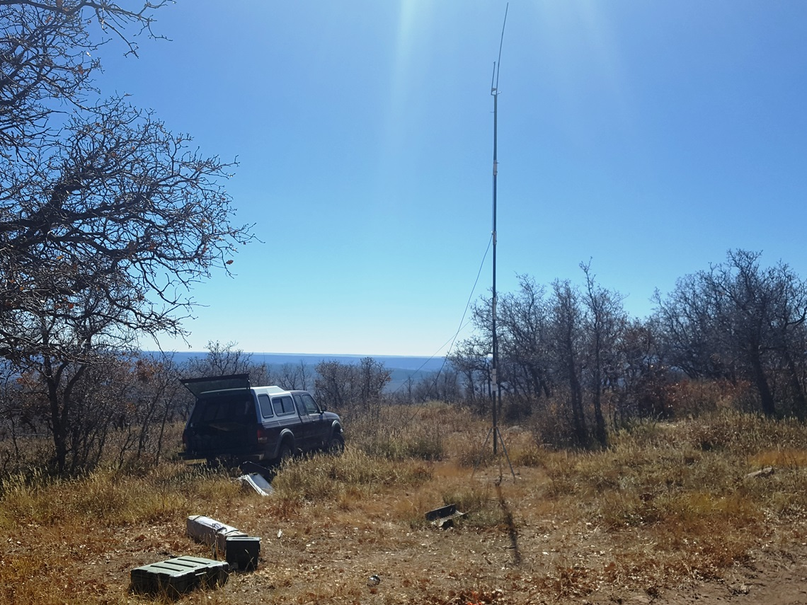

Slide 37
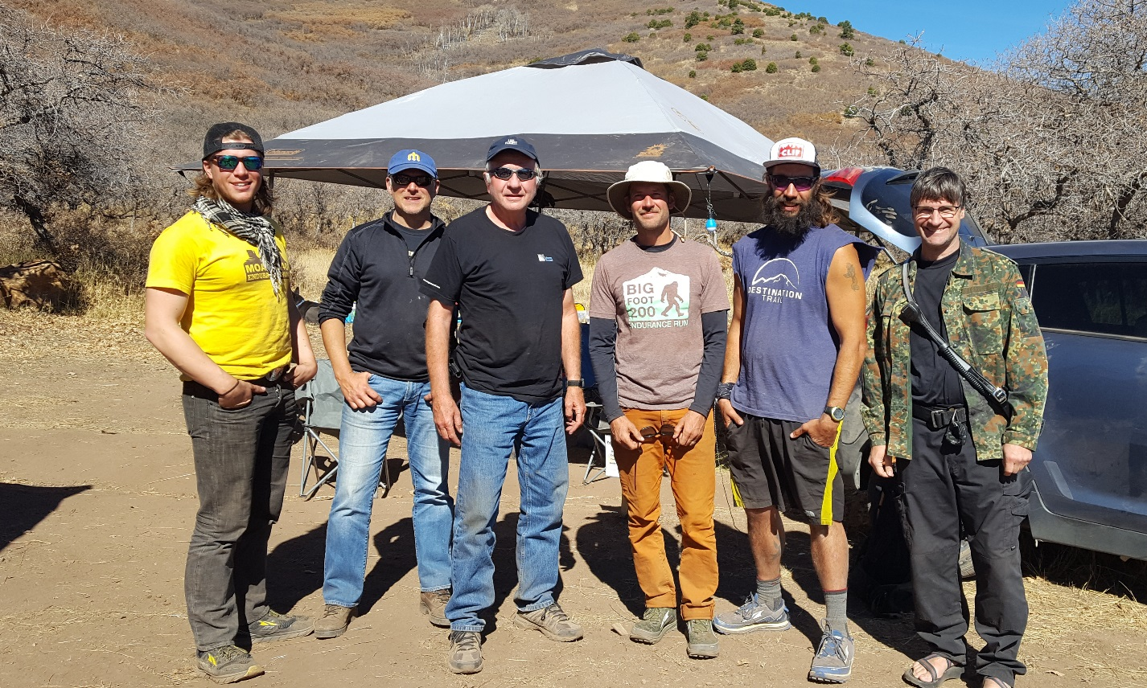

Slide 38
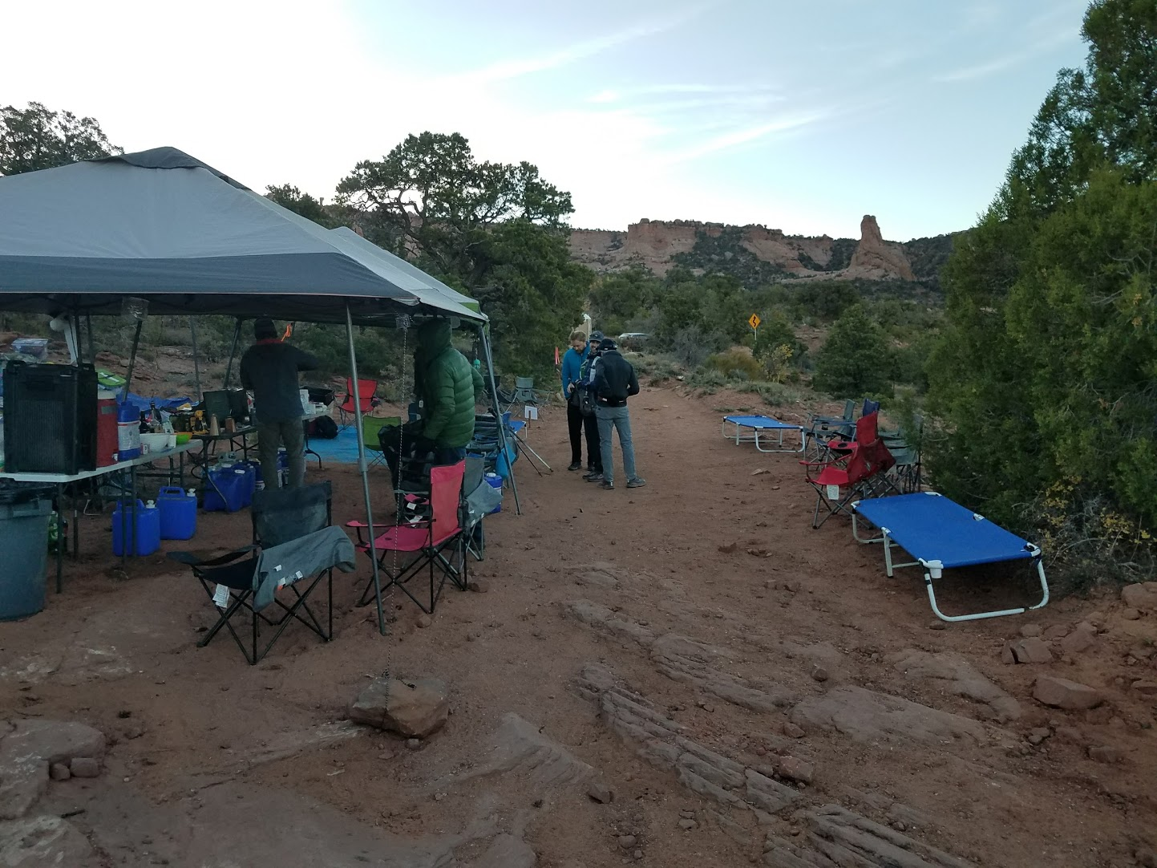
PORCUPINE RIM
THE LAST AID STATION
204.2 MILES

Slide 39
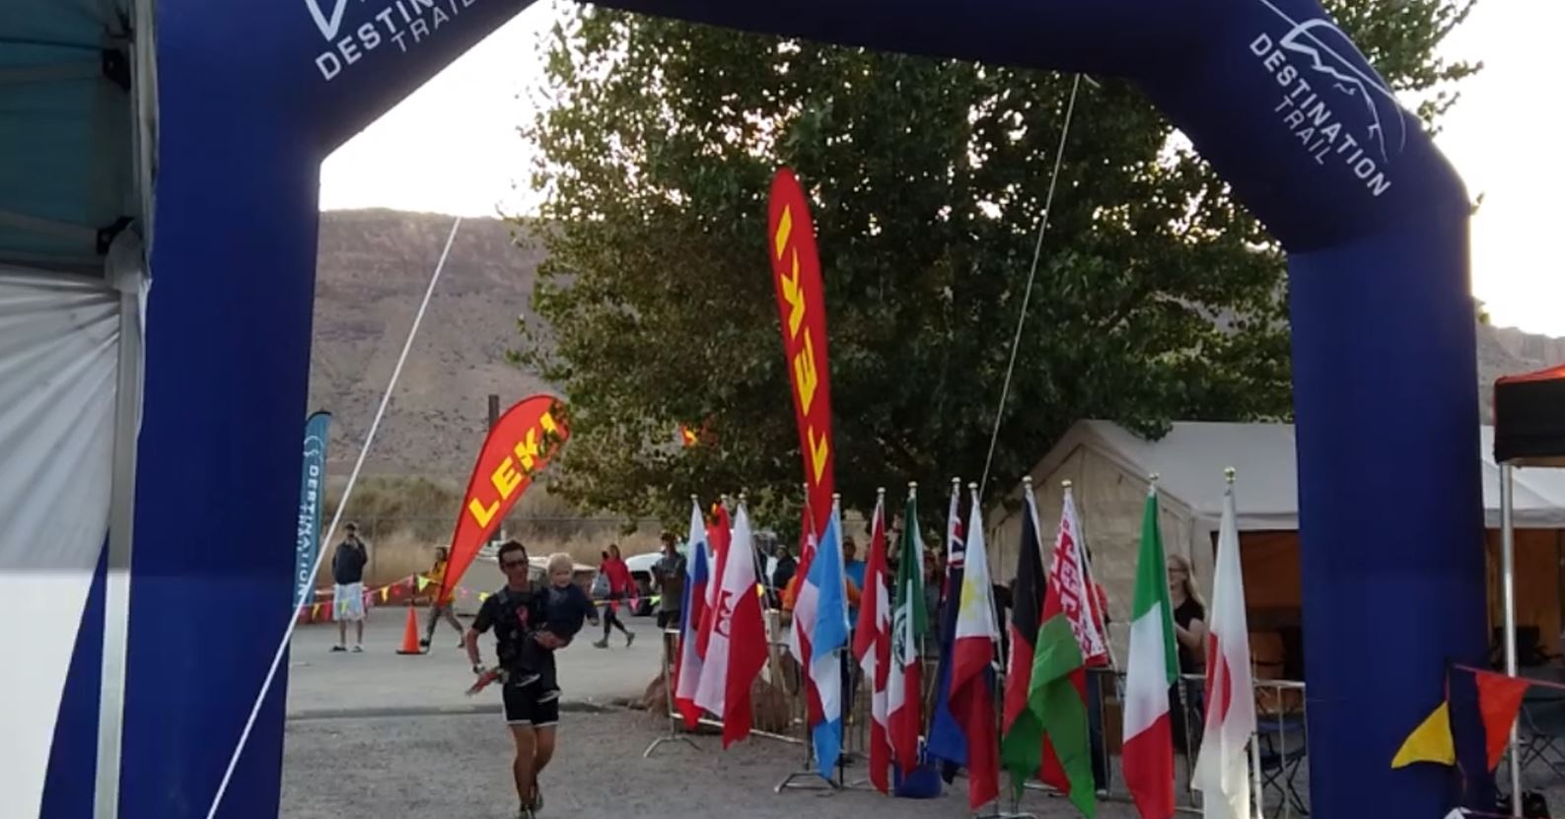
FINISH

