Slide 1
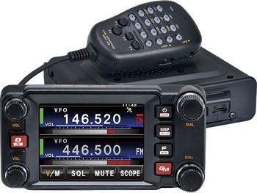
Installation of
Yaesu FTM-400XDR 2M/440 Mobile Radio into 2006 Mazdaspeed 6
Ham Radio Report
Brad Denham – KF6PSL
Wednesday, June 14, 2023

Slide 2
Equipment Overview:
2006 Mazdaspeed 6 Sedan:
Walmart “Everstart Platinum” Battery (new)
AGM | Group 35 | 650 CCA
Made by Johnson Controls
110 Amp Alternator
Stock Battery Cables / Wiring
Yaesu Power Cable Hook-up
2019 Yaesu FTM-400XDR:
2M/440 Dual Band Transceiver
Yaesu “System Fusion”
Analog FM
C4FM Digital
BIG Beautiful Display w/ Remote Mount
Scope Screen
Altitude Screen
APRS® Screen
Smart Navigation Screen
Frequency Direct Input Screen
Clock / Timer Screen
50 W / 20 W / 5 W
APRS & Cross-Band Capable
Factory Installed GPS w/ Smart Navigation
Antennas:
Comet #CA-2X4SR 2M/440 Mobile Antenna, PL-259, 40” (“Daily Driver”)
MFJ #1432 2M/440 Mobile Antenna, PL-259, 62.5” (Event Support)
Diamond #AZ507RSP Mobile Antenna, PL-259, Spring Base, 27.5" (Back-up)
Diamond #K600S HD Trunk Lip Mount
Radio/Mic Mount:
Lido Radio Products #LM-500-DB-AMPS Heavy Duty Ram 1" Ball Style Mount
Lido Radio Products #LM-EXT-01 Extension Bracket
Lido Radio Products #LM-1203 Mic Hanger
Remote Speaker:
RoadPro #RP-160 6 watt 3½”x 5”
B-pillar mounted (for now) at my left shoulder
Cable is too short…will be relocated to the visor when I get a 3.5mm mono extension cable

Slide 3
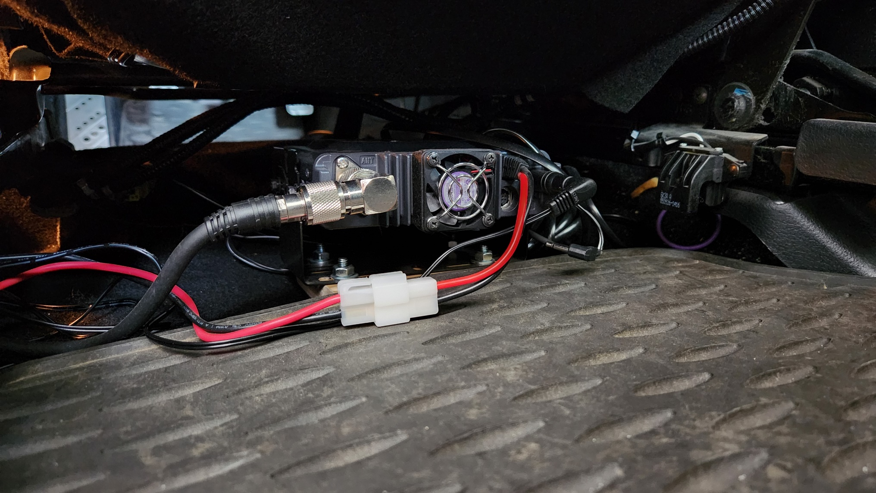
FTM-400XDR Radio Mounting:
The main FTM-400XDR radio body is located under the driver’s seat…
Remote speaker cable
…mounted to a heavy plywood base proving air flow under and over the radio with the exposed cooling fan getting access to the coolest air
Power cables

Slide 4
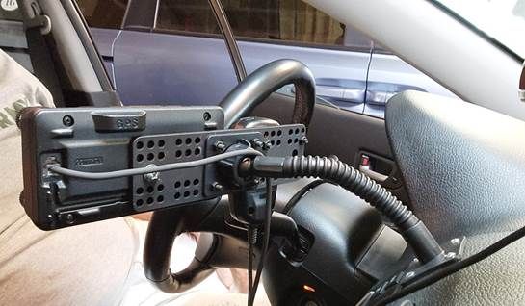
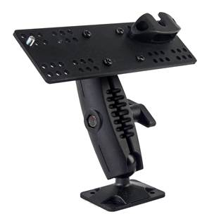
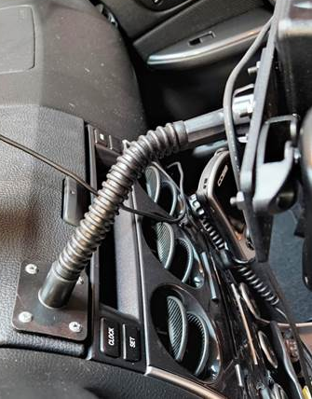
Remote Head Mount:
The old LIDO Mount…
The NEW LIDO Mount…
Snapped!

Slide 5
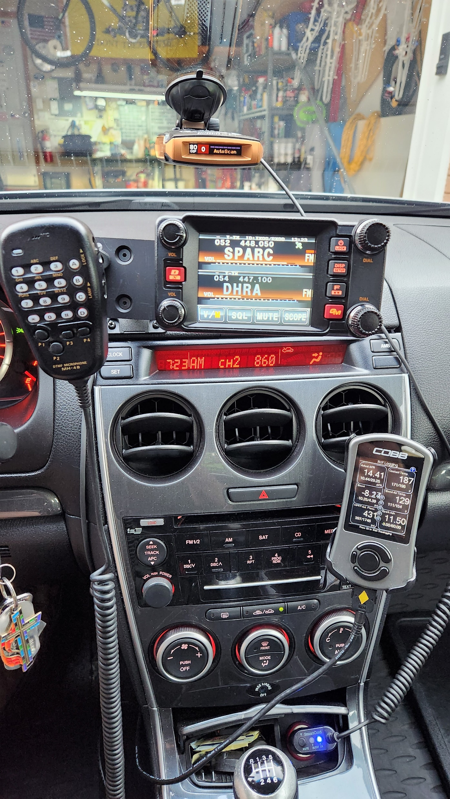
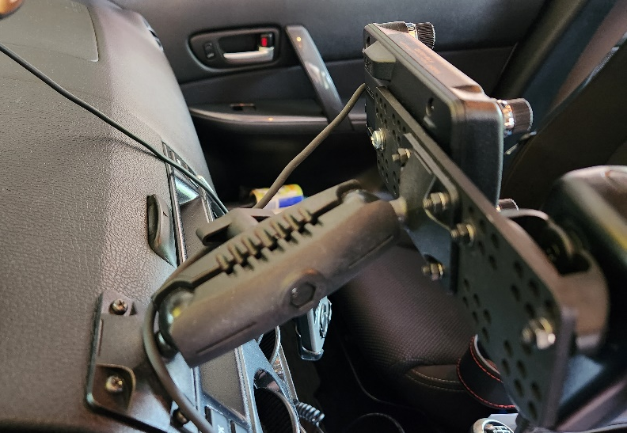
Remote Head Mount:
The NEW LIDO Mount…
https://www.lidoradio.com/
Mounted directly to lid of the center console storage tray

Slide 6
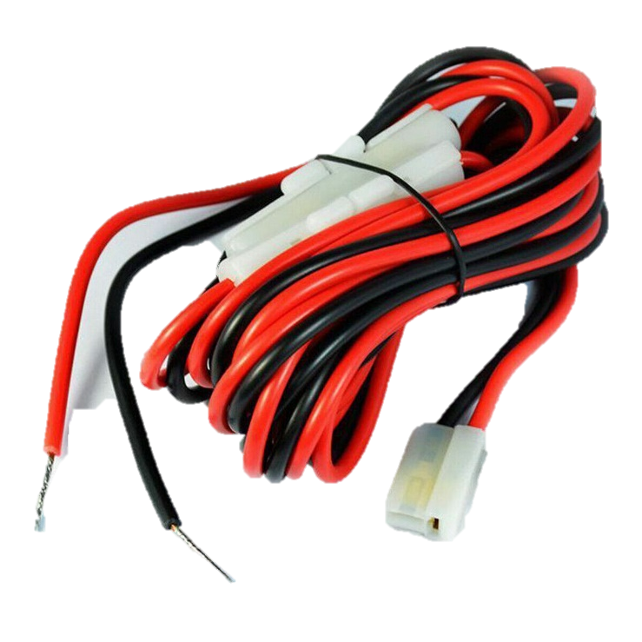
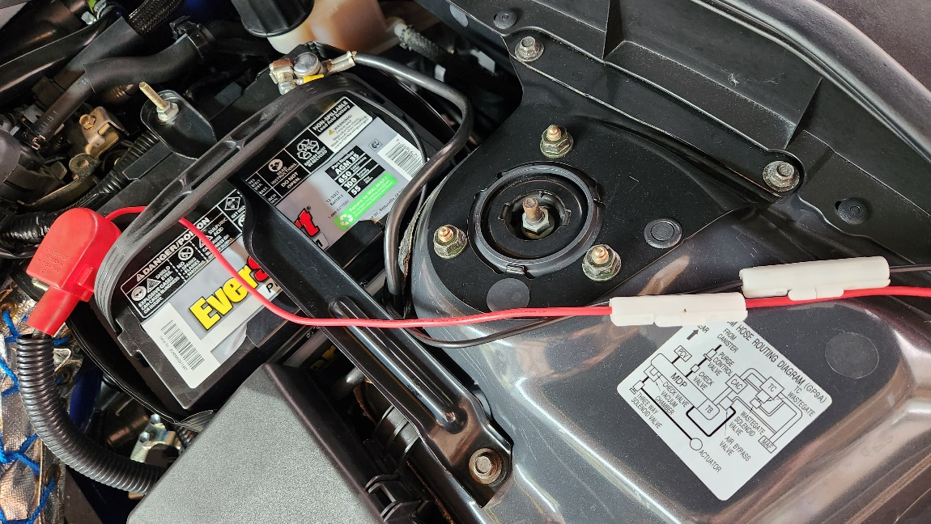
Battery / Wiring:
Direct-to-battery power connections!
Dual inline fuses

Slide 7
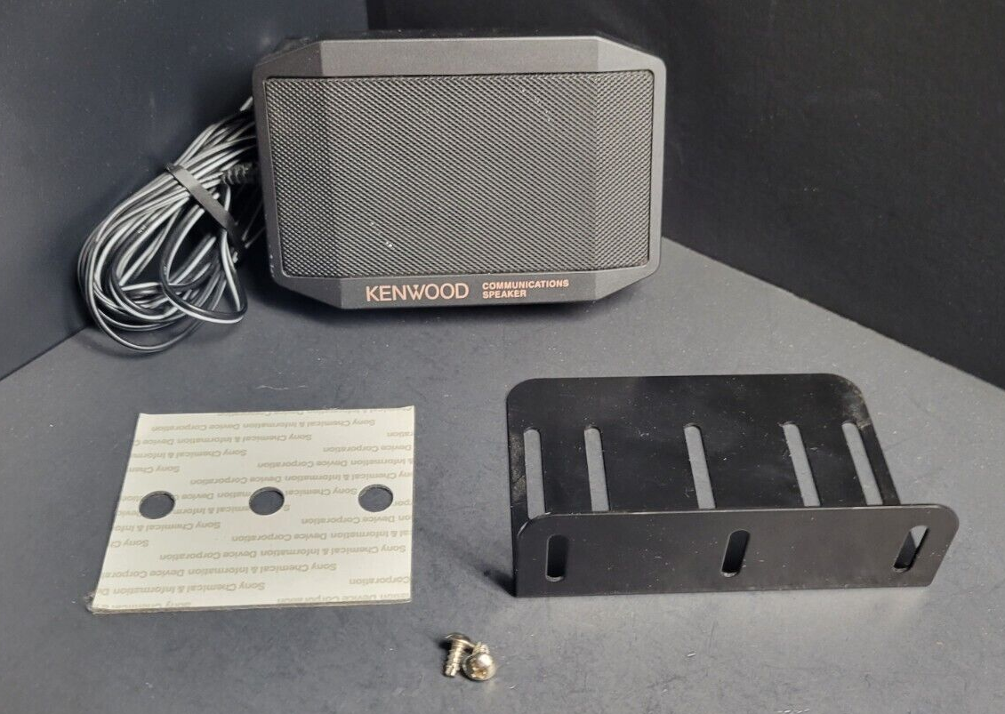
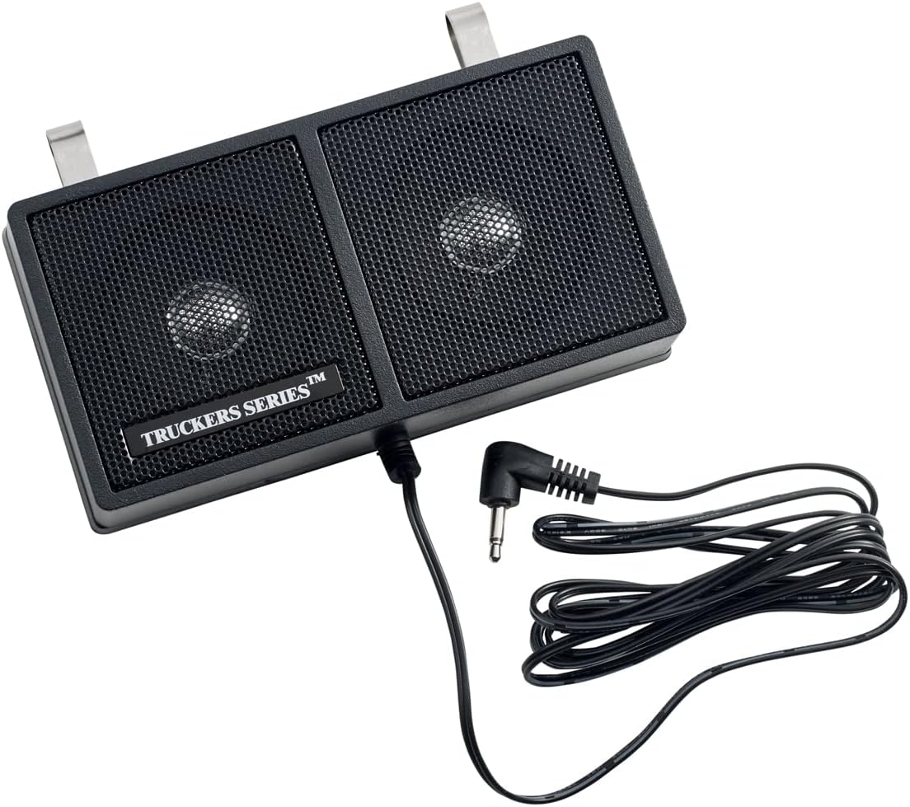
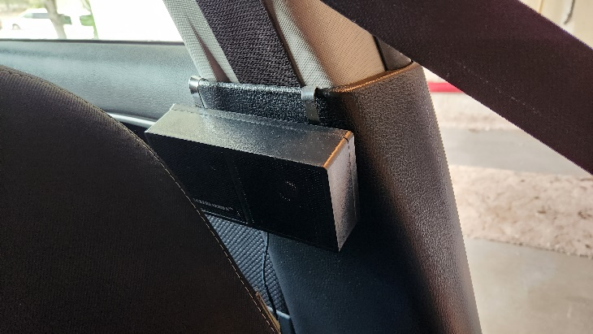
Remote Speaker Mount:
Kenwood #SP-50B Mobile Speaker mount (under-seat location)
RoadPro #RP-160 6-watt 3½”x 5” “CB Radio” Speaker…
B-pillar mount (for now)

Slide 8
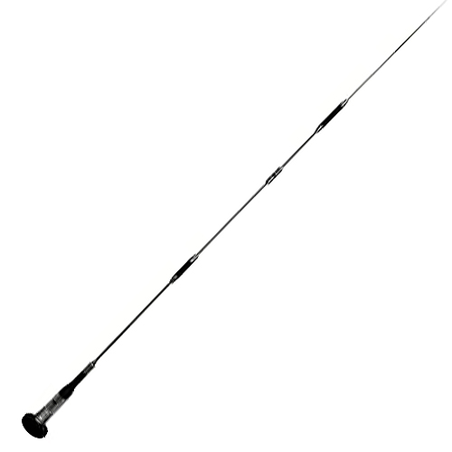
Antennas & Mount:
Comet #CA-2X4SR
40”
Fold-over
MFJ #1432
62.5”
#AZ507RSP
27.5”
Spring base
#K600S
Heavy Duty
Trunk Lip
SO-239

Slide 9
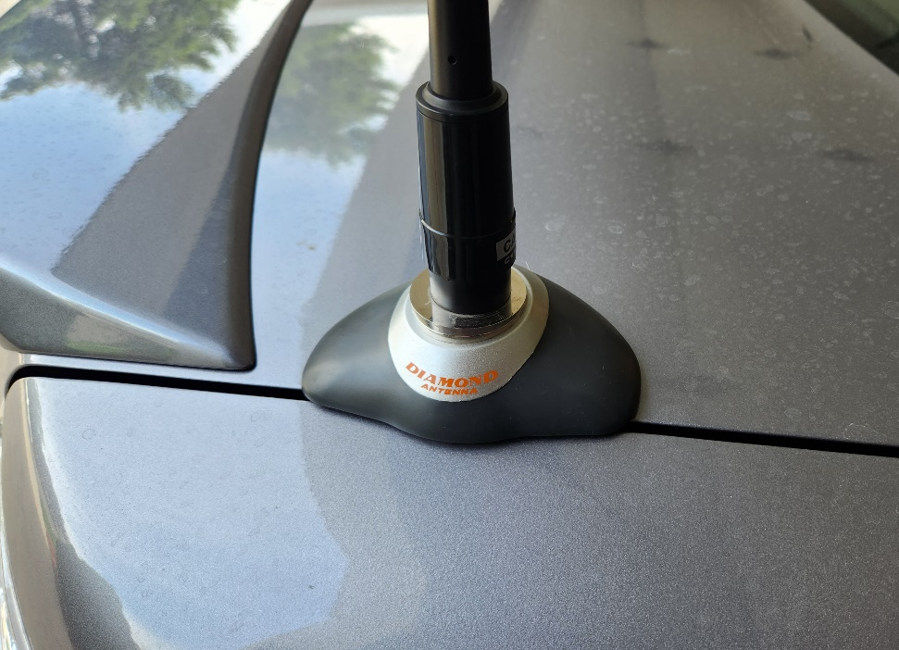
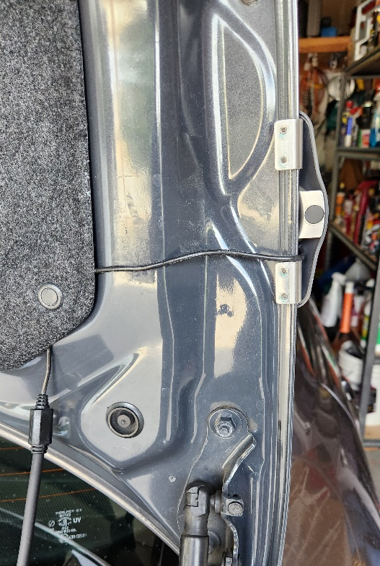
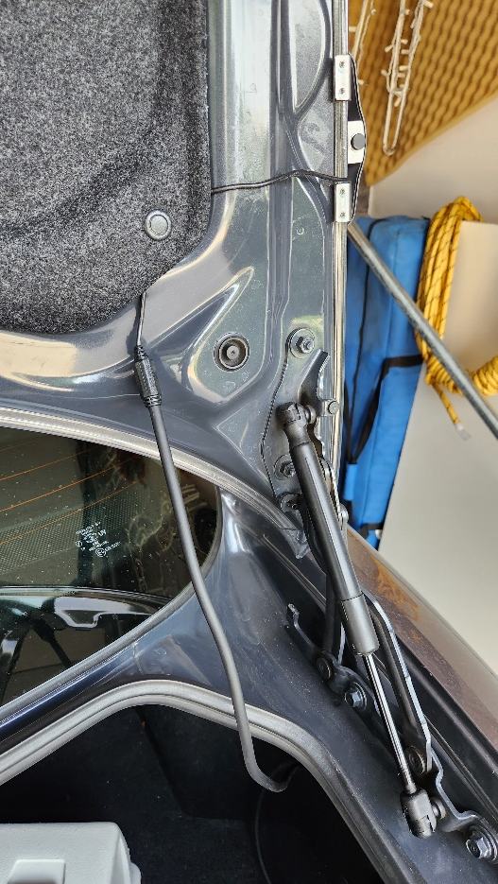
Antennas & Mount:
I tighten the four mounting set screws twice a year; no issues with the SO-239 mount with the long MFJ antenna @ highway speeds

Slide 10
Future Plans/Upgrades:
Big Three Upgrade (supplemental 6AWG +/- electrical cables):
Battery negative (-) to chassis
Battery positive (+) to alternator output stud
Alternator case to battery negative (-)
Supplemental 5-wire grounding kit: chassis to the engine block, trunk lid to body, negative (-) battery terminal to various locations, etc.) by Flex-Innovations: https://www.flex-innovations.com/new_page_2.htm
Dedicated 140 Ah Ham Radio Battery in Trunk (similar to the dedicated radio battery set-up that was in my ‘96 Bronco)
Powerwerx / West Mountain Radio DC Power products for battery power cables, battery charging & isolation, battery mount, etc.
Additional Lido mounts for Uniden BCD463HP and SC150B hand-held scanners

Slide 11
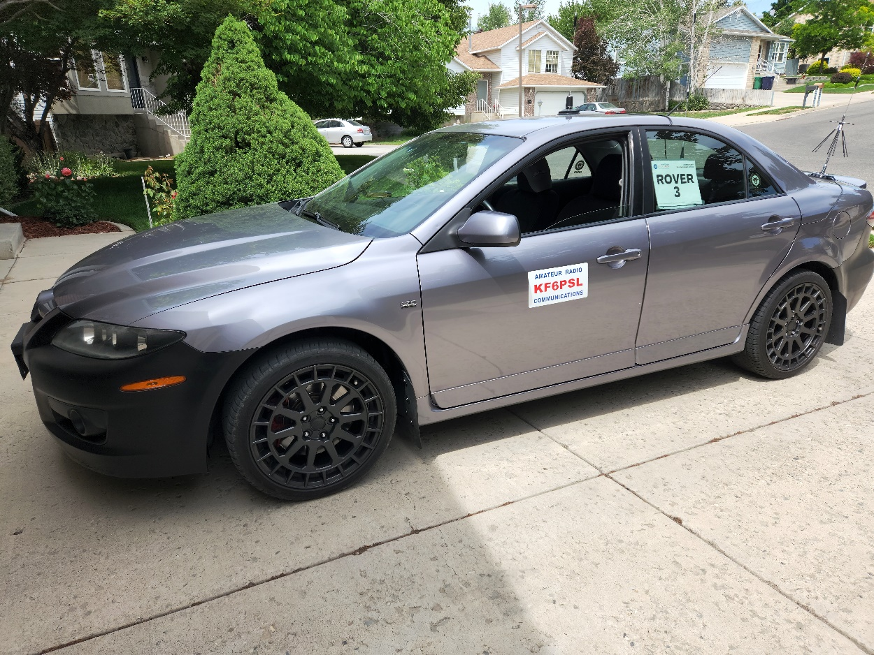
2022 Huntsman SportsFest
Thanks!
2023 SLC Marathon
Brad Denham
KF6PSL
801-502-5094
kf6psl@gmail.com

